Slide 1
Studio 2
Reflective presentation

Slide 2
Early Inspiration
Interested in exploring technology in terms of animation
Thought about directions of depicting technology in multiple ways
Research about technology and animations all through the semester as I iterated my concept
How technology is being used in animation
Explored that people are using animation to depict technology and its effects as a single side (either positive/negative)
Concept of social commentary through animation
Made many, many iterations on the concept itself as I researched

Slide 3
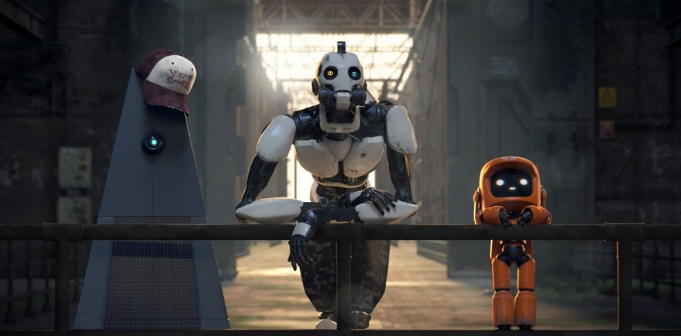
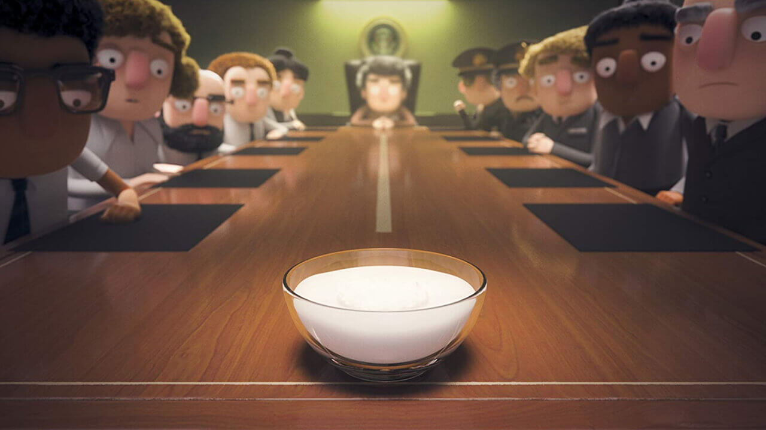
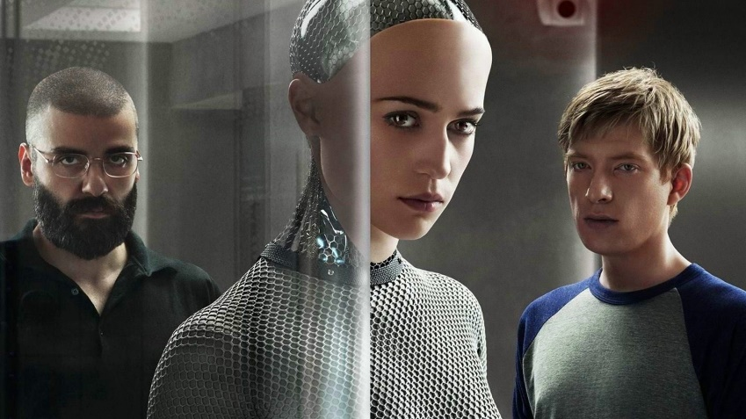
Context
Concept of exploring Social commentary through animation
Love death and robots episode Three robots (work of Victor Maldonado and Alfredo Torres)
When yoghurt took over

Slide 4
Inquiry
Exploring technology as a double edged sword through an animation

Slide 5
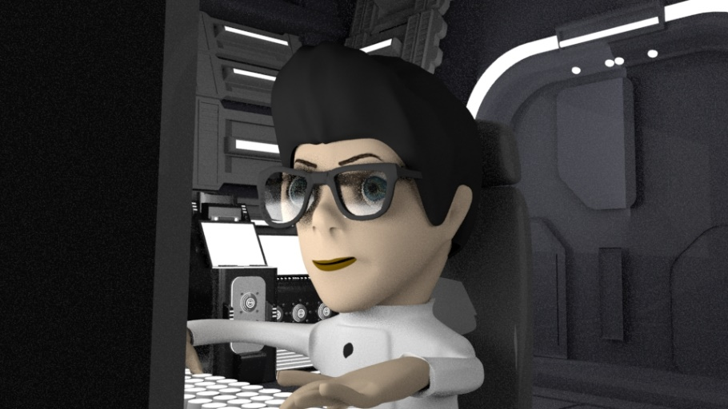
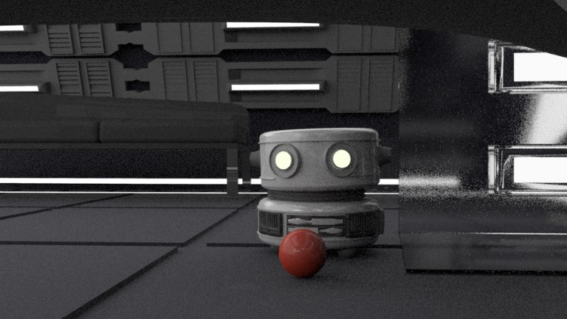
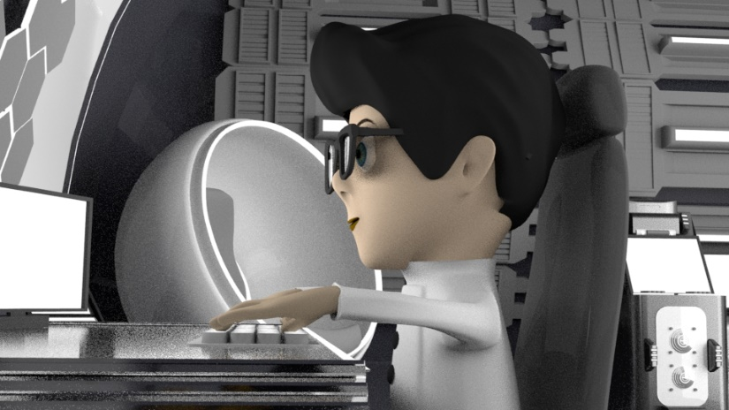
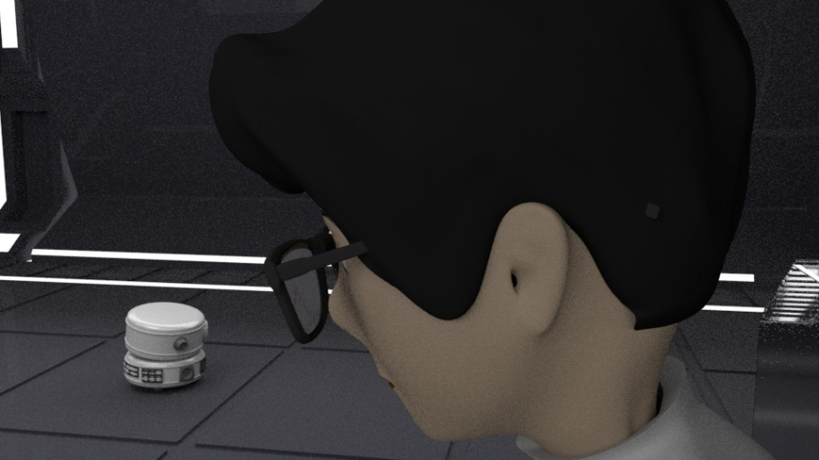
What is the project?
3D animation focussing on technology as a double edged sword
Relationship between a scientist and a robot dog
Focus on technology being harsh on a human and another technology
sympathising with the human

Slide 6
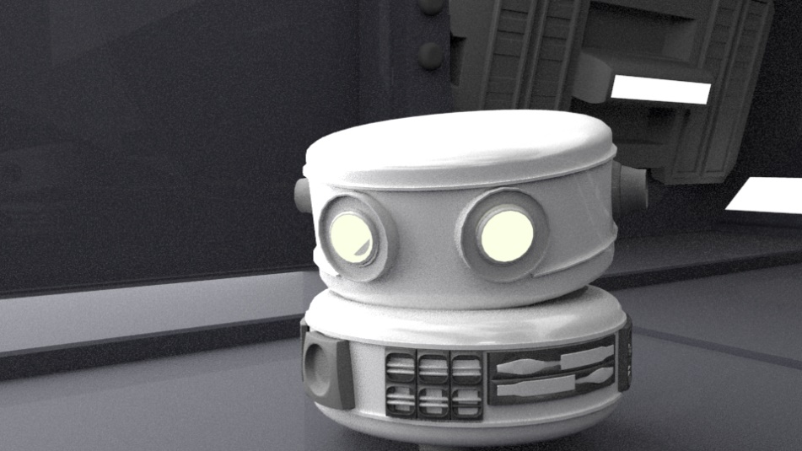
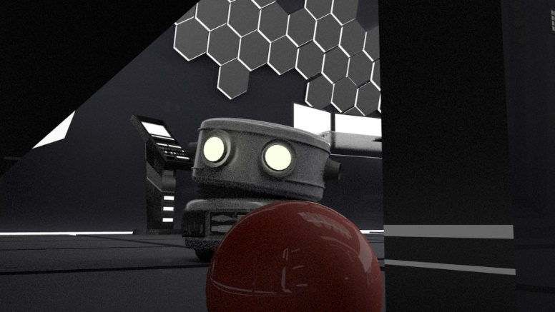
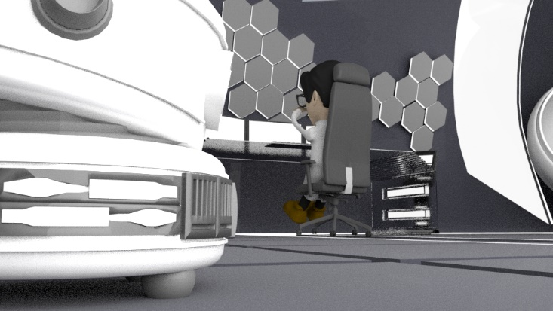
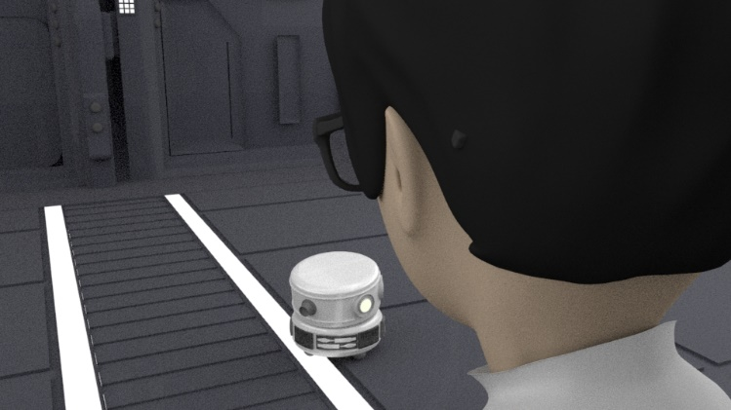
Basic Storyline
A robot dog wanting to play with the scientist
The scientist rejecting the ball and not wanting to play
Robot trying to go away
Stopped by the sound of “you’re fired”
Robot returns to the scientist
Scientist thinks he won’t stay but he does

Slide 7
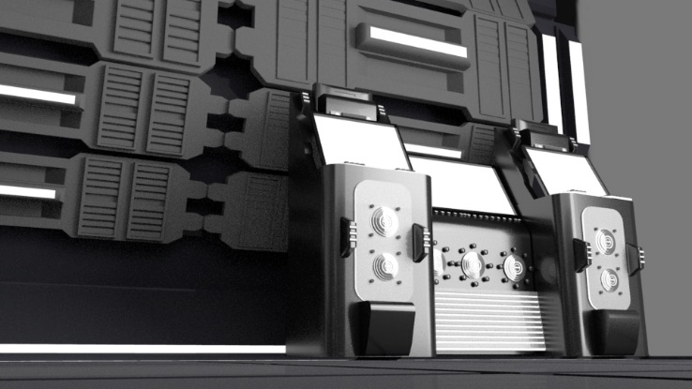
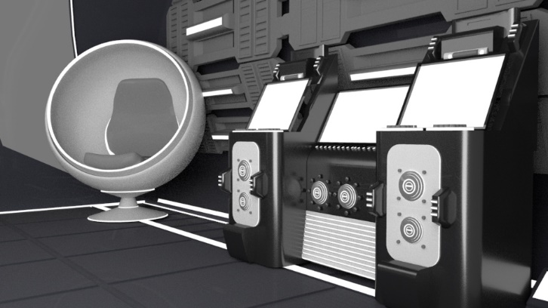
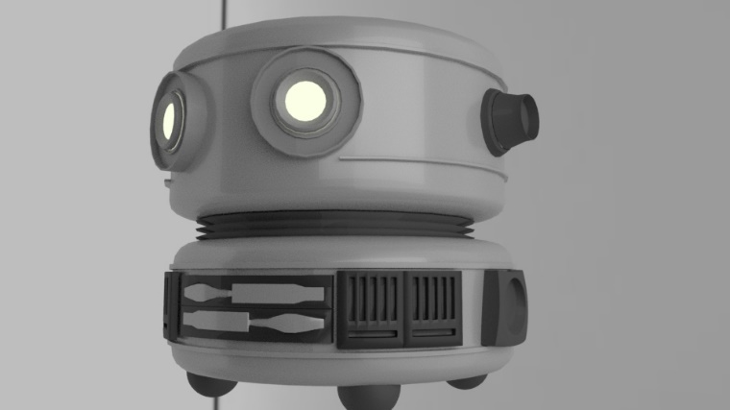
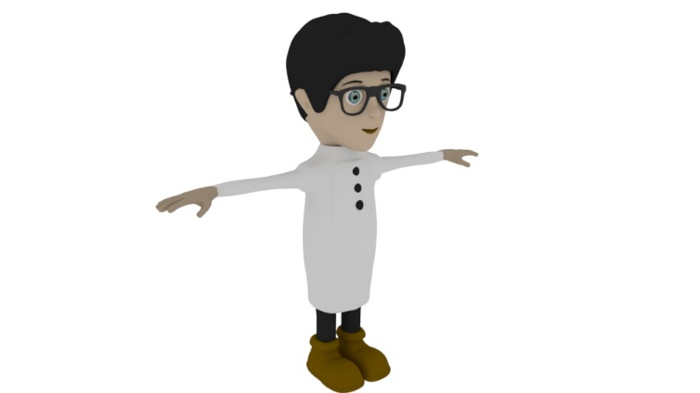
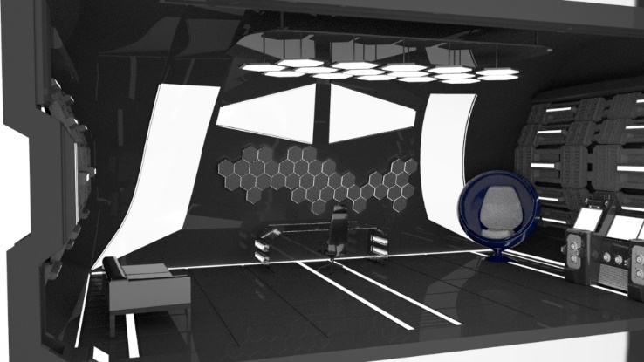
Method
Animatic
3D environment
3D characters
Animation
(along with research all along, altered the story and plot as I researched too)

Slide 8
Significance
This project focuses on both sides of technology
Social commentary work generally focuses and portrays one type of technology
Human feelings into visual elements from the perspective of the robot
Depiction and awareness of both sides
This is my first complete 3d animated movie(outcome)

Slide 9
Work in Progress Animation
https://www.youtube.com/watch?v=iY6l1iHrhKY&feature=emb_logo

