Slide 1
Studio 2: Folio 1
Jessica Chen (Jiaxin Chen)
s3729714

Slide 2


Inquiry
My inquiry for Studio is: How can Augmented Reality be used to encourage people to explore specific spaces?
Today, lots of AR games are location-based games. Players need to reach a specific location in the city to experience the game.
In my project, I want to find out if there are other solutions for AR experience. And try to let audiences experience it in a small space.
Pokemon Go
Ghostbusters World

Slide 3
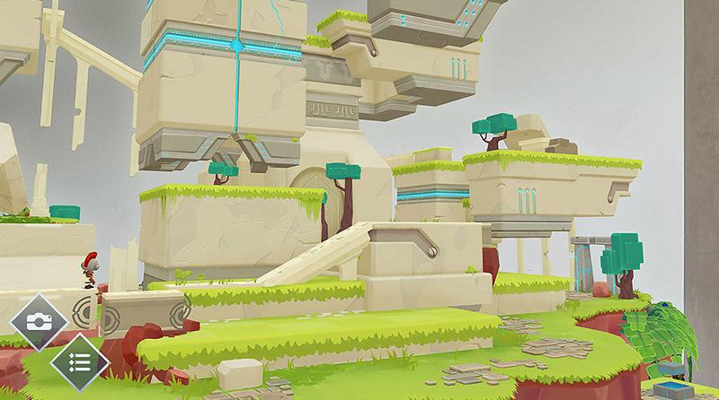
2. My field & related practice
My field is: Augmented Reality, Environment Design
I did a lot of research on existing AR games and tried to find ‘why it have to be an AR game?’
Then I found that: AR camera is a really powerful tool in Augmented Reality.
It let audience experience the ‘invisible world’ directly.
ARise: Use Camera to solve puzzles

Slide 4

3. Content
My idea for this project is: combine physical environment and AR together. Let audience experience the invisible world by finding clues in real world.
Find the first Identification card
…...
Use AR to see the first invisible world & find clue for the position of next Identification card
Find the second Identification card
Hidden Folks
https://youtu.be/IY2rWPccoEM

Slide 5
4. Things needs to be done
Modeling
Design 3-4 low poly environment in C4D
Character Design & animation
Narrative
Finish the story (in 3 or 4 scene)
Interactive
Simple ways to interact with the AR world (Lean touch?)

Slide 6
5. The value of this project
Find new solution for AR experience.
Encourage audience to explore specific space (eg. exhibition, museum... )
Use space to tell story.

