Slide 1
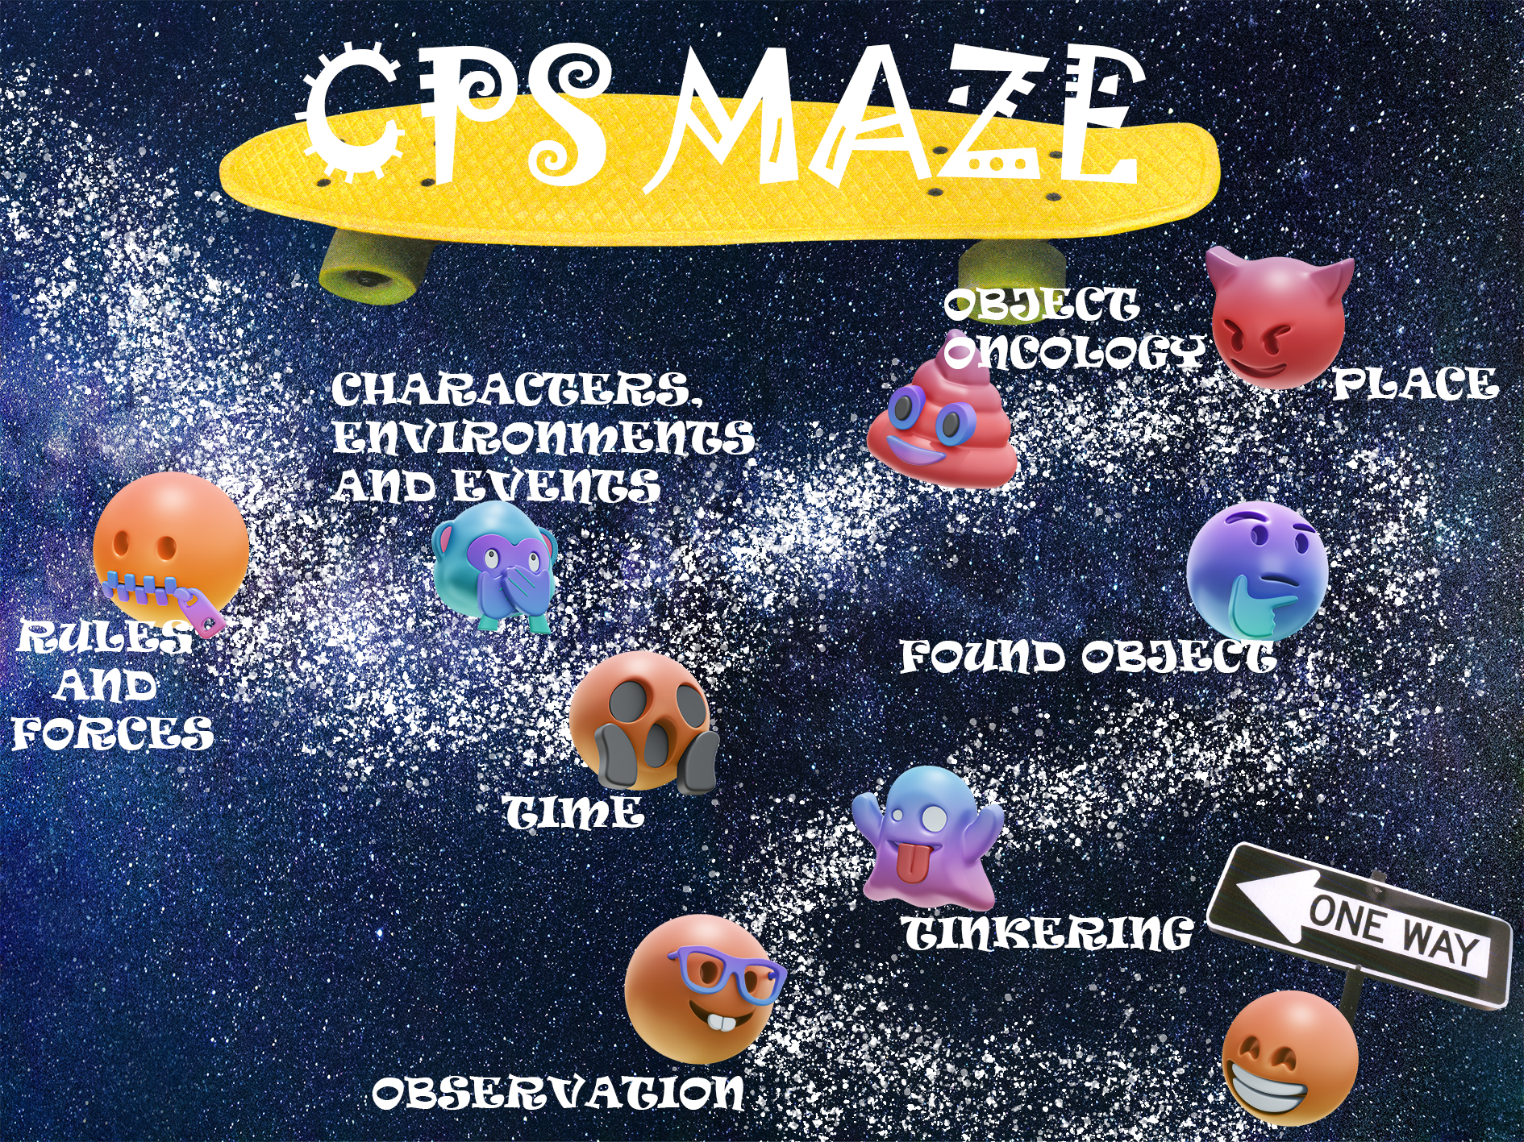
空白演示
单击输入您的封面副标题
Xiying Yao
Eve
s3729319

Slide 2

Direction for use
Try to found my object in remake project and click it
Ps: click original project on right bottom to return

Slide 3
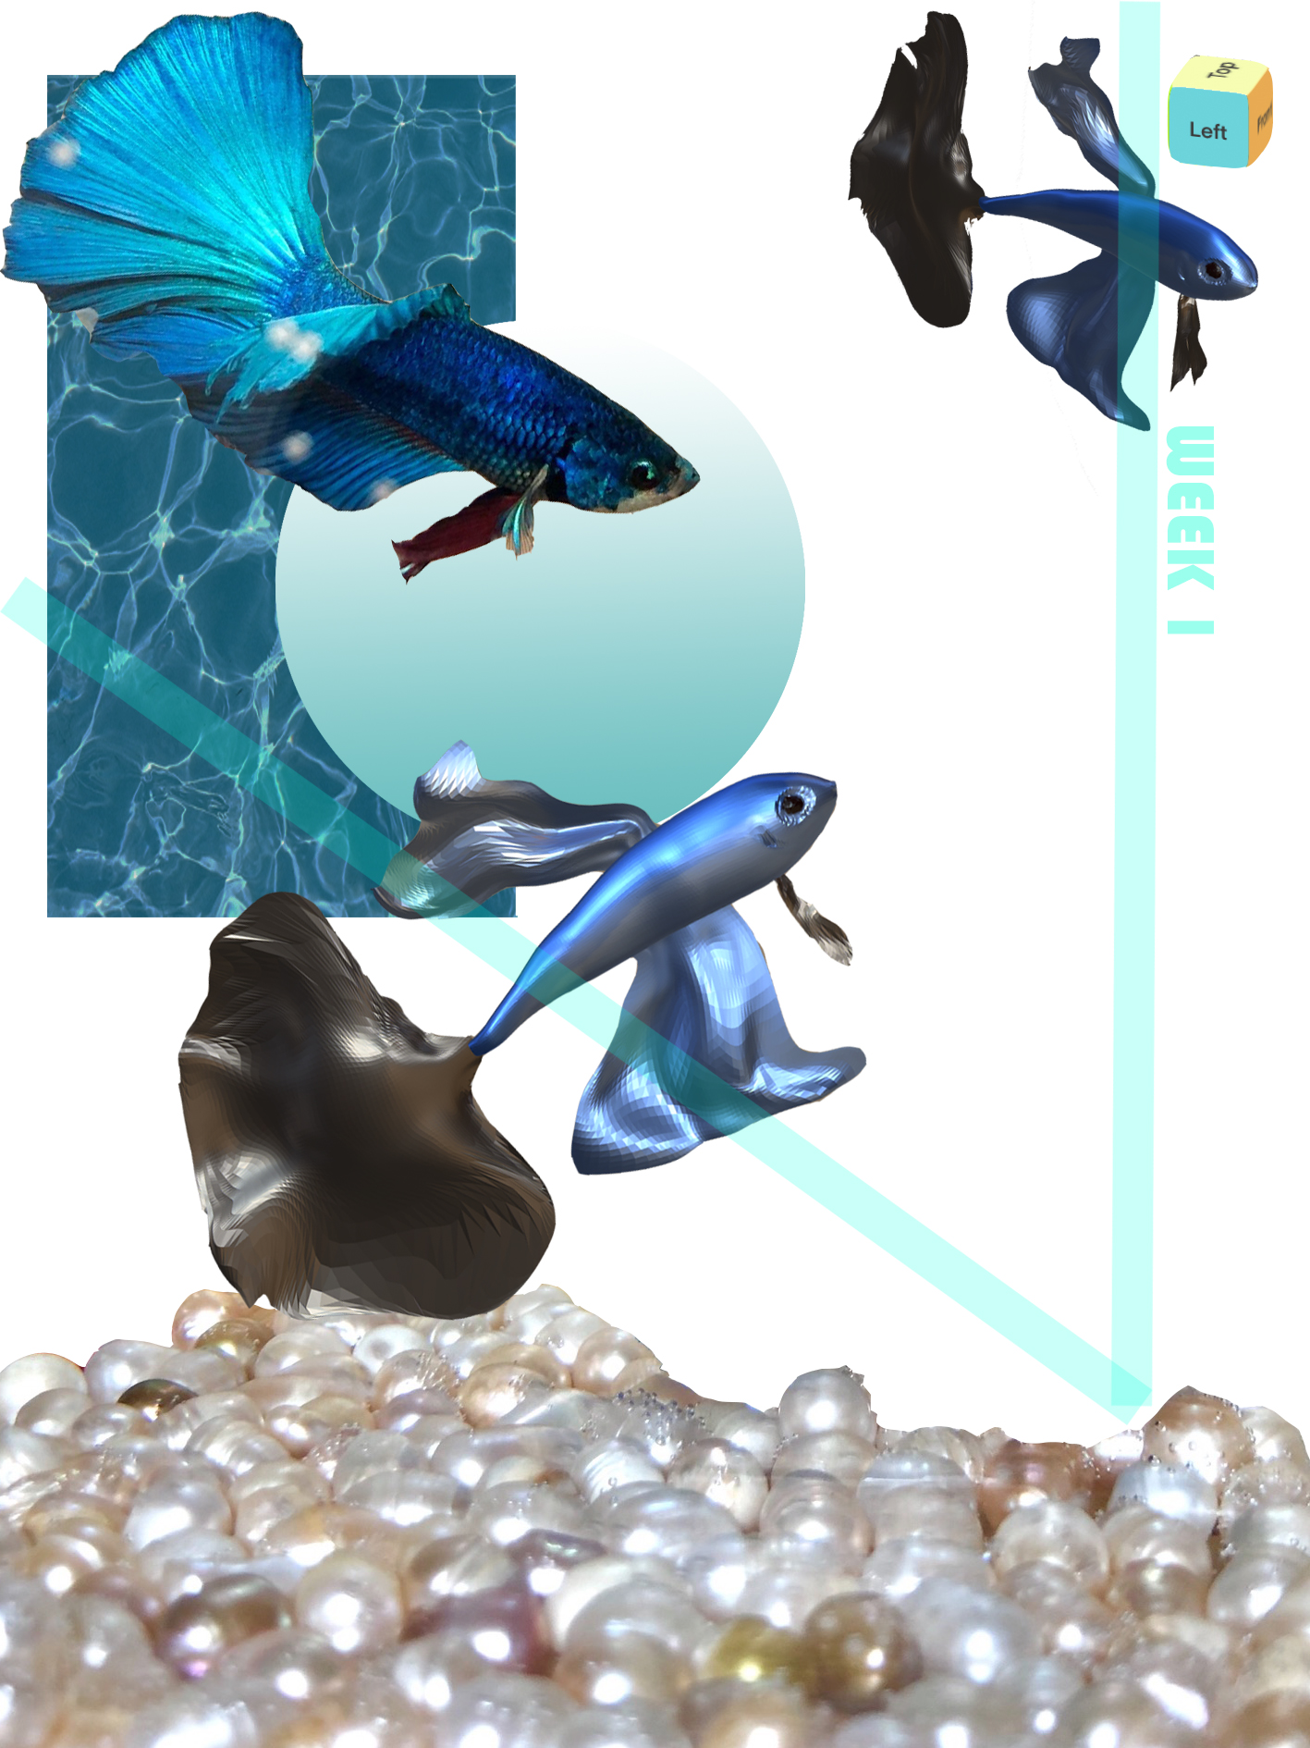
REMAKE POJECT
Week1 CLUE
THEME: Observation
FORM: 3D model
INSPIRATION ELEMENTS: My pet Tony, a Thailand betta/ Nomad(a modeling app)

Slide 4
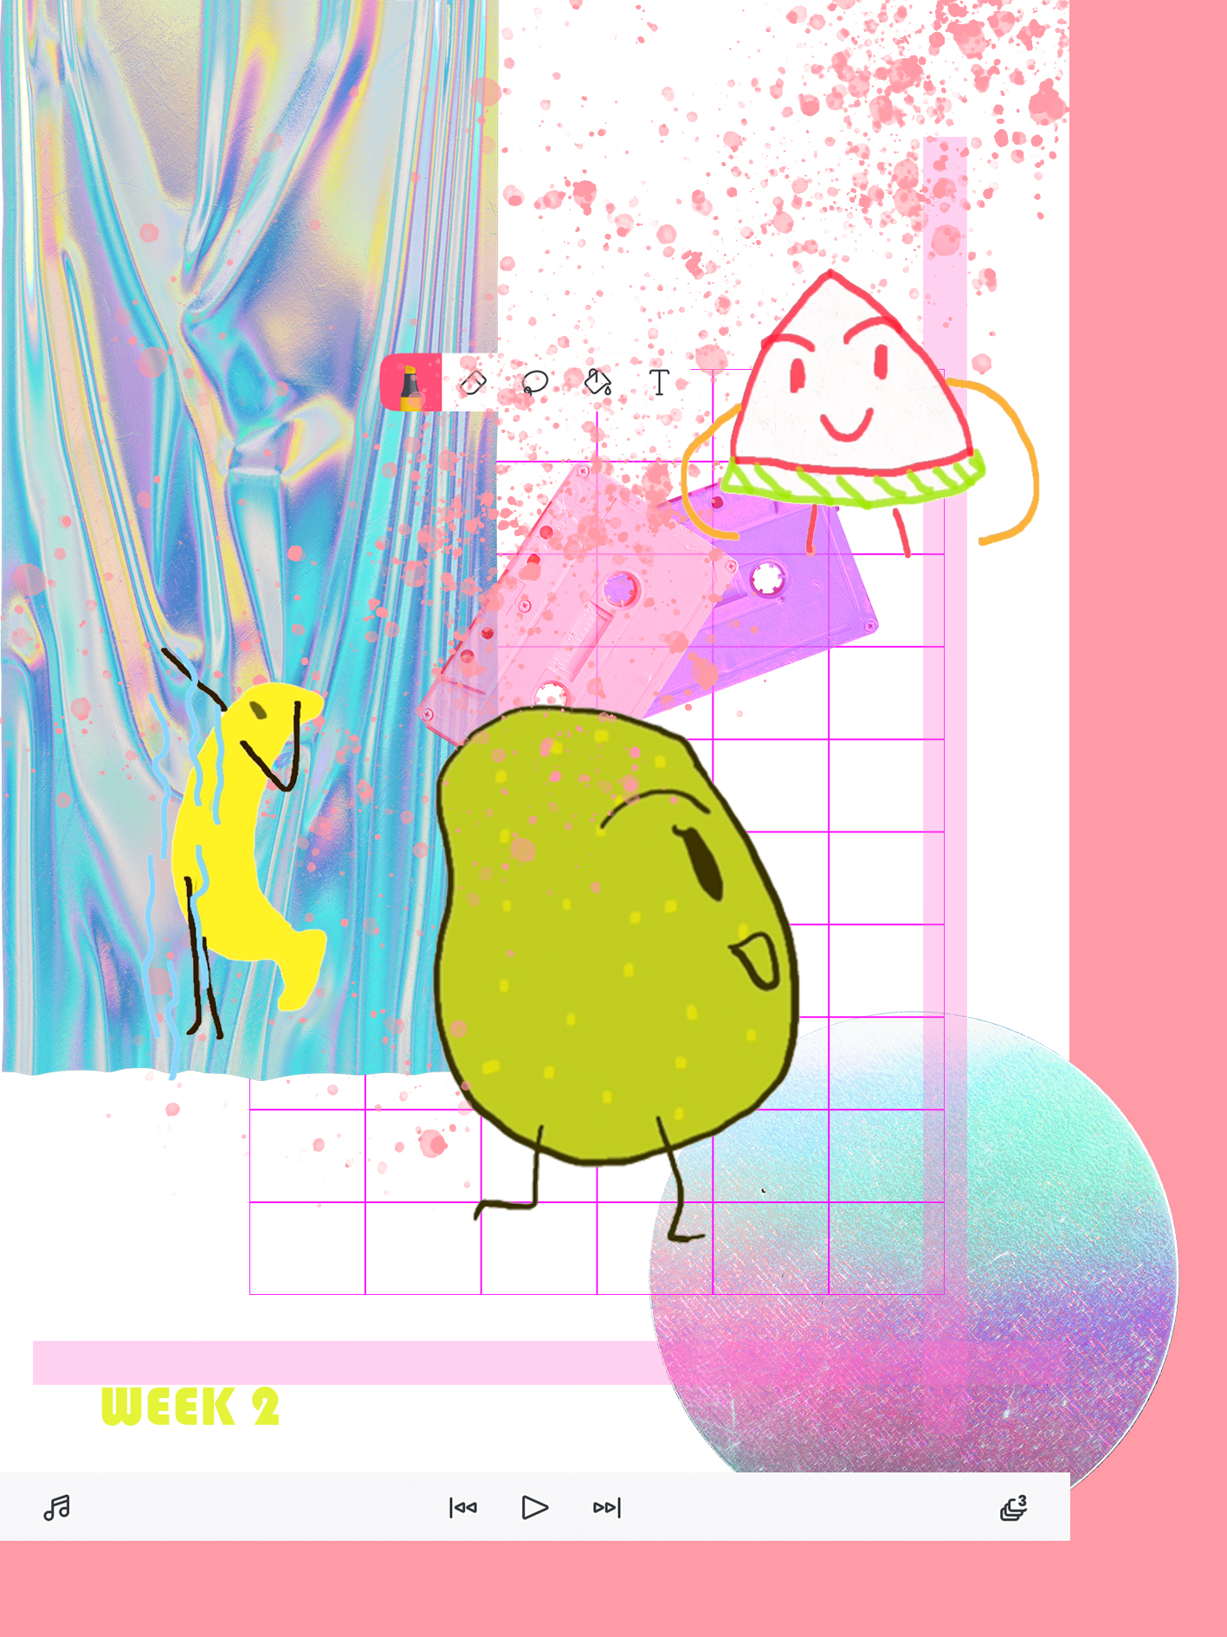
REMAKE POJECT
Week2 CLUE
THEME: Tinkering
FORM: 2D animation
INSPIRATION ELEMENTS:pearl/watermelon/banana/FlipCLip(a animation app)

Slide 5
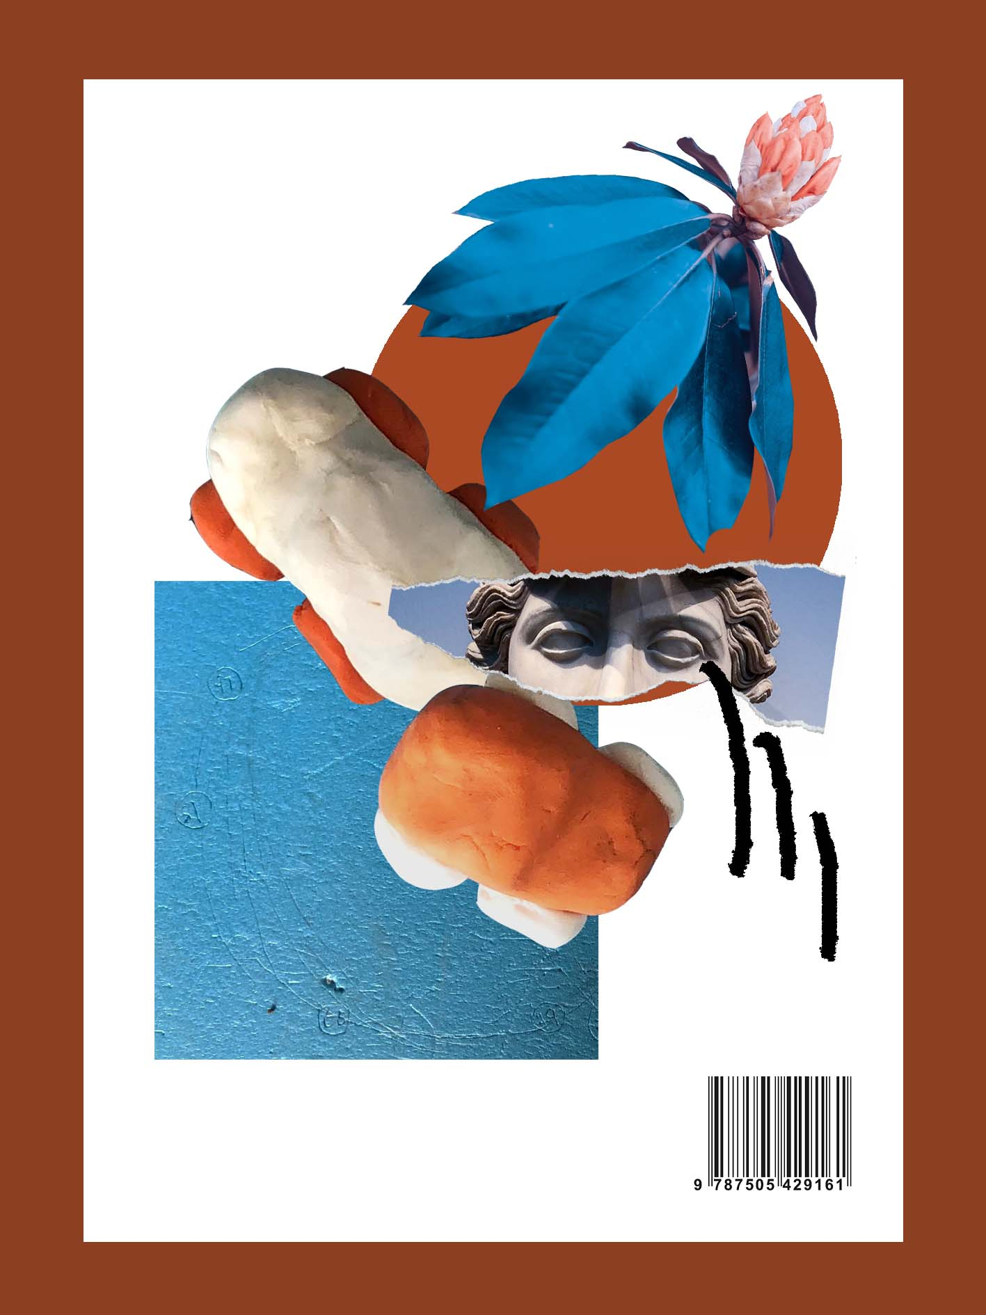
REMAKE POJECT
Week3 CLUE
THEME: Found Object
FORM: Stop motion animation
INSPIRATION ELEMENTS:Car/Plasticene

Slide 6
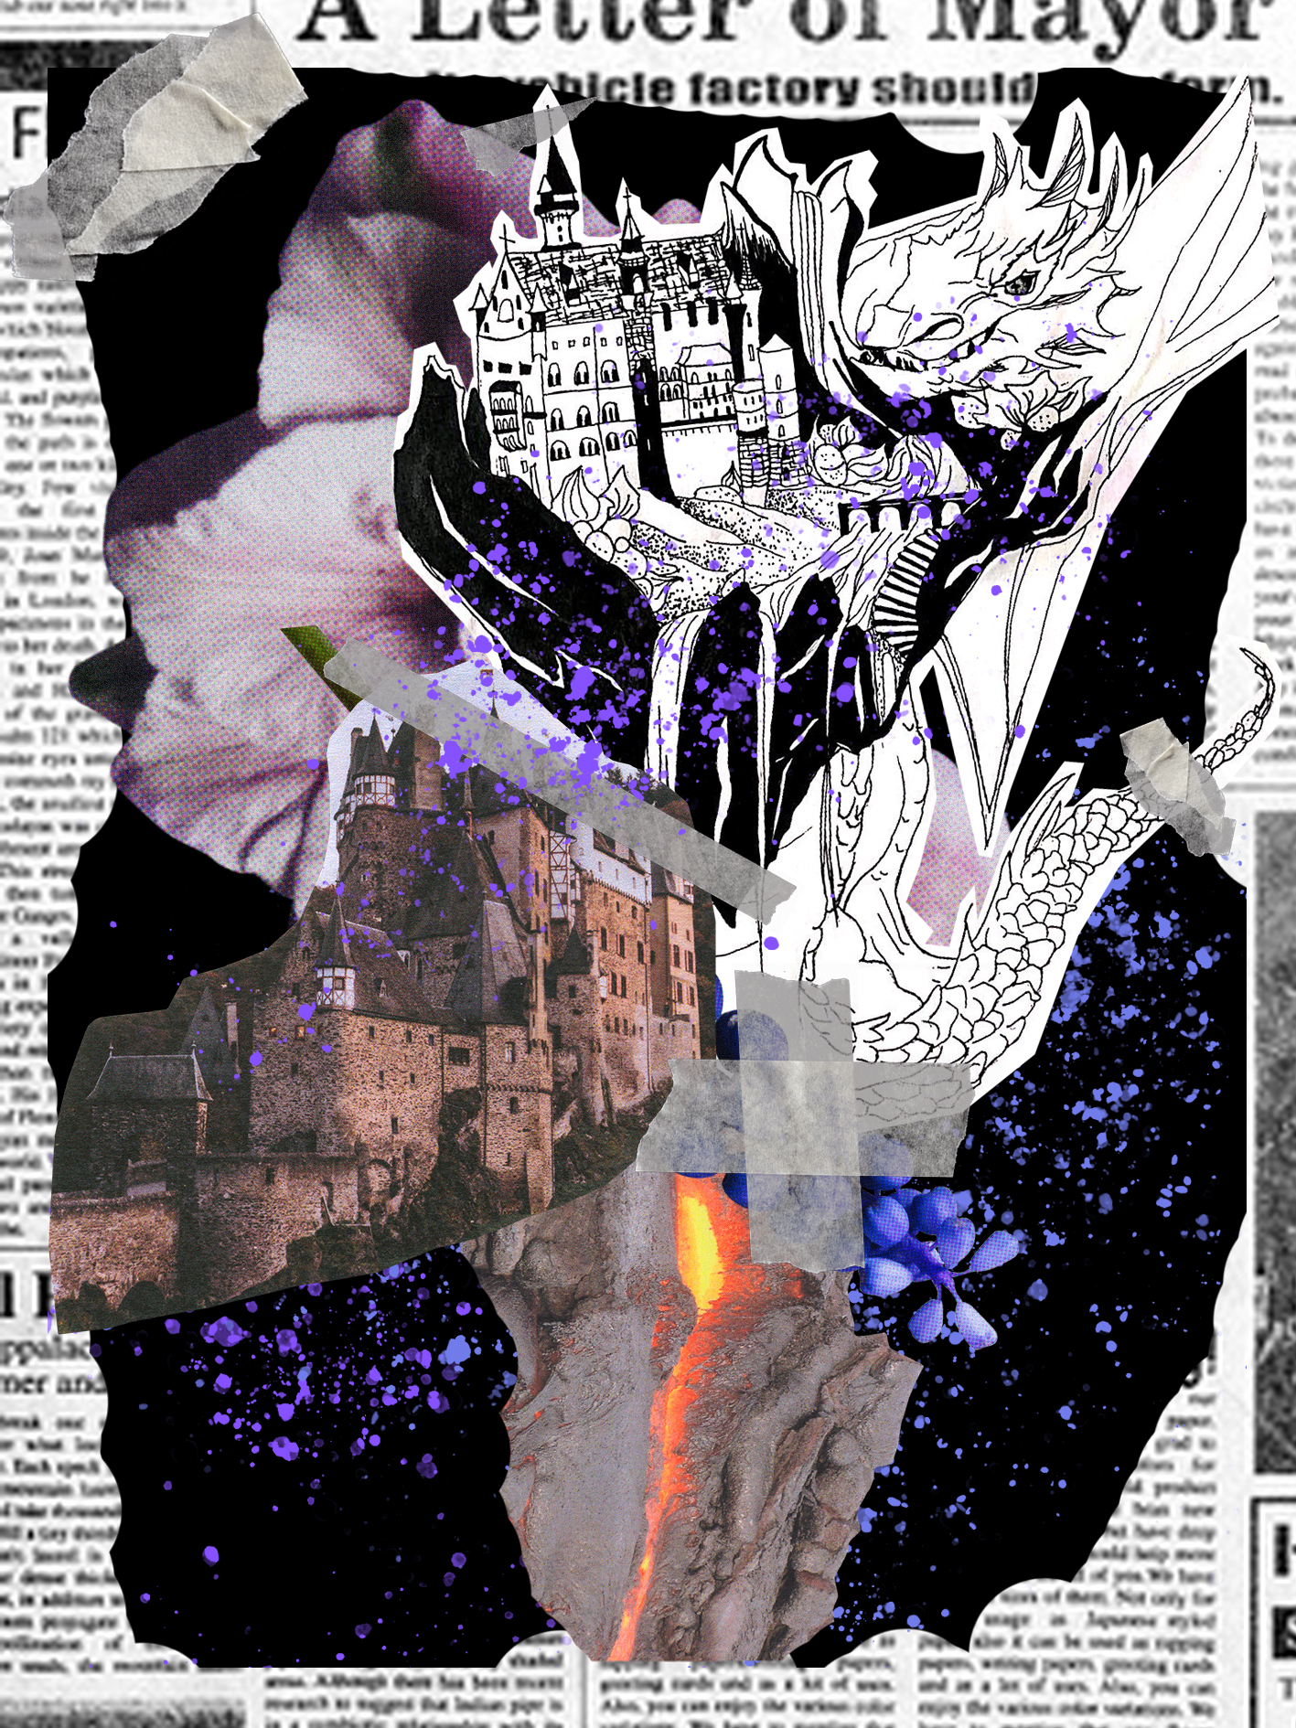
REMAKE POJECT
Week4 CLUE
THEME: Place
FORM: Black and white drawing
INSPIRATION ELEMENTS:Dragon/ Castle/ Floating island

Slide 7

REMAKE POJECT
Week5 CLUE
THEME: Object Oncology
FORM: Four-frame comic
INSPIRATION ELEMENTS:milk/ cow/apple/chicken/egg/apple tree

Slide 8

REMAKE POJECT
Week7 CLUE
THEME: Time
FORM: Clour painting & 2D animation
INSPIRATION ELEMENTS:Four searson/moon/flower/fallen leaves/cloud

Slide 9
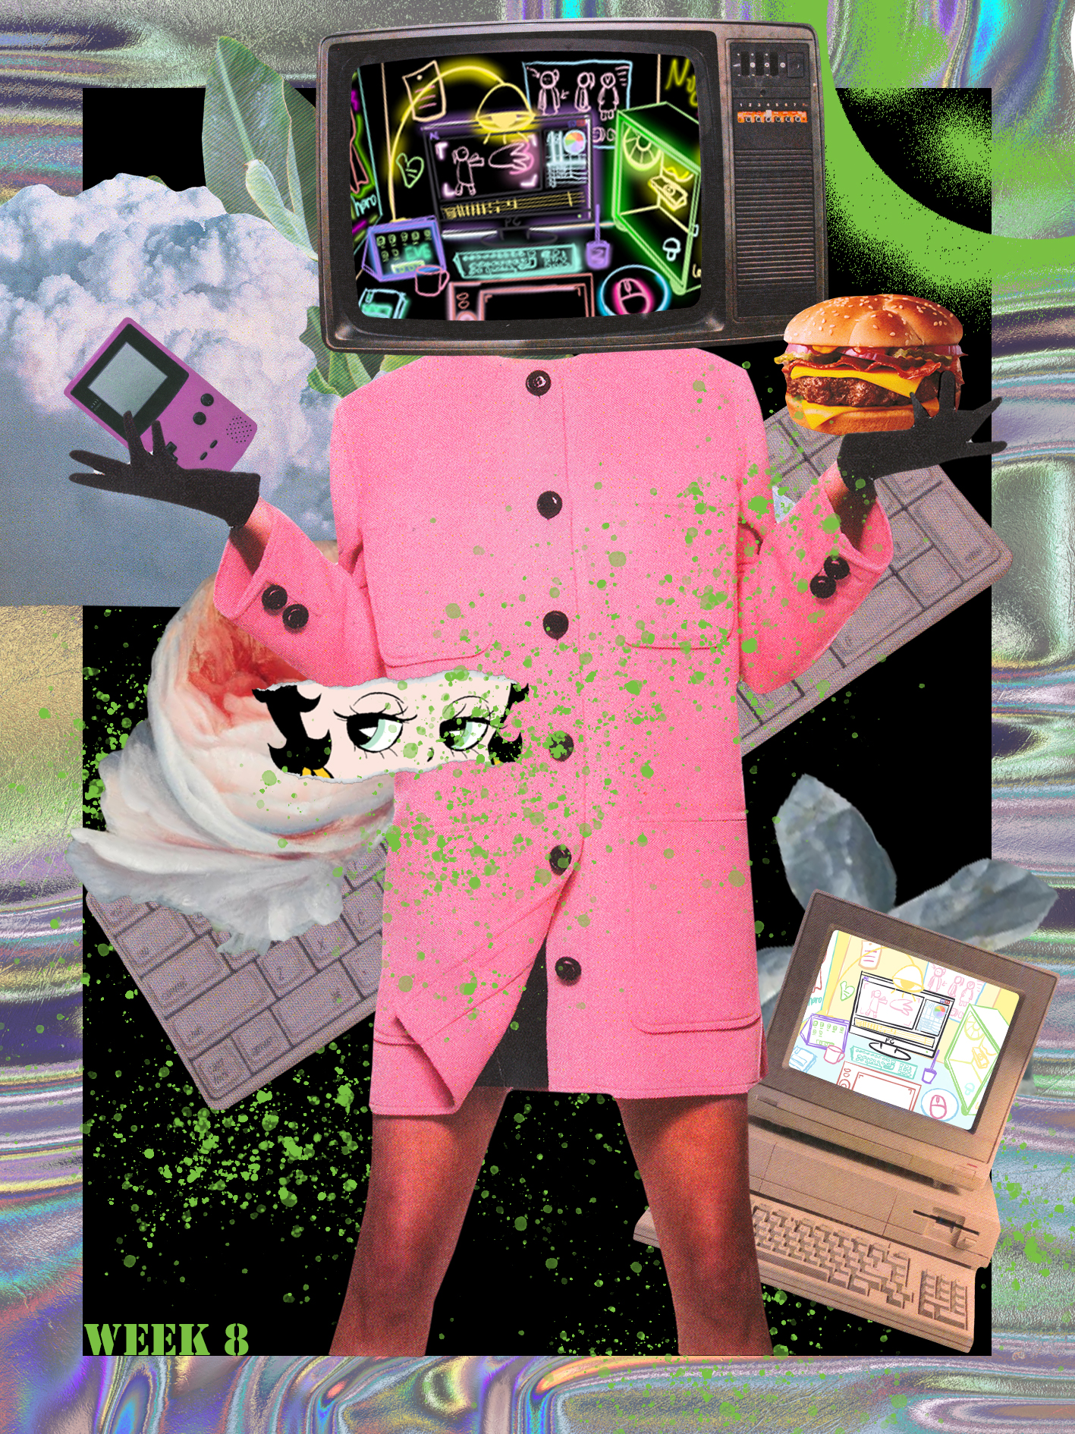
REMAKE POJECT
Week8 CLUE
THEME: Characters, environment and events
FORM: 2 Paintings
INSPIRATION ELEMENTS: Computer desk/wacom/ipad/animation student

Slide 10
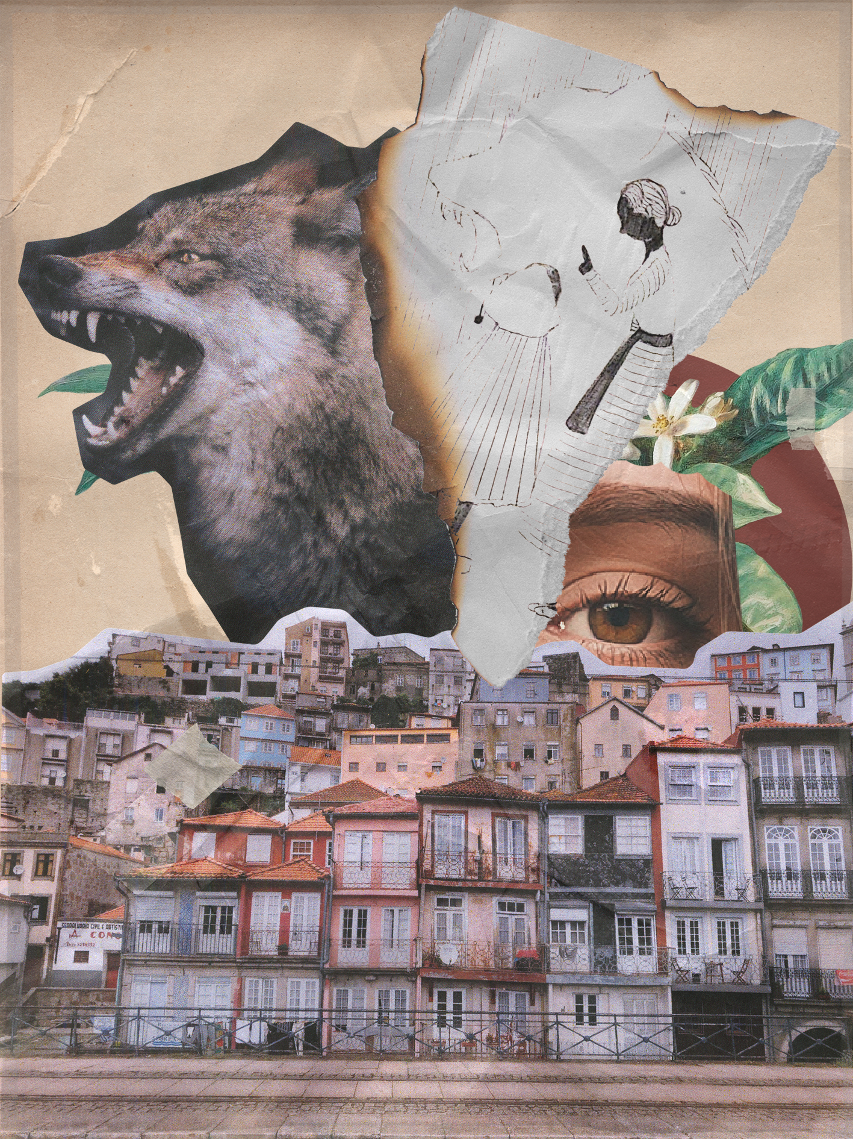
REMAKE POJECT
Week9 CLUE
THEME: Rules and Forces
FORM: Paintings
INSPIRATION ELEMENTS: Fairy tale/little red riding hood/line/black and white

Slide 11
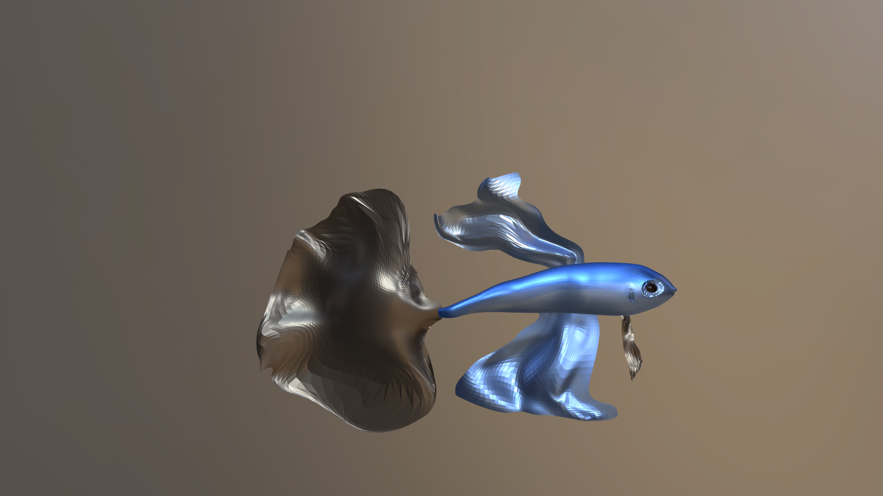
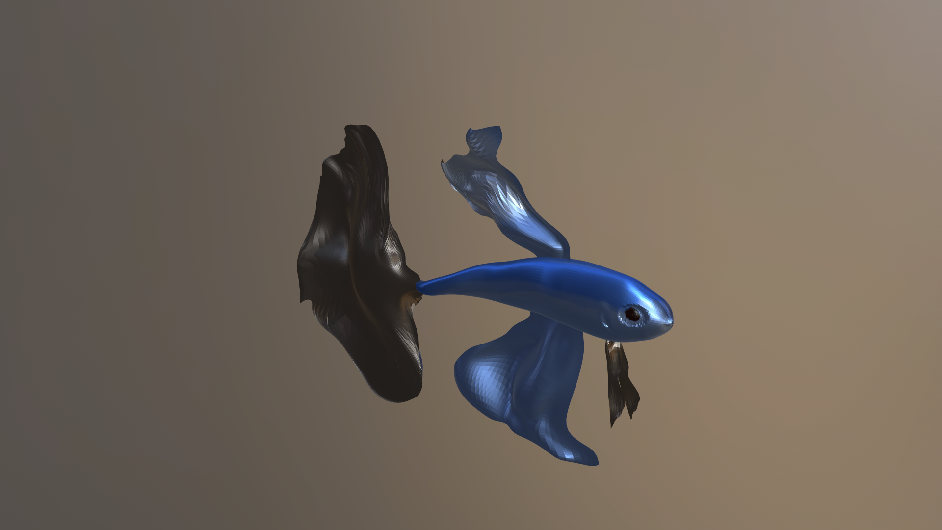
ORIGINAL POJECT

Slide 12
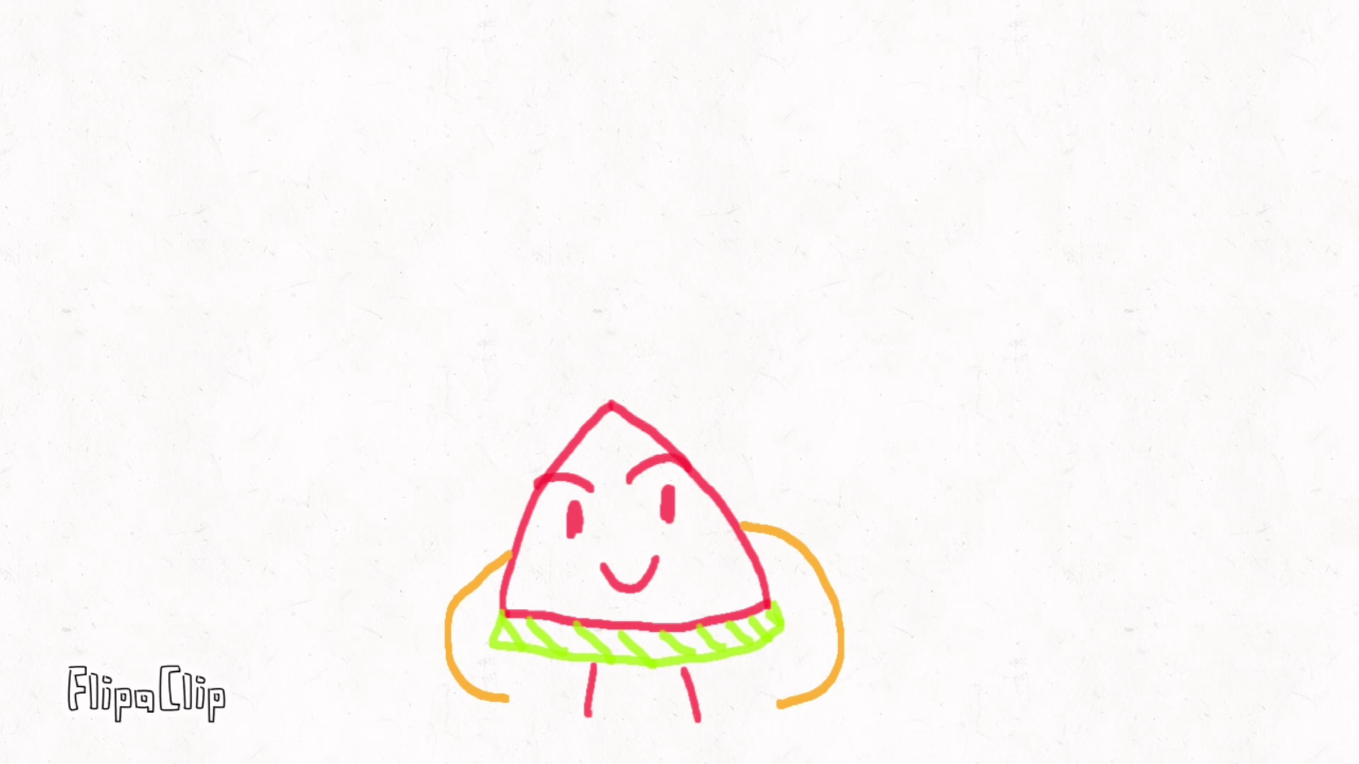
ORIGINAL POJECT

Slide 13
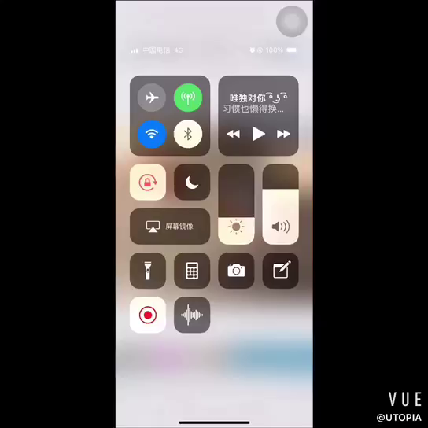
ORIGINAL POJECT

Slide 14
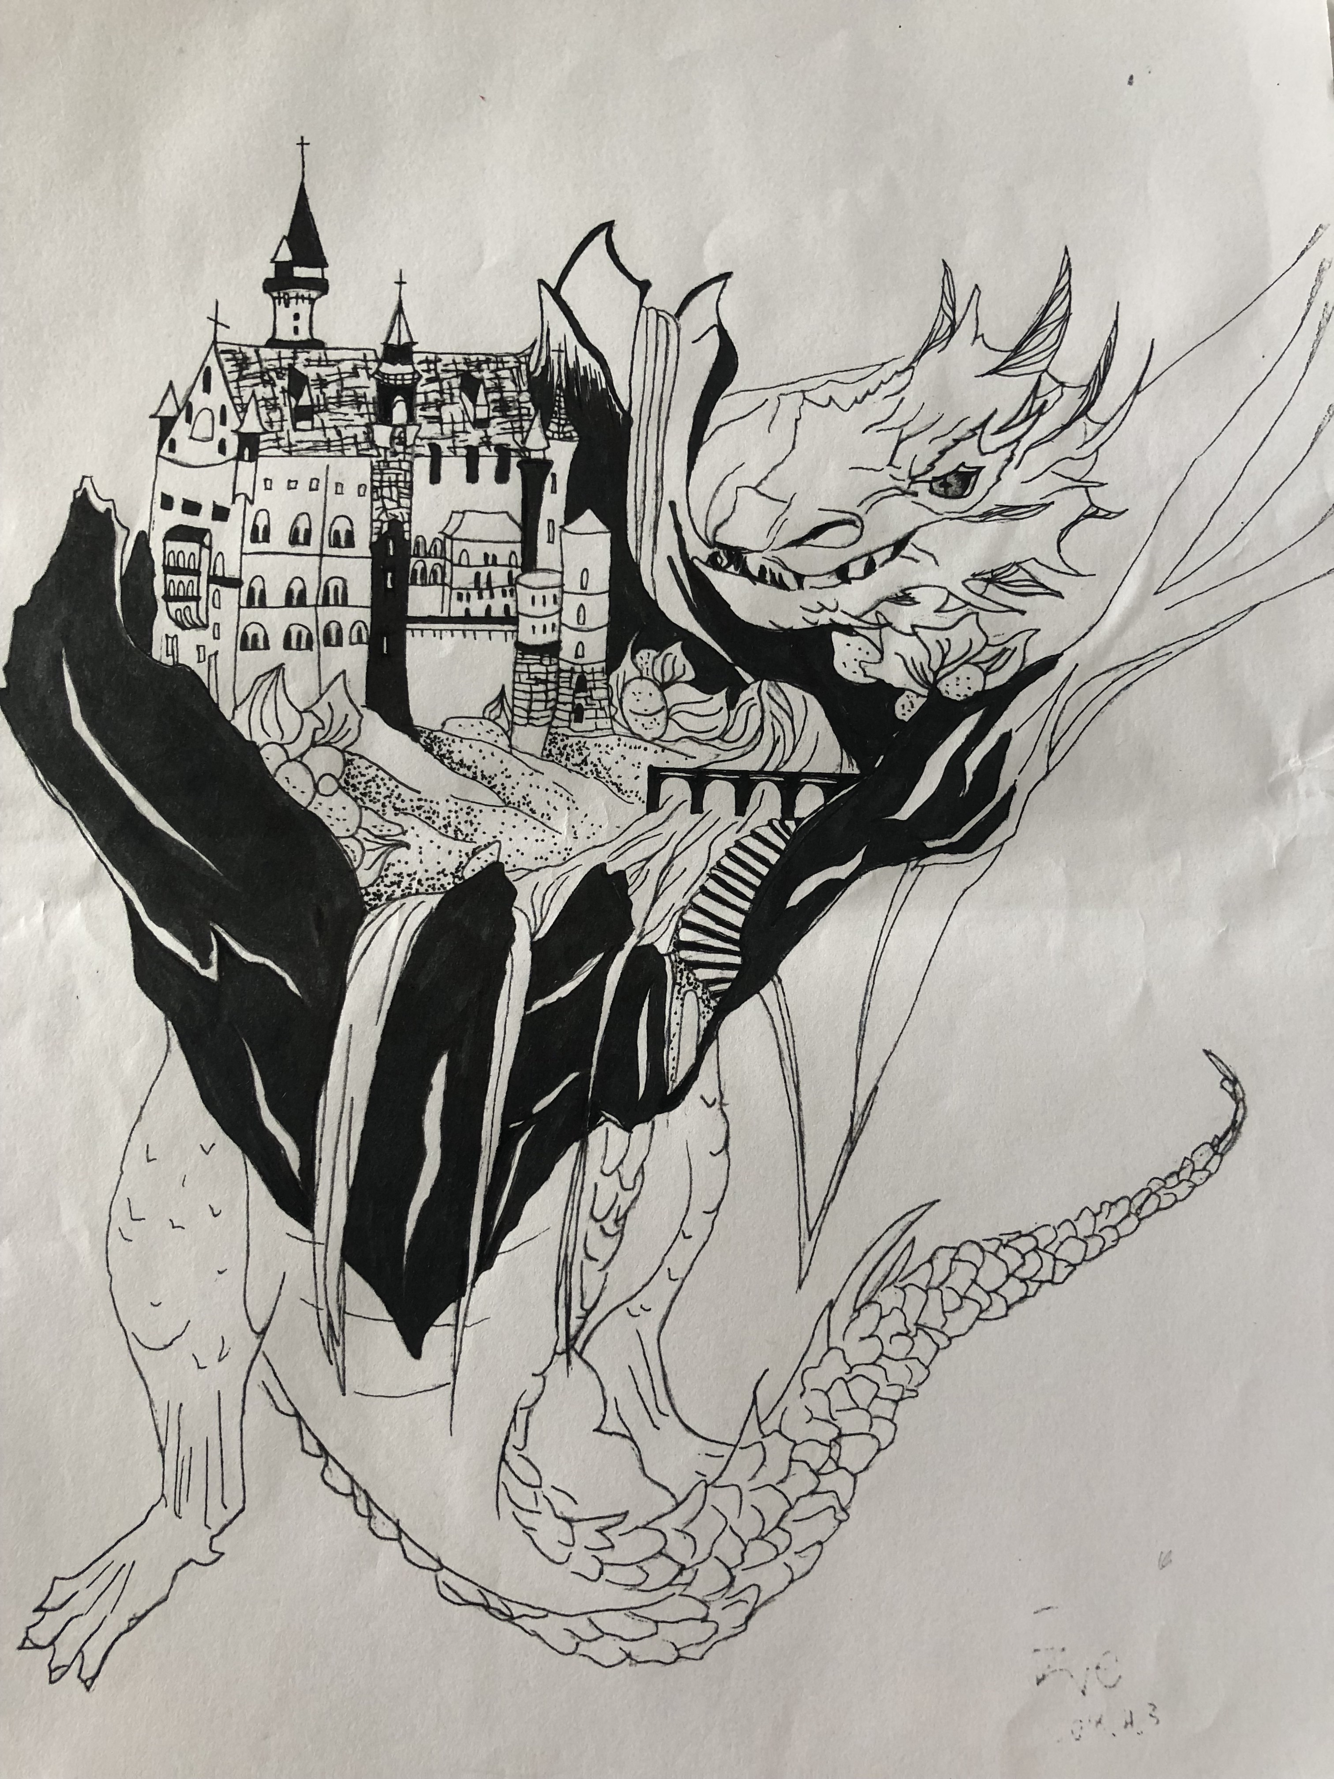
ORIGINAL POJECT

Slide 15
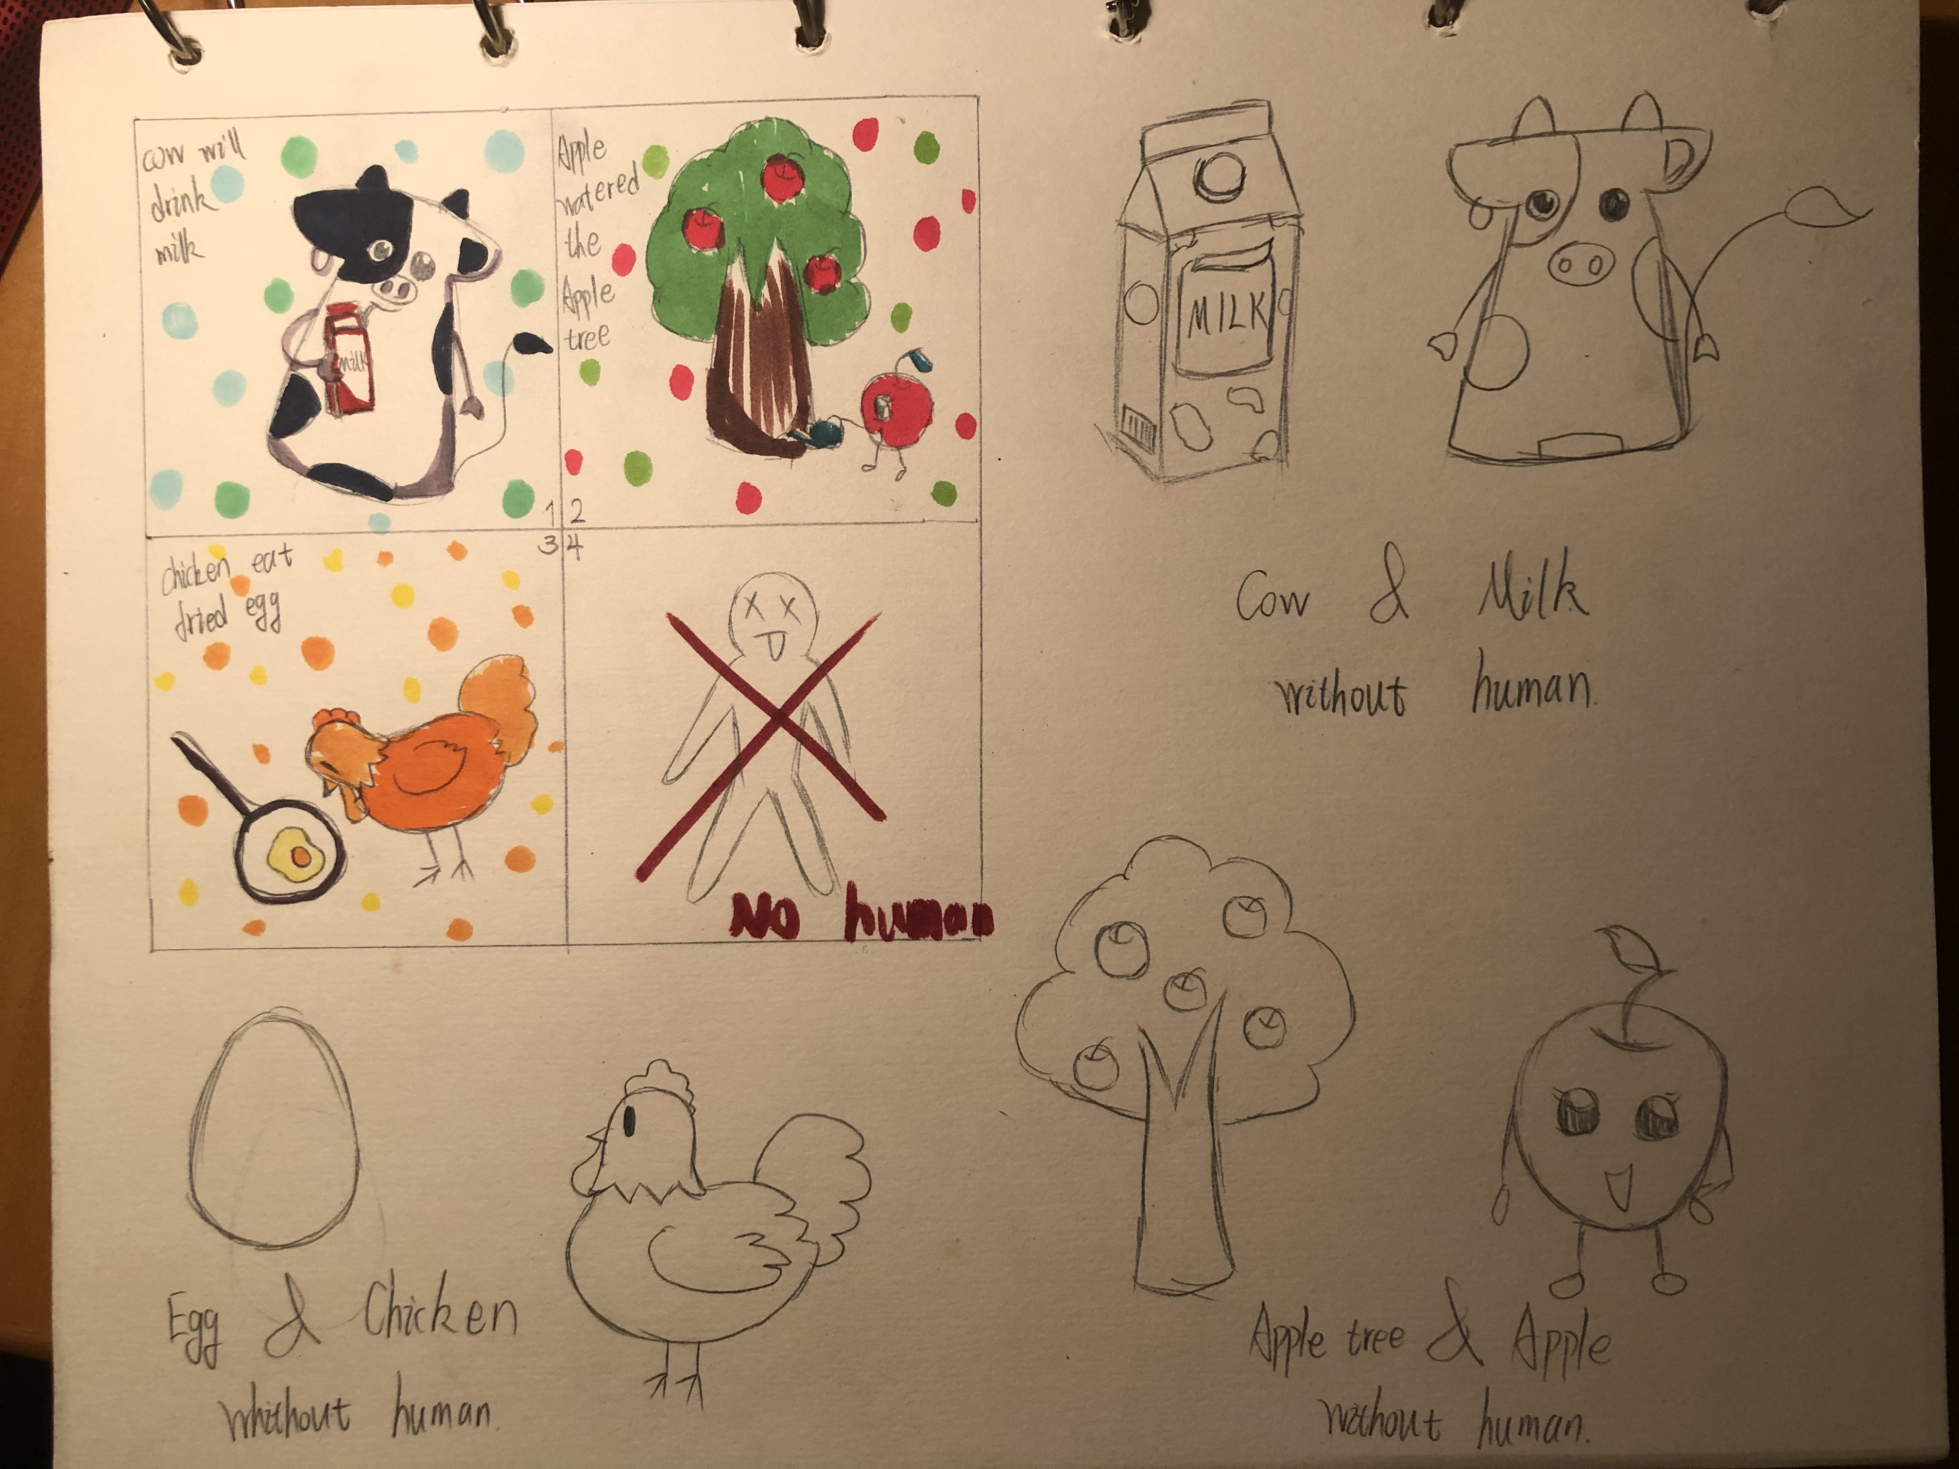
ORIGINAL POJECT

Slide 16
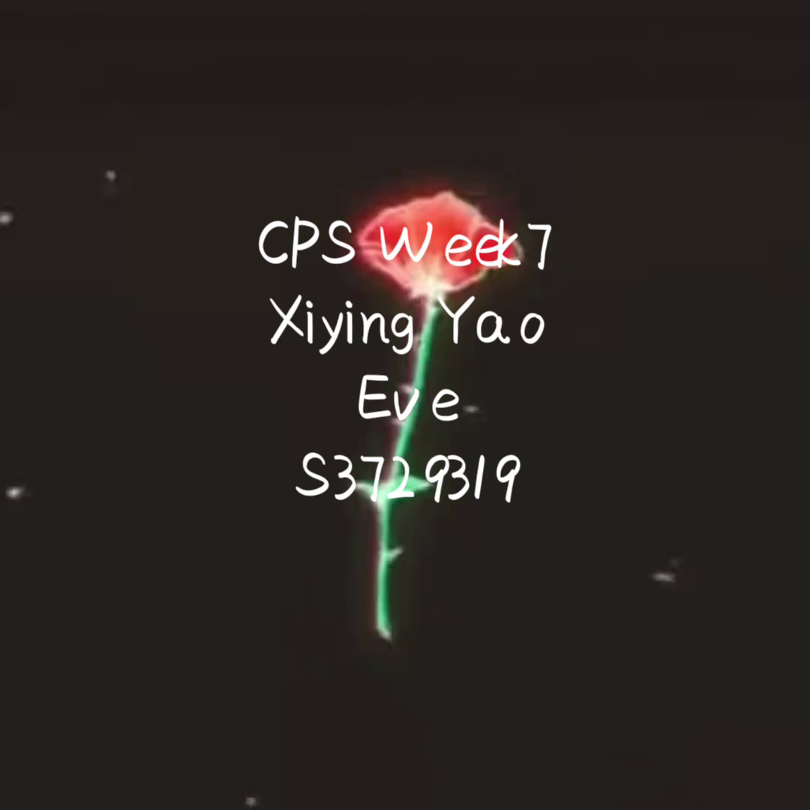
ORIGINAL POJECT

Slide 17
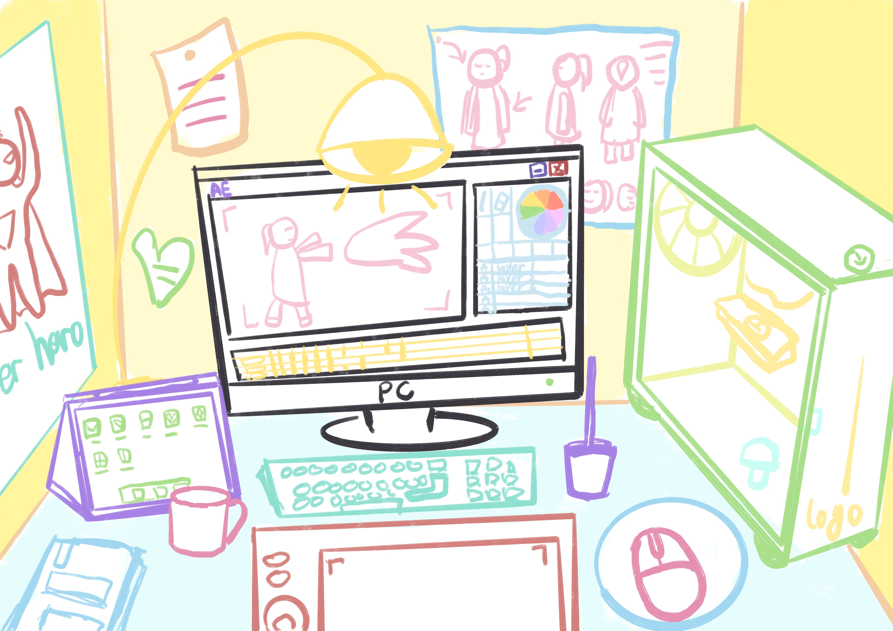
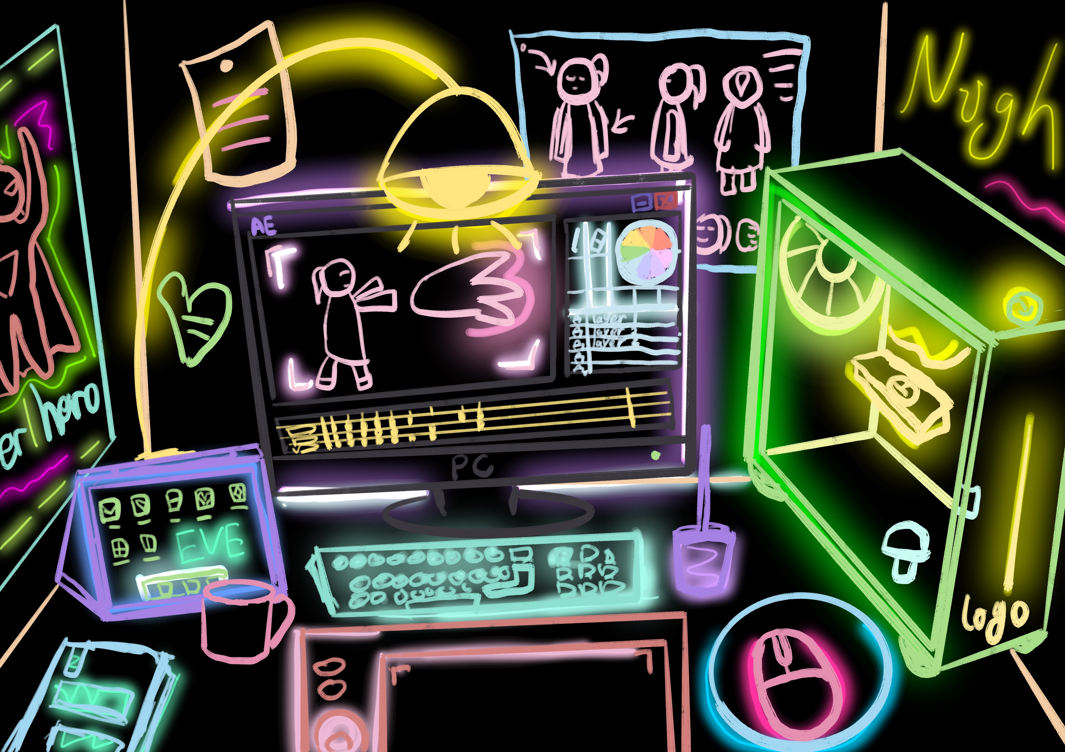
ORIGINAL POJECT

Slide 18
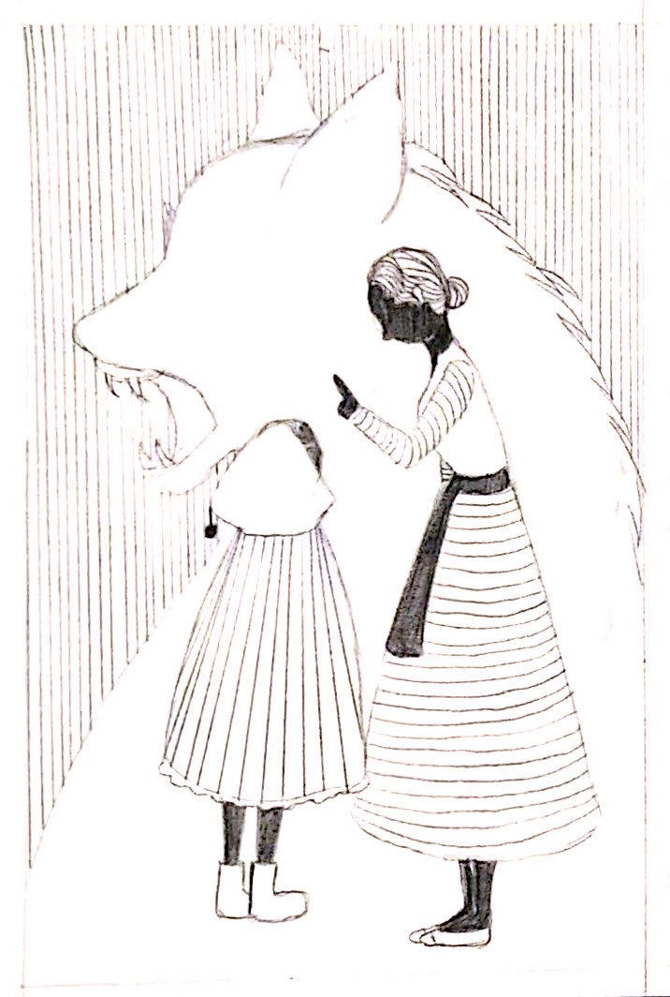
ORIGINAL POJECT

