Slide 1

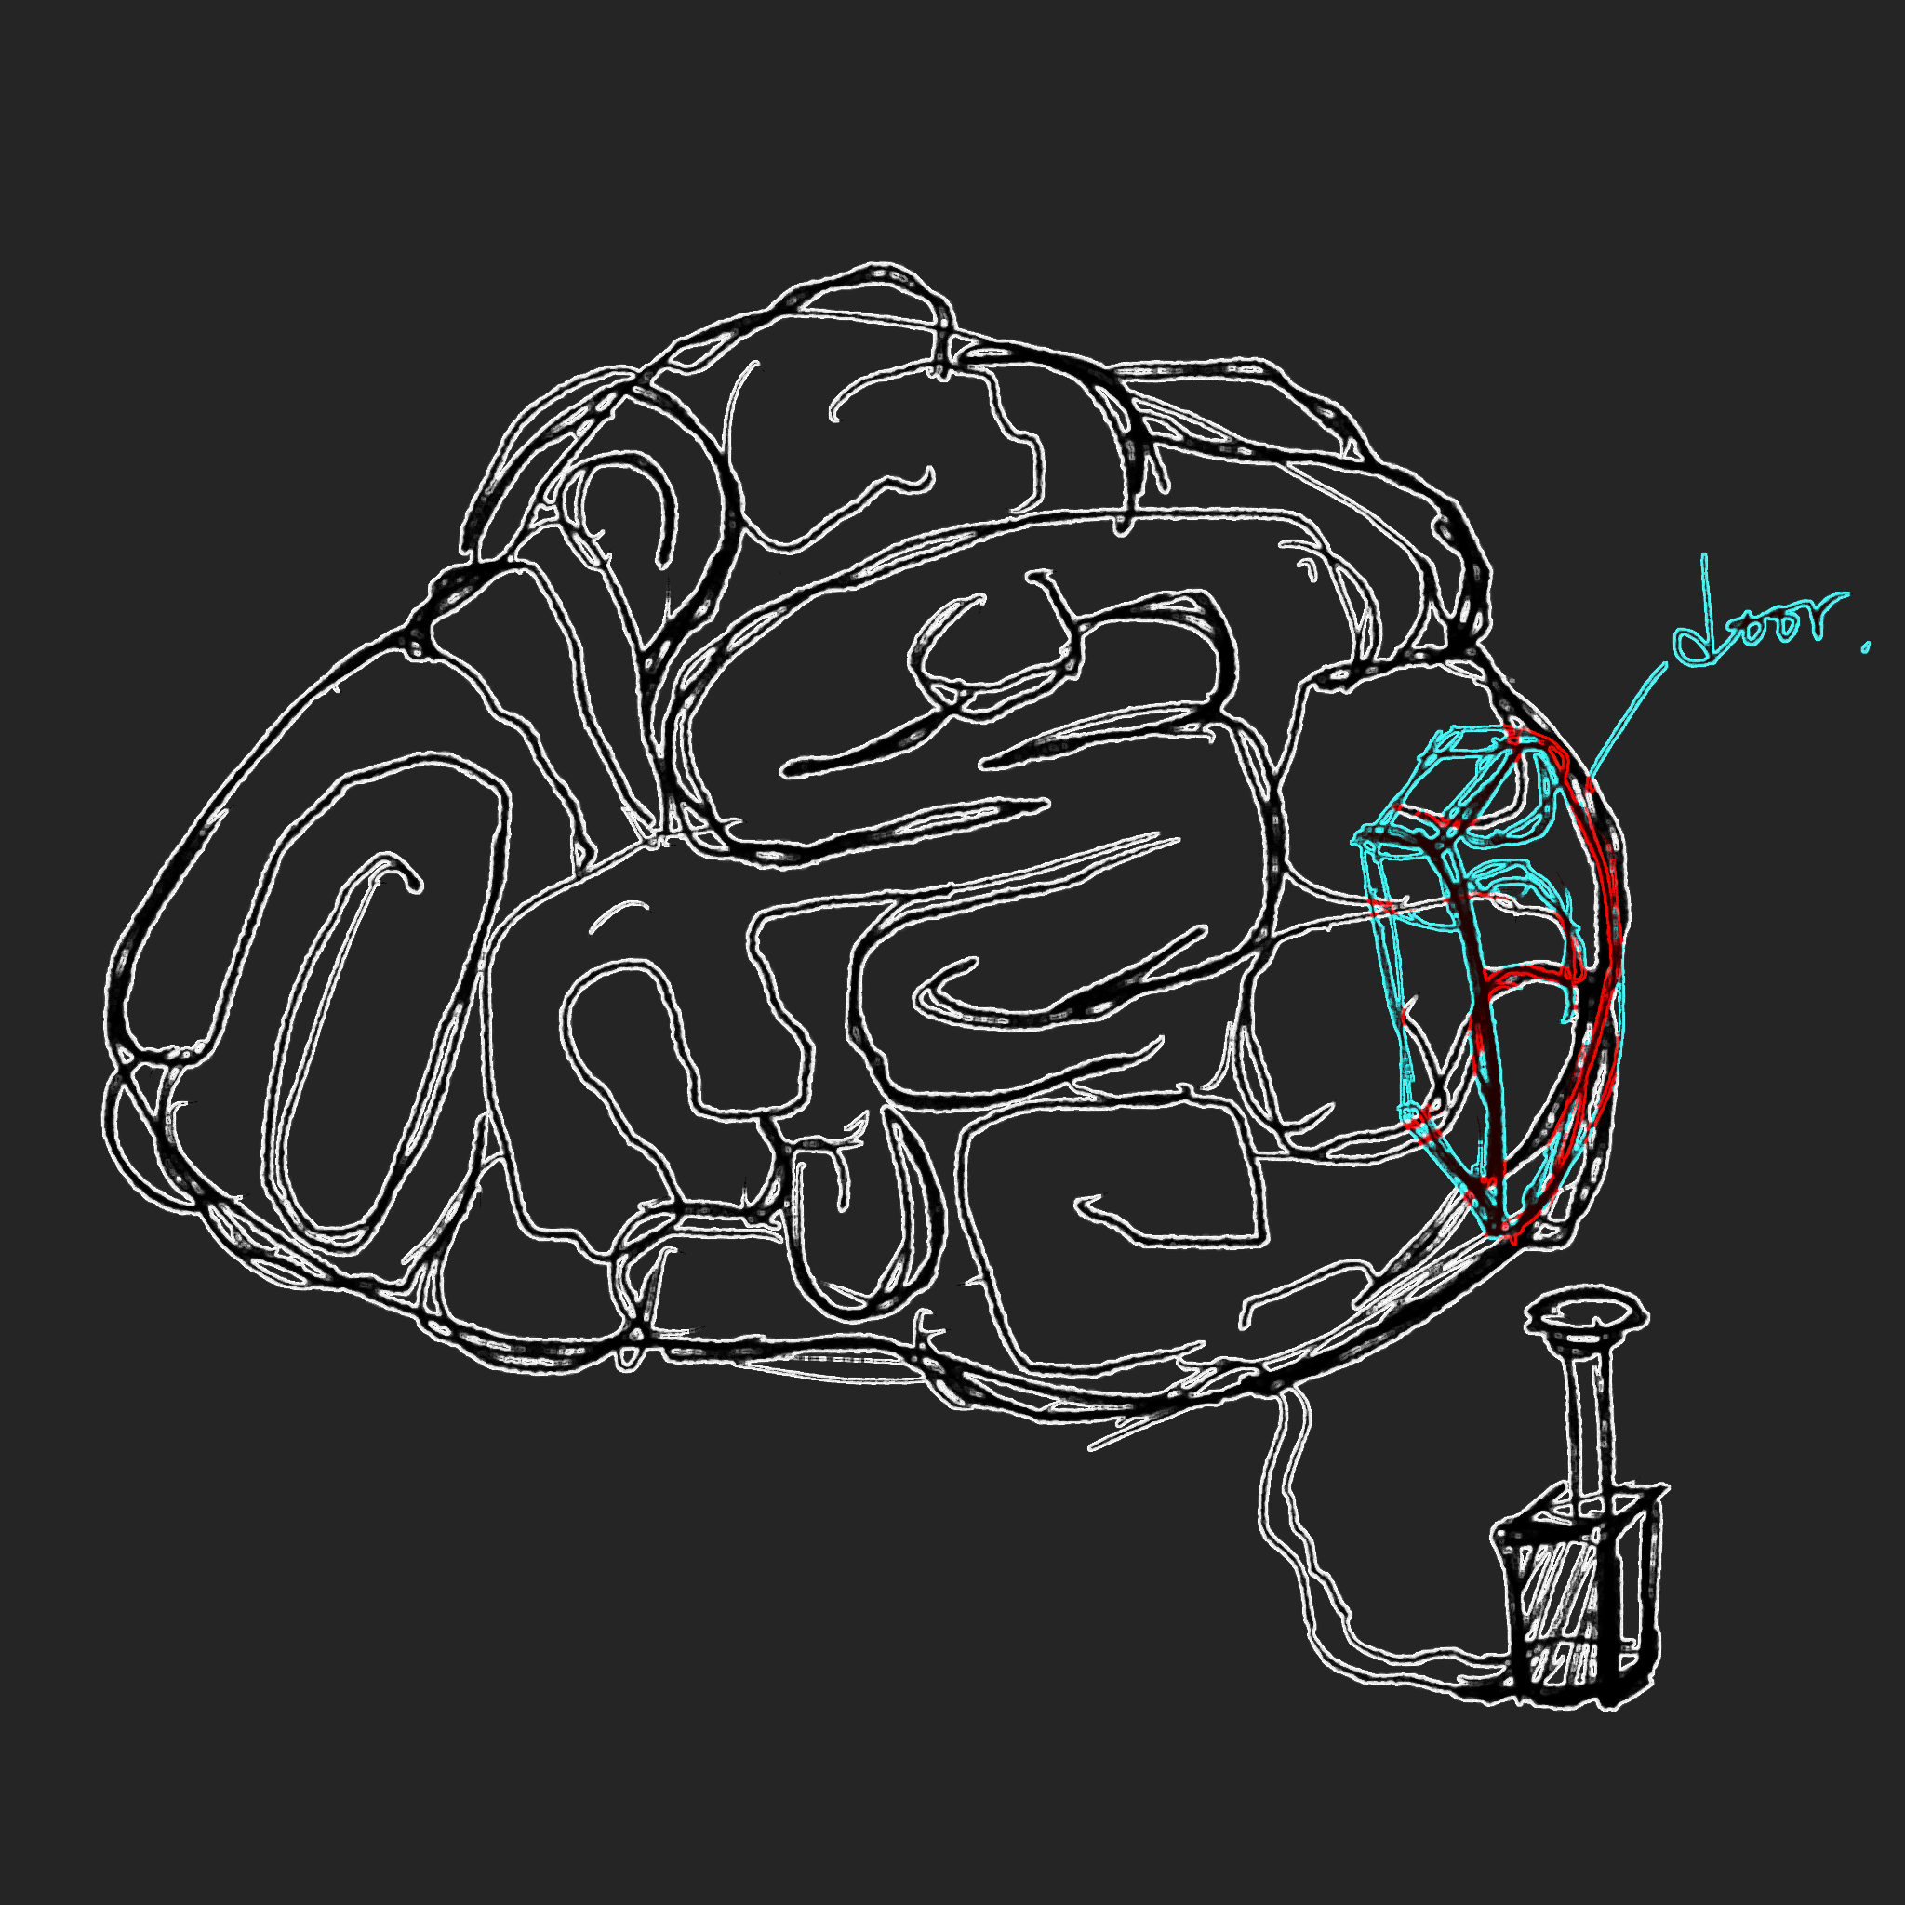
Week 4-5 Production
Animatic Ver 3 & 4
The Animatic for Folio 1
Character’s Design (Draft)
Next Step

Slide 2
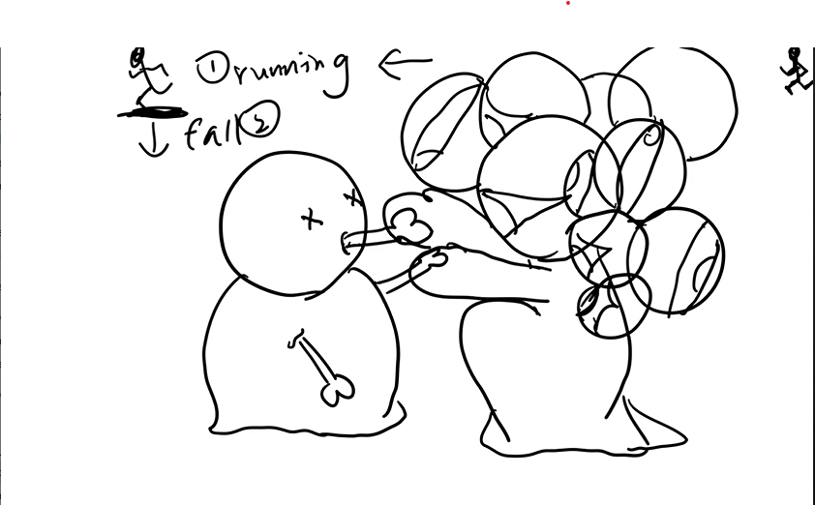
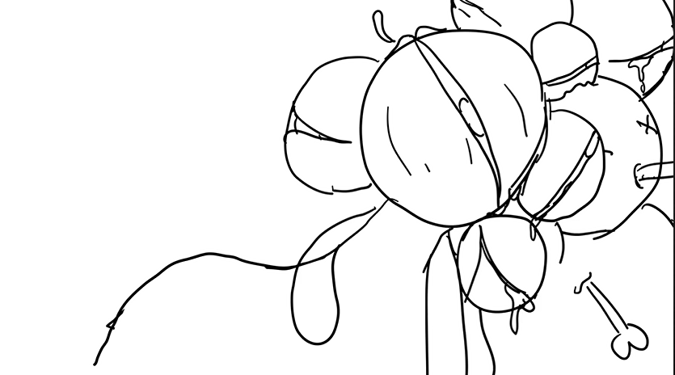
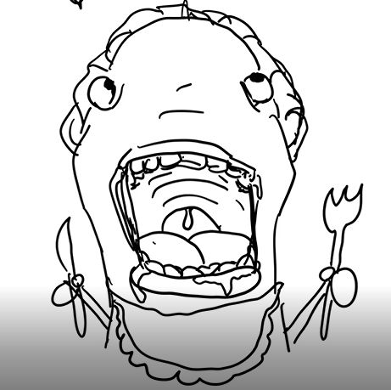
Animatic Ver 3 & 4
After consultation and research, I have added new scenes to show the death gods’ reaction to the action of the girl.
Focus on: Presenting their interactions and emotional connections
These scenes carried a sense of humor and information on character’s interaction. However, the inquiry of presenting human’s reaction to death was still not strong enough. So, these scenes were changed later in version 5.
New Scene:
Hecate has waited too long for the girl to accept the truth, It feels boring and falls asleep
New Scene:
Thanatos cannot wait to eat the girl’s again. It wears apron and waits for it’s “food”.
Animatic ver 3: https://youtu.be/NzQr3LS6MnE
Testing(1):https://youtu.be/MfTf-LN2pIM
Testing(2):https://youtu.be/c1uRELsaywM
Animatic ver 4:https://youtu.be/kCX9tOsbwGE

Slide 3
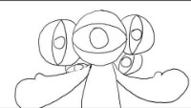
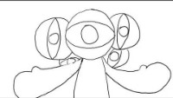
The Animatic (Ver 5) for Folio 1
Focus on: Strengthening the emotional impact through visual transformation, increasing the tensions on how the character running away from death.
Music are from Uppbeats:
https://uppbeat.io/t/richard-bodgers/dangerous-times
https://uppbeat.io/t/yeti-music/death-of-a-friend
https://uppbeat.io/t/paulo-kalazzi/heros-time
Animatic ver 5 (without Audio) : https://youtu.be/__3qjhpzjtI
Animatic ver 5 (with Audio Sample) : https://youtu.be/9jIhp32Gmhw

Slide 4
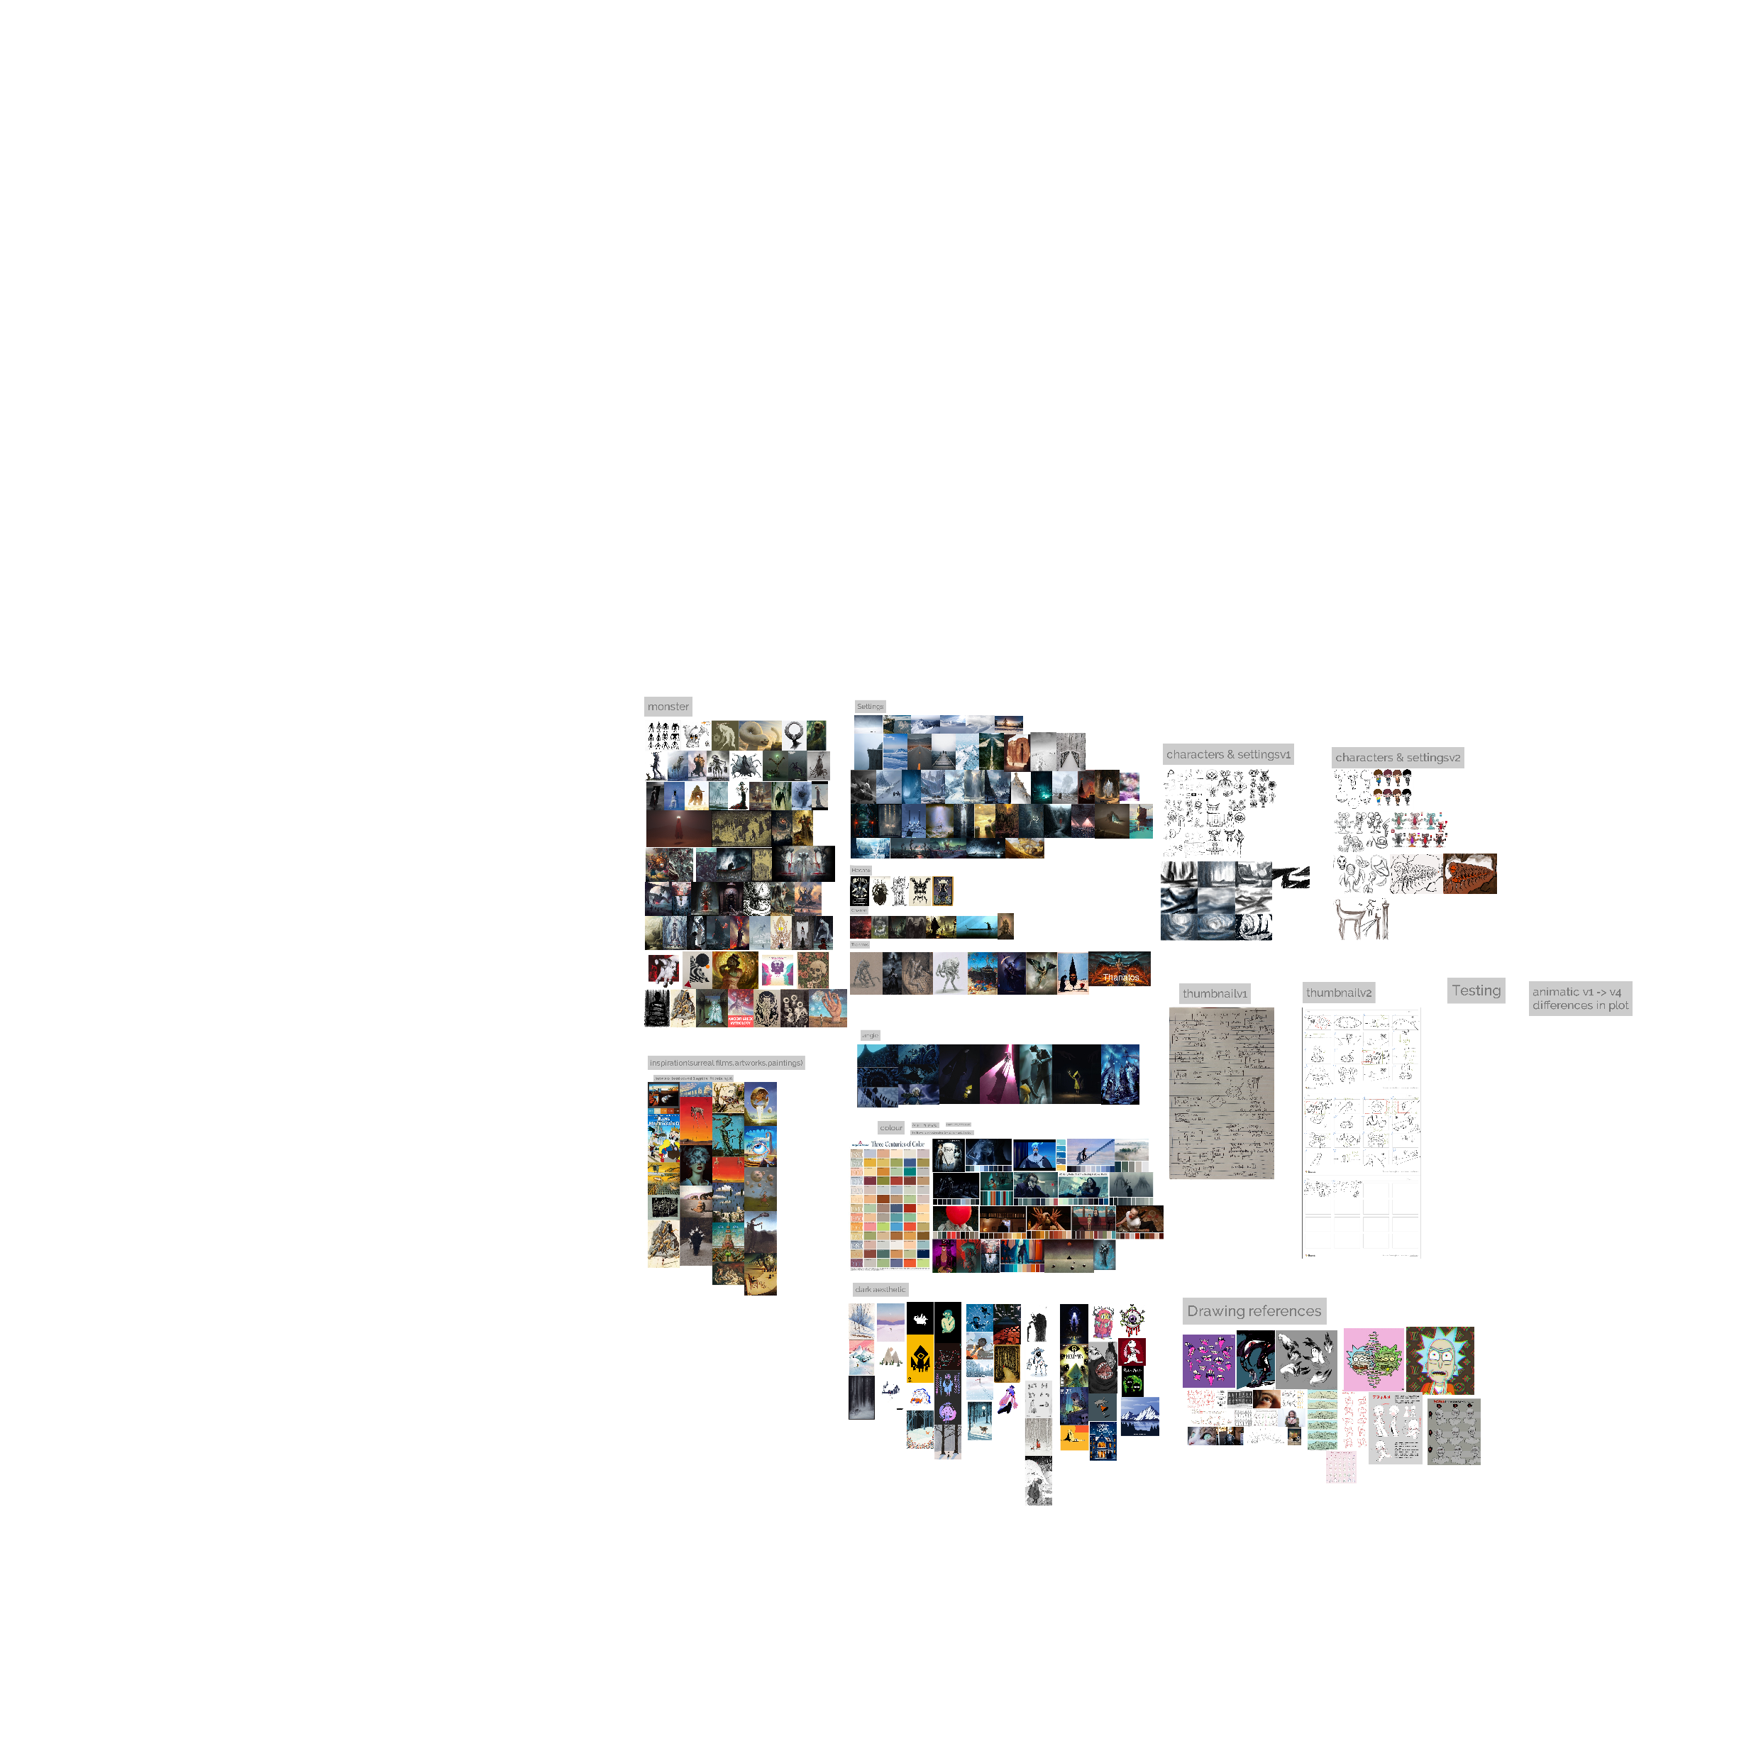
Designs – Mood board for character and settings
These are not my works

Slide 5
Designs – Mood board for colour, style and camera angles
These are not my works

Slide 6
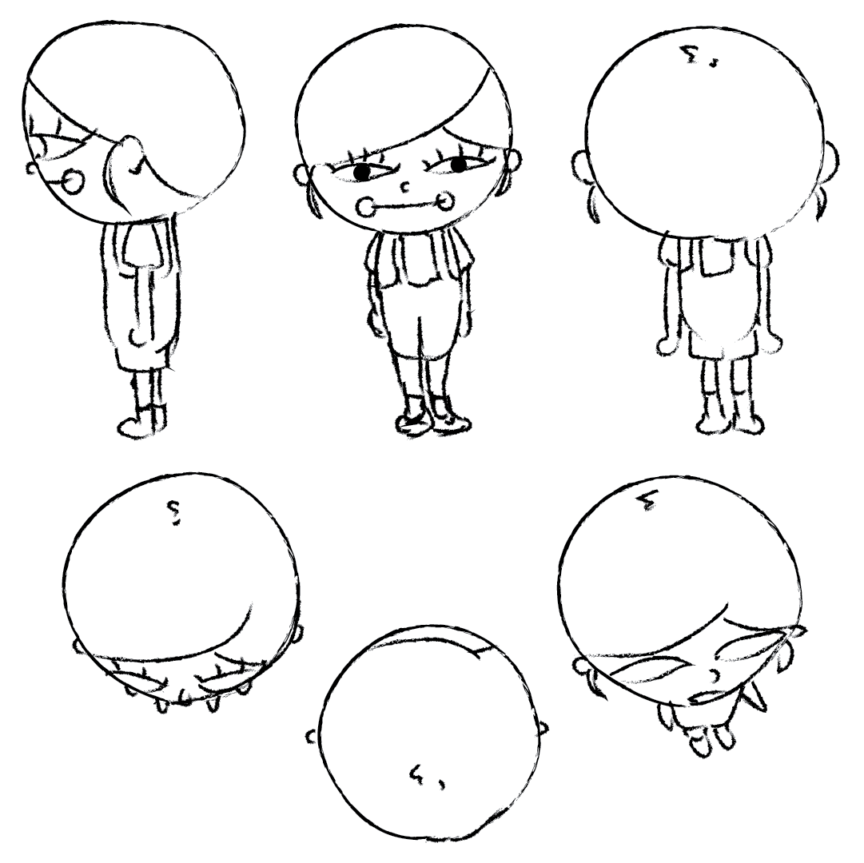
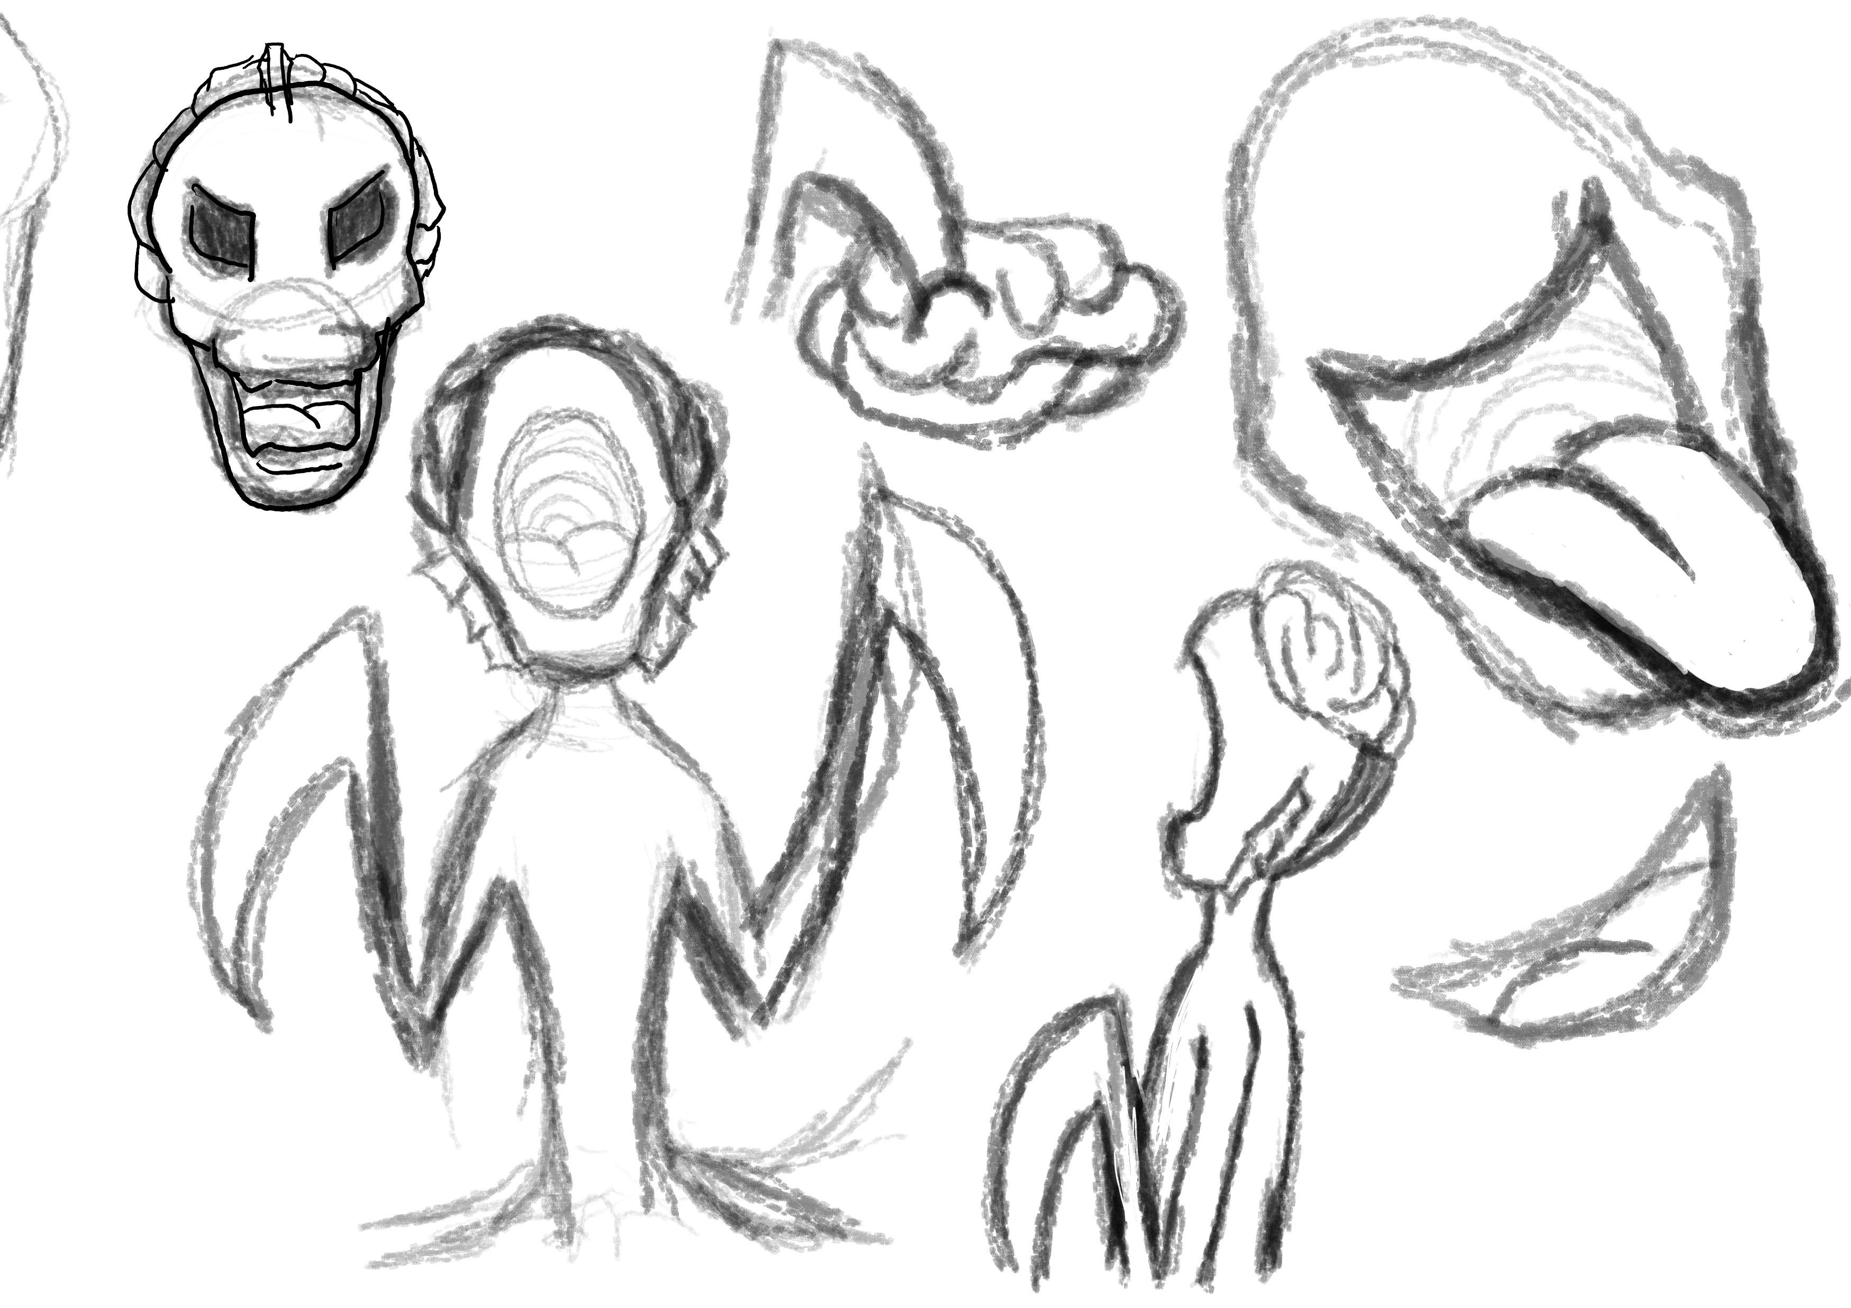
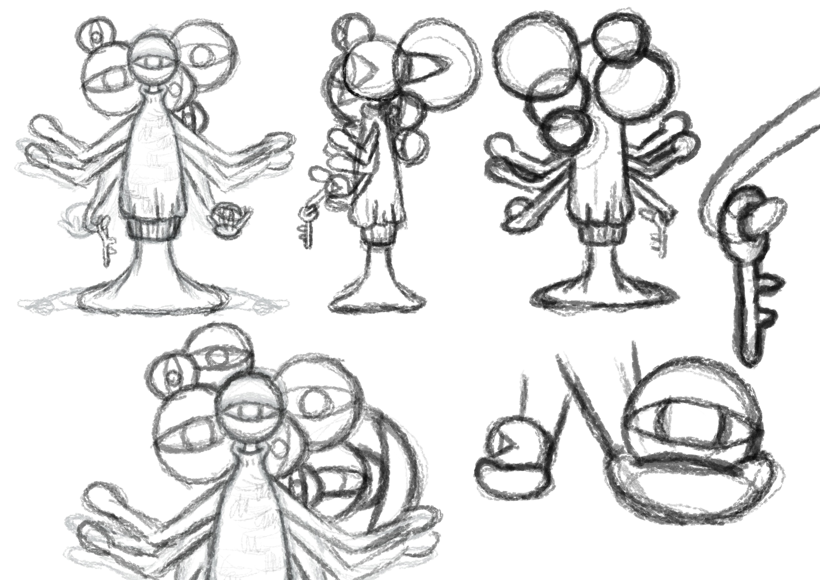
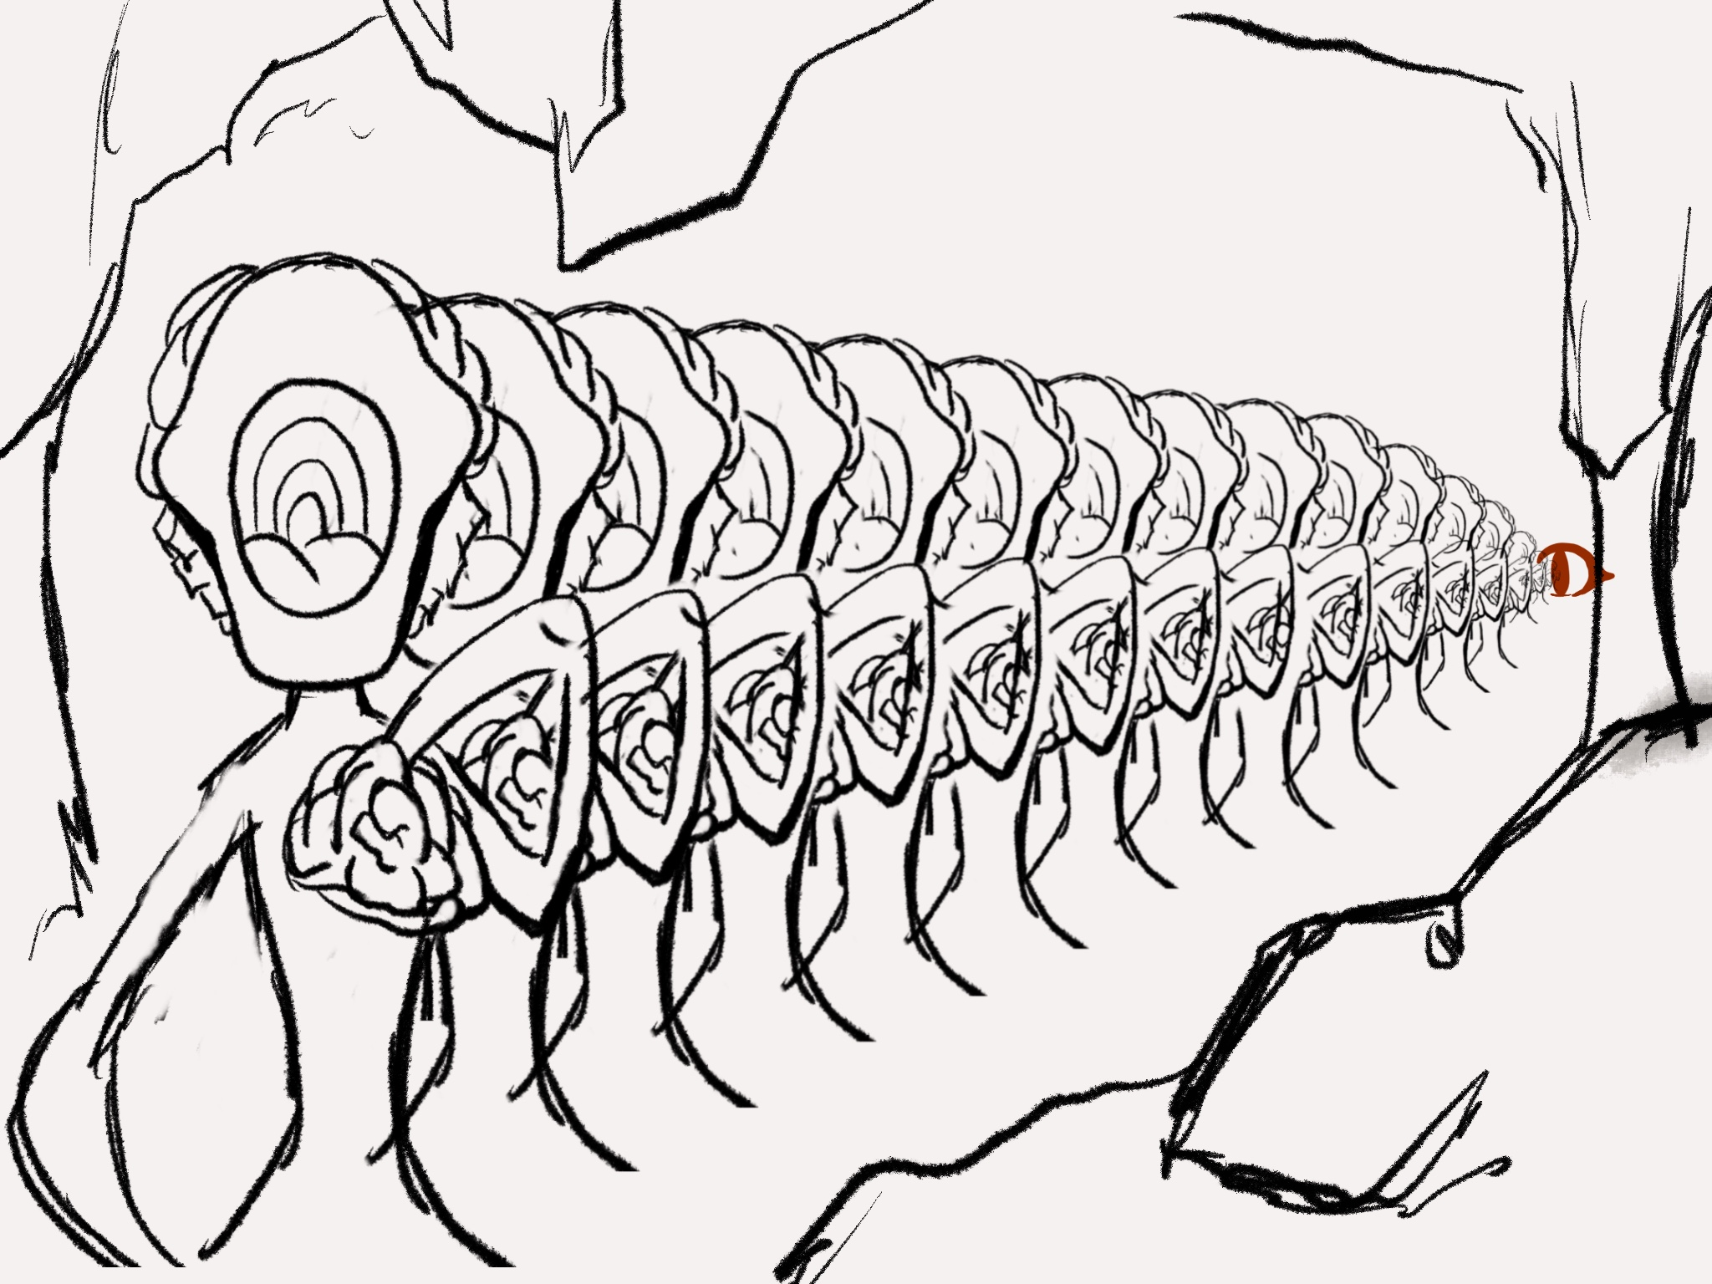
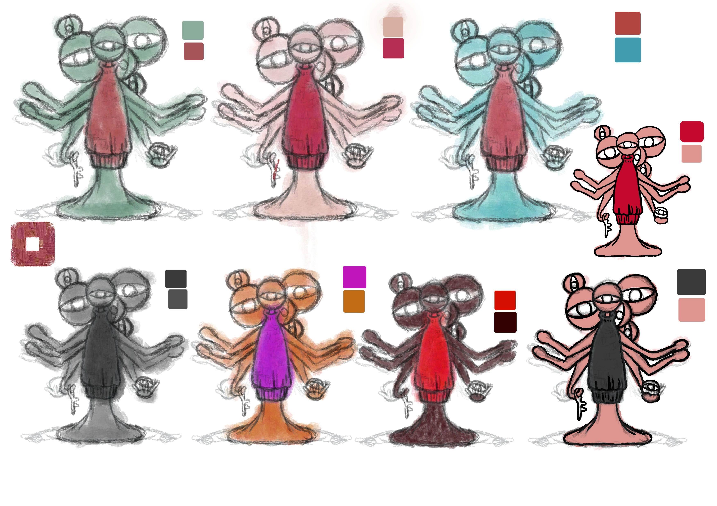
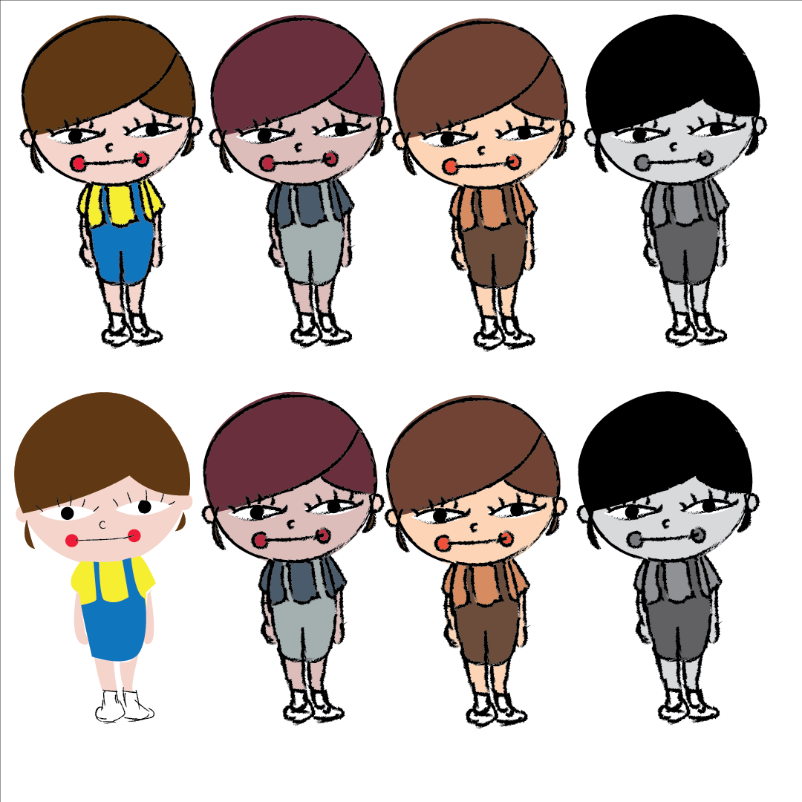
Characters’ drafts
Main Character – the girl
Thanatos
Hecates

Slide 7
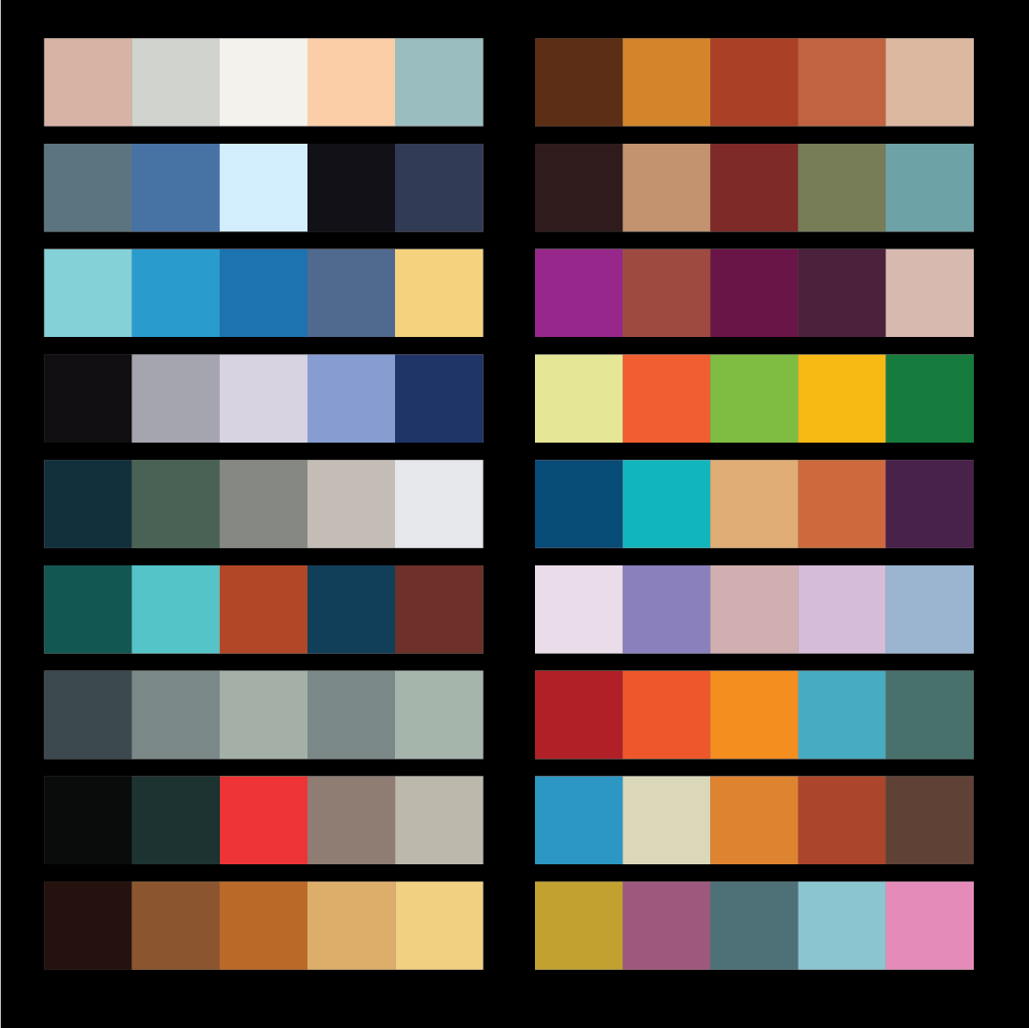

Next Step
I’ve sampled some colour palettes from mood boards. Then I will do colour tests. Also, I should have the final designs on characters and settings of the animation already according to my schedule. However, I have spend more time on refining the animatic. Therefore, I have to go with Plan B and finish the final designs on characters and settings next week.

