Slide 1
Reflective Presentation
Linh Nguyen

Slide 2
Rationale
Using 2D puzzle game to portrait the feeling of self-hatred

Slide 3
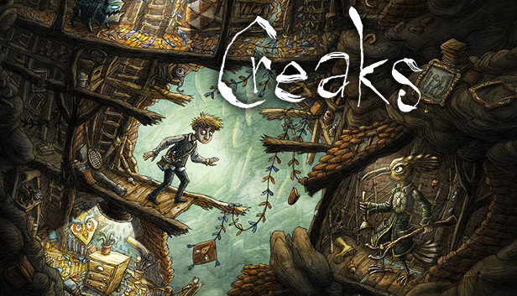
Context
2D puzzle game

Slide 4
Method
Gameplay mechanism
Lofi prototype
Concept design
Assets
Hifi prototype

Slide 5
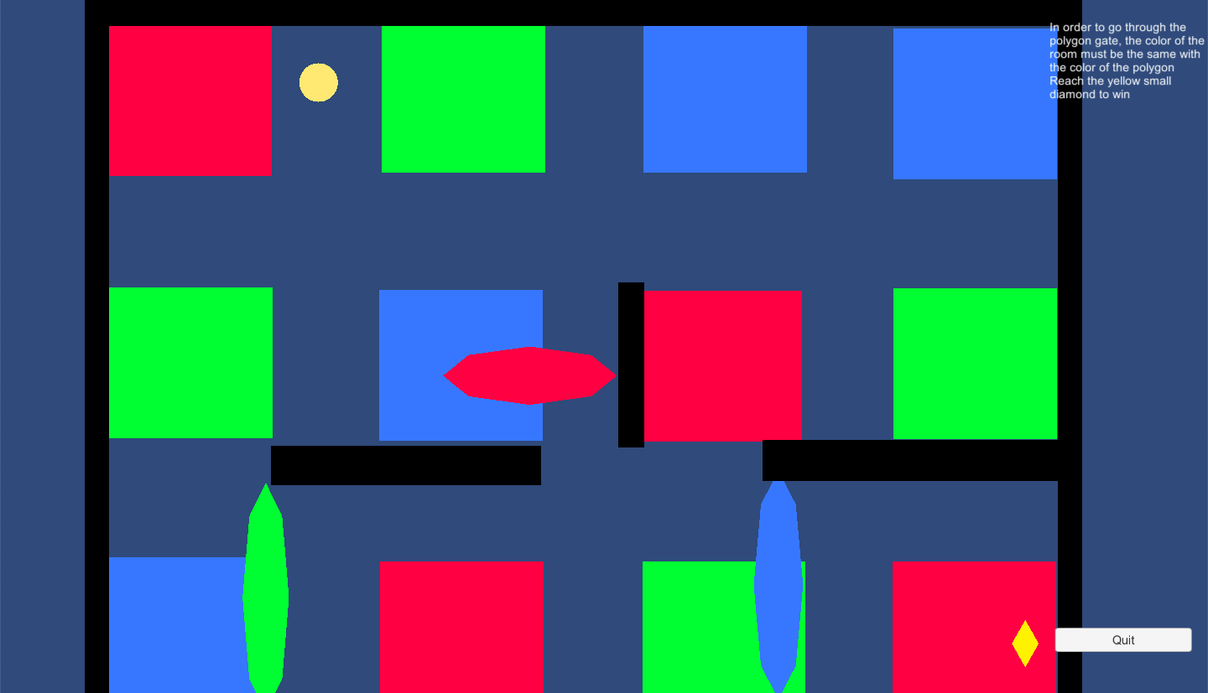

Slide 6
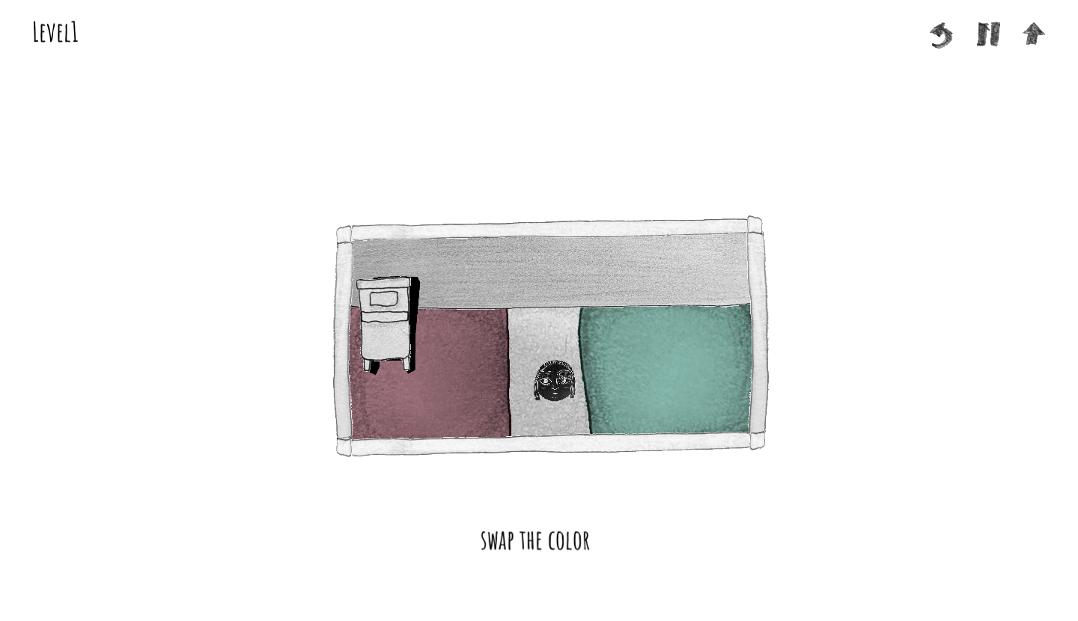

Slide 7
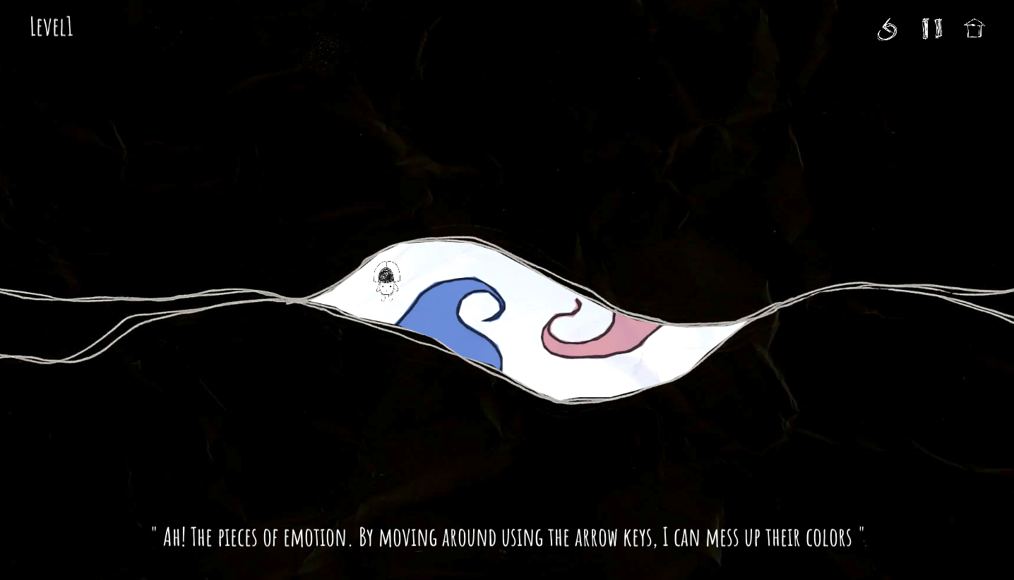

Slide 8
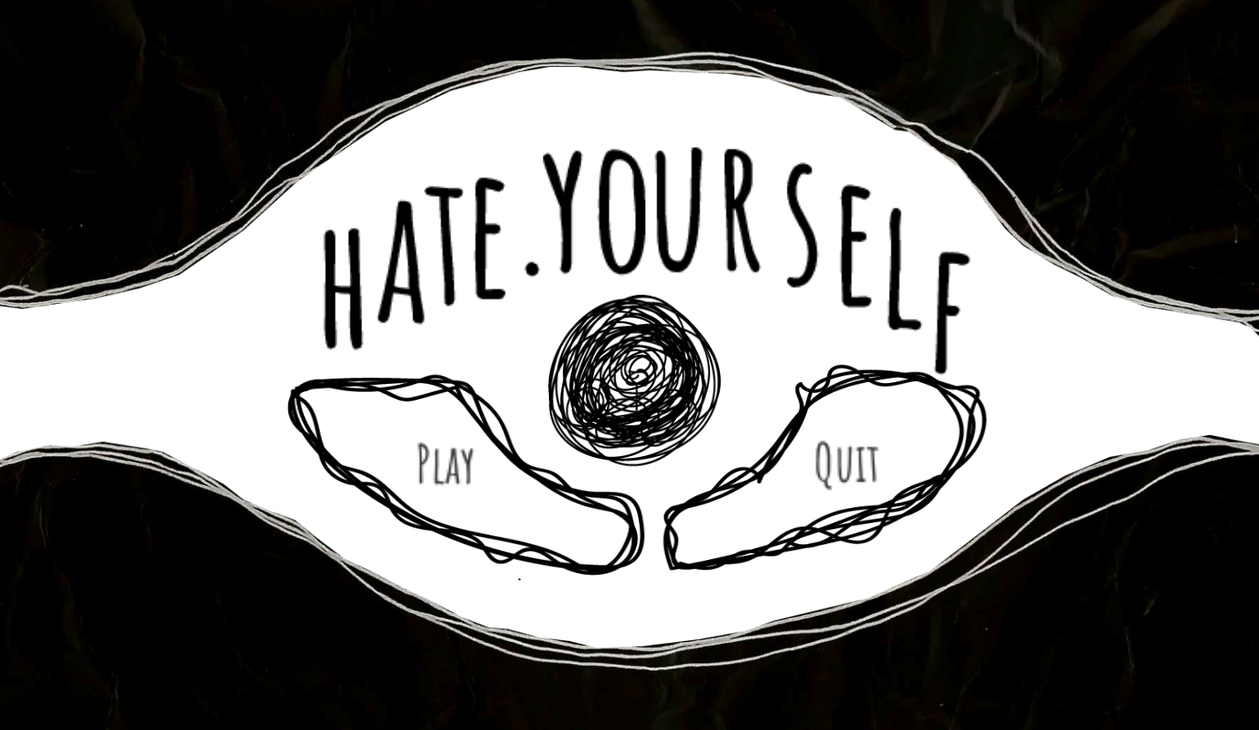
Outcome
A 2D puzzle game

Slide 9
Reflection
What is the meaning of the game mechanism
What are the meaning of the design element (background, character, game elements, etc.)
What will the player seek?

Slide 10
Thank you

