Slide 1
CPS Week 10 – ‘Forces’
Pei – Ju (Janifer) Lai

Slide 2
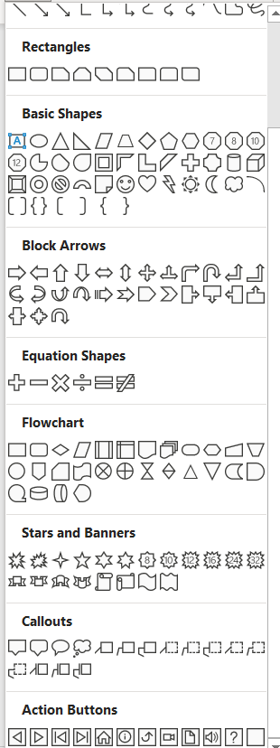
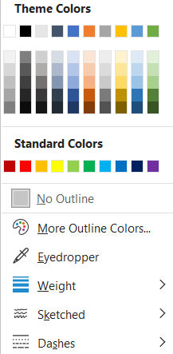
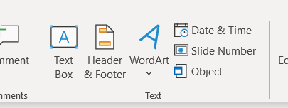
RULES
1. Default Shapes
2. Default Color
3. No Text Allowed

