Slide 1
APD folio1 presentation
Rui

Slide 2
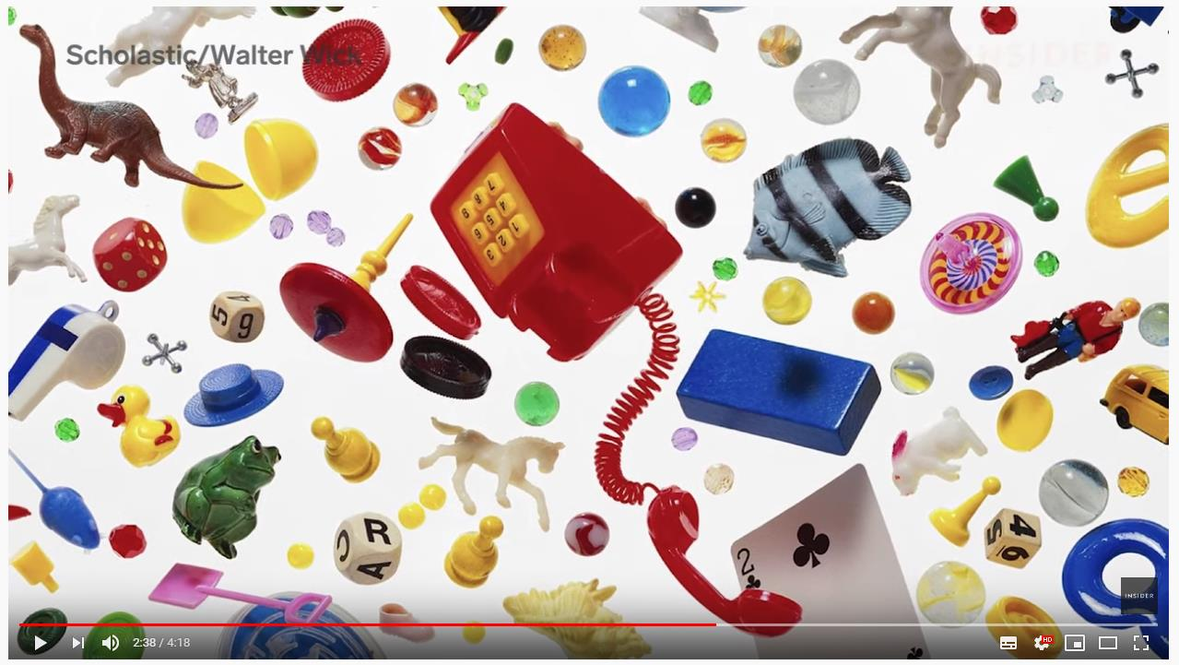
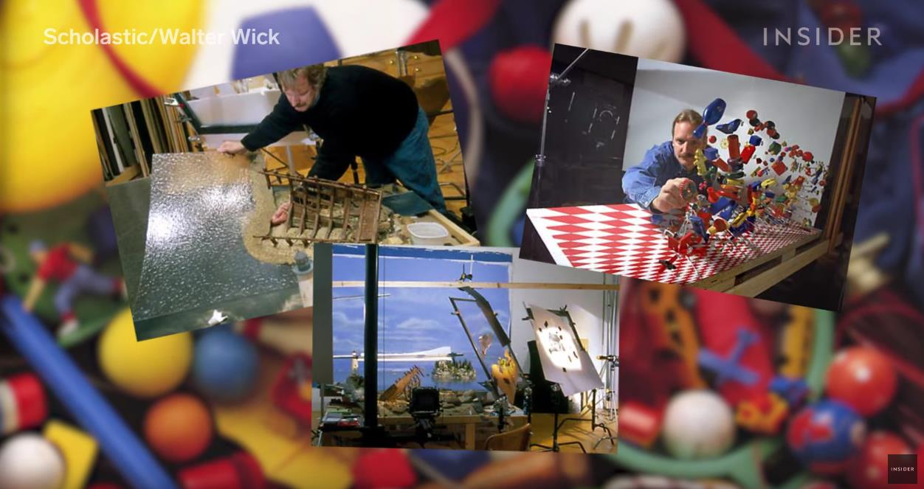
Week4
Theme：play and place
Context:
1、How ‘I Spy’ Books Are Made - https://www.youtube.com/watch?v=sz8luEznxbM
A highly playful and captivating book series that creates spaces and places out of an assortment of inanimate objects, then asks the reader to engage with it to find the hidden objects within.

Slide 3

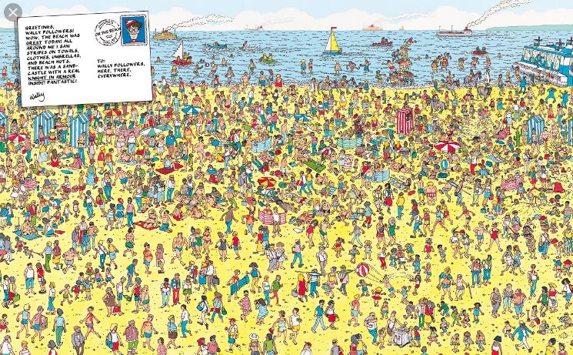
2、Where’s Wally - http://www.todayifoundout.com/index.php/2013/08/the-history-of-wheres-waldo/
Another famous book series that further stretches the focus on space and place, creating chaotically crowded locations and asking the reader to look closer in order to search for Wally inside them.

Slide 4
Method:
The idea and context were offered by Ben, and Ben makes several low poly models in Maya, and textured it as well. Then, I use those models to build the landscape.
Ben figure out how to manipulate portal in Unity, and I build an AR app based on Vofuria engine in Unity.
Roles:
3D Modelling - Ben
Portal Investigation - Ben
3D Scene Arrangement - Rui
AR & Portal Implementation - Rui
Reflection:
We make a prototype of our idea, and it still has some problem can not fix yet. But it was a big step like this is my first times write down so many words in here. If we have time to dig more thing about this idea in the future and using screen projection to give more paly better user experience.

