Slide 1
IOL Project 1：Surveillance
S3703903
Huiwen Feng

Slide 2
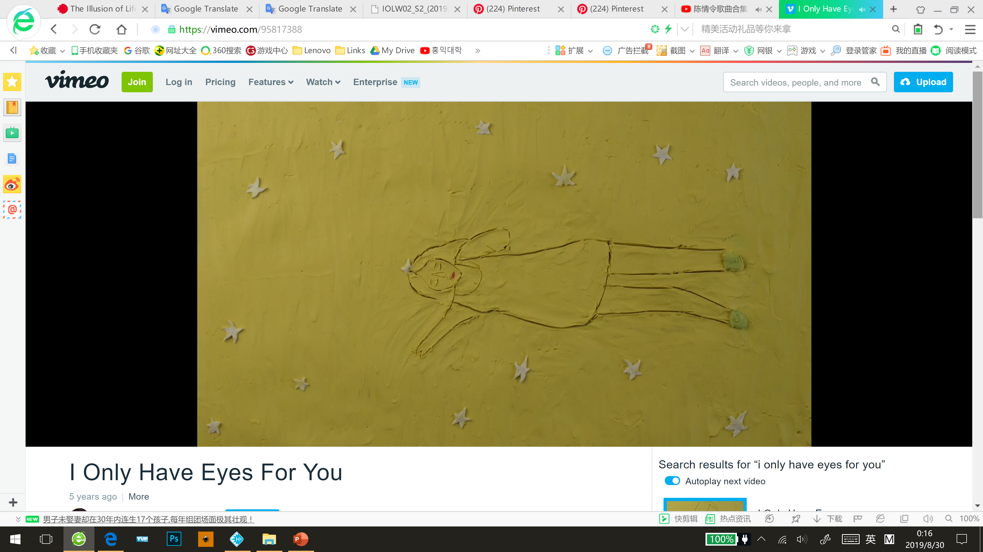
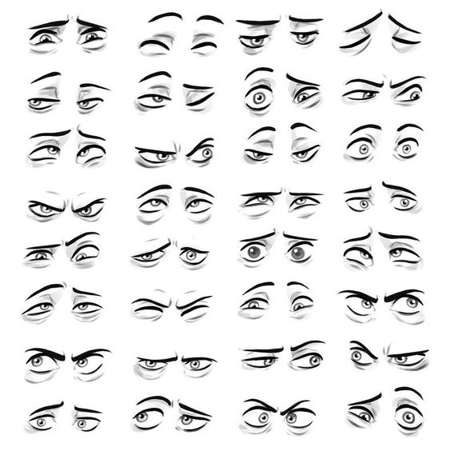
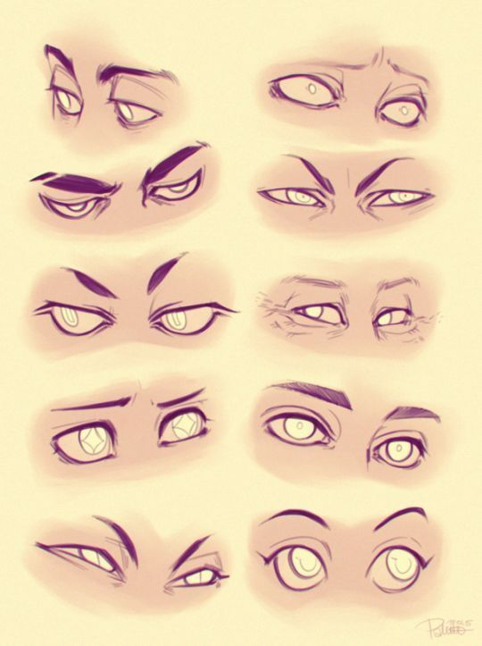
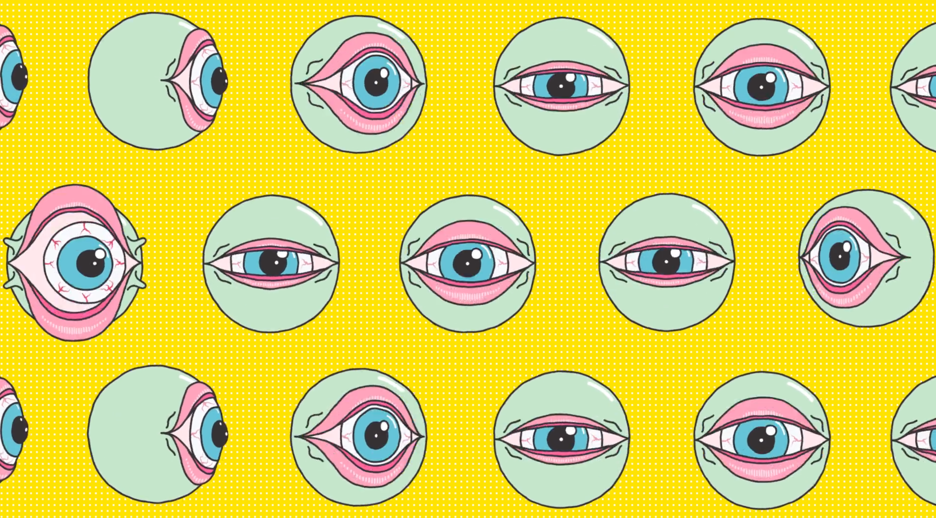
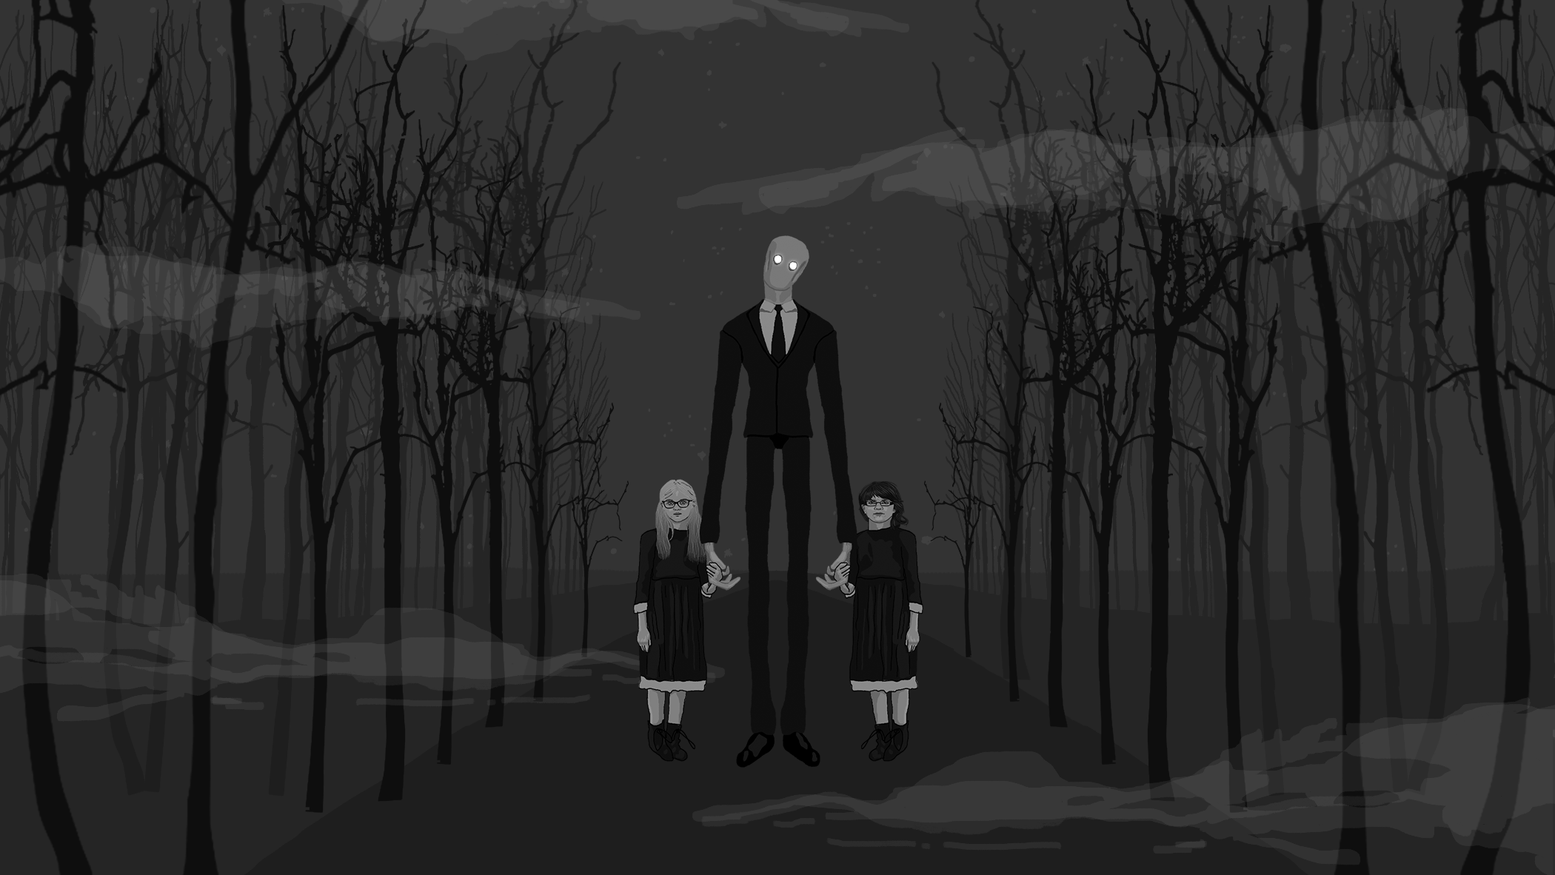
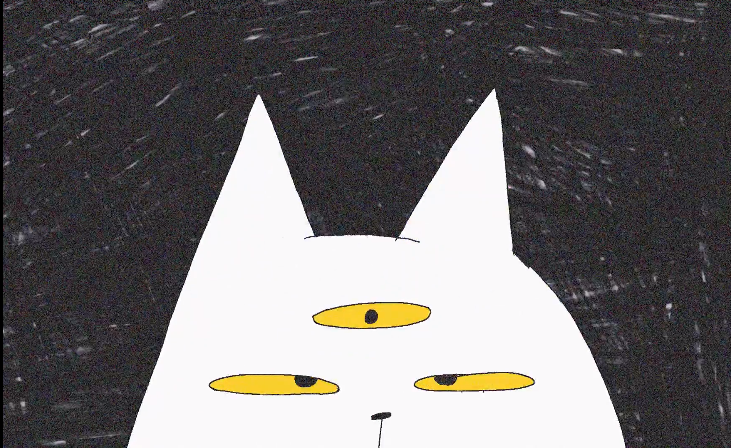
Research：
In the detective class of games, and some weird animations. I found that eyes are good helper to create a strange or horrible atmosphere(in the picture).
And a pair of eyes can convey a lot of complex emotions.
In the second week’s work, we try to express an adjective with a simple graphic. This makes me want to still use a simple object to convey the mood of the owner. And in the fourth week‘s work, I tried to use one eye to convey sad emotions.
https://vimeo.com/186364289

Slide 3
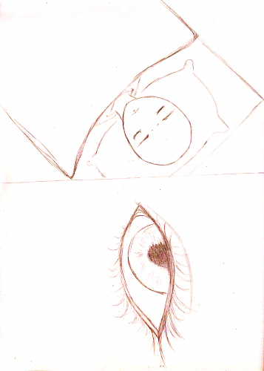
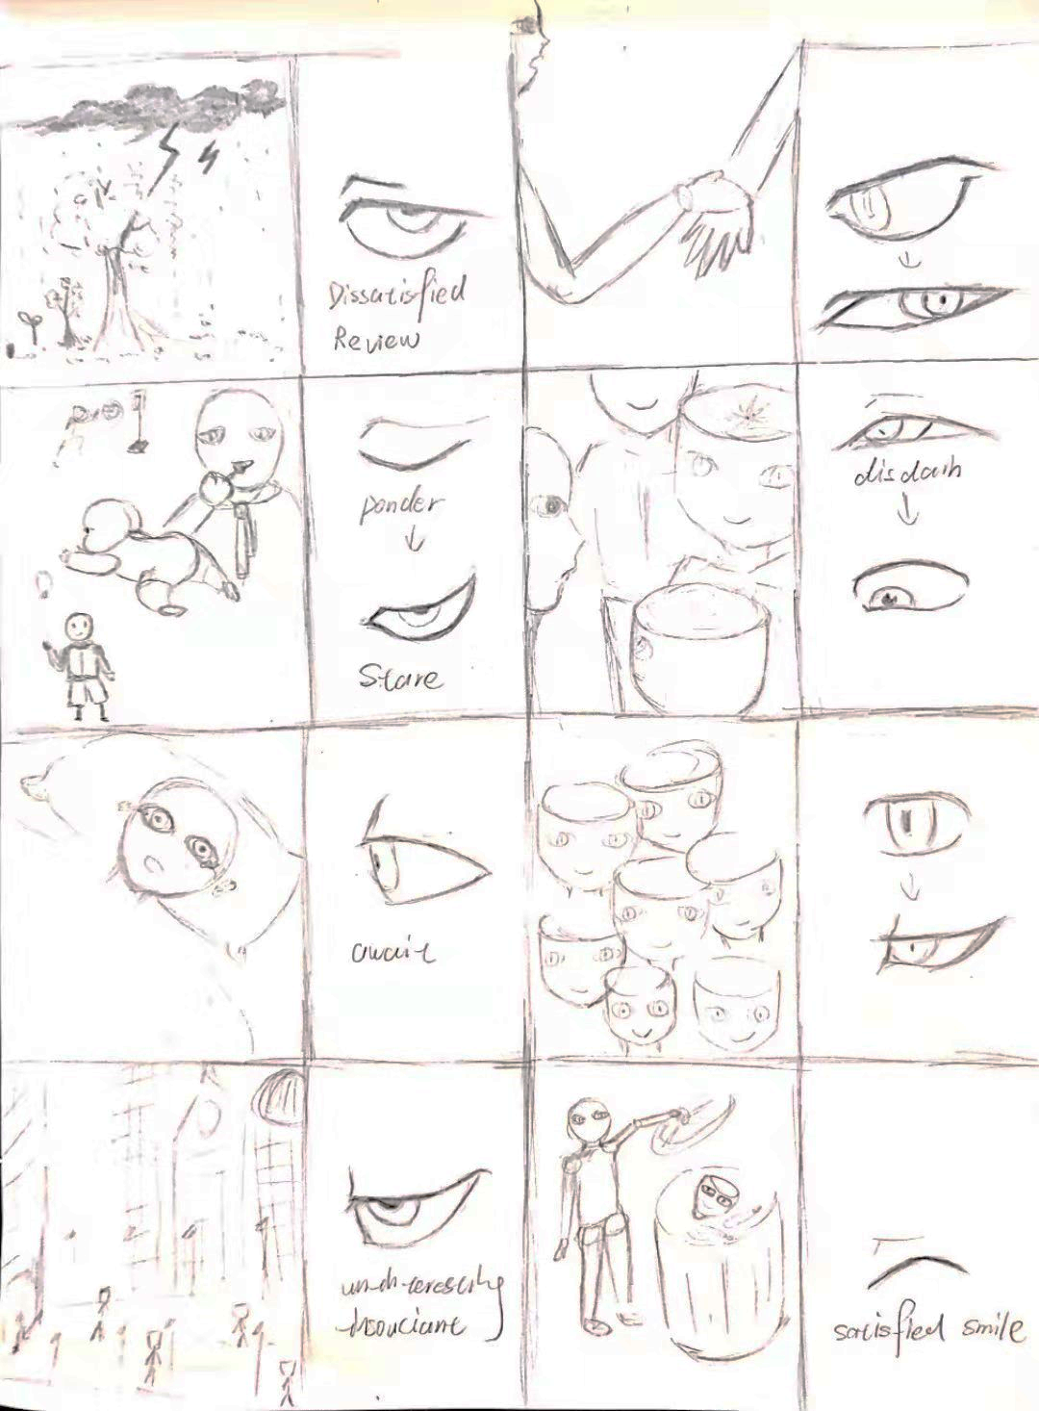
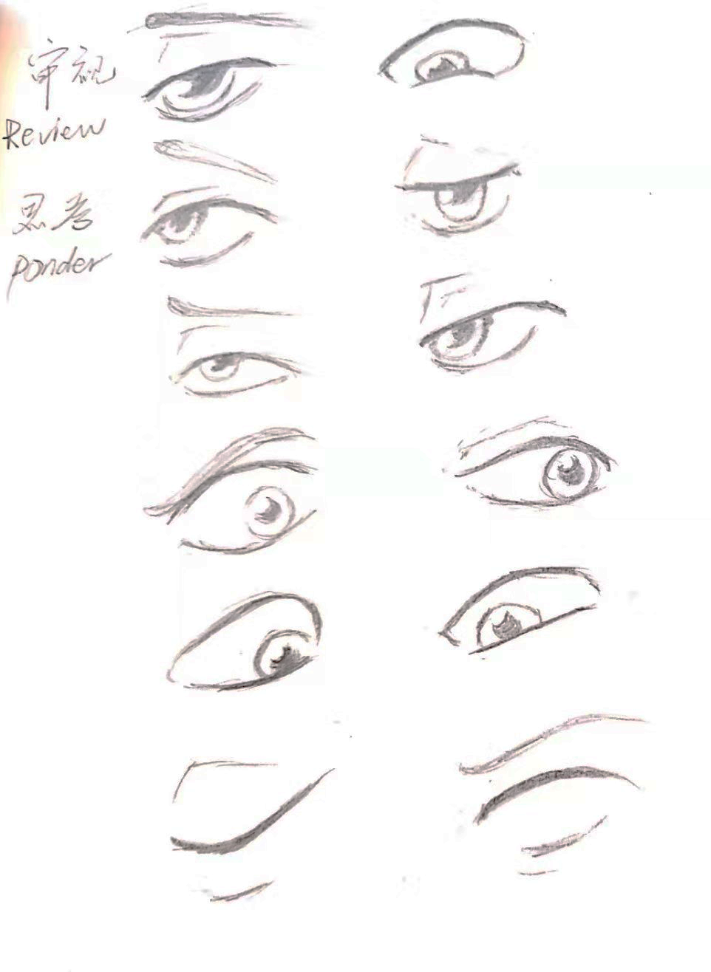
Storyboard:
The protagonist (a monitored doll) had a nightmare in bed, and the two very different memories in his dream made him look painful. After waking up, he walked on the road and helped the passerby to help ask the situation, but the passerby just gave him a standard smile, and he unconsciously released his hand. Realizing that he was wrong, he wanted to escape, but he was surrounded by other people with standard smiles in an instant. He wanted to find his companion, but found out that he was a smirk. In the end, he chose to compromise and became a member with a standard smile.
But I realized that one problem is that I intend to express a manipulated doll. If I only tell this story, I can't express this theme. So I tried to divide the picture into two parts, one part of the story itself and the other part of the eye. This eye represents the manipulator, and emotional changes presage the development of the plot.

Slide 4
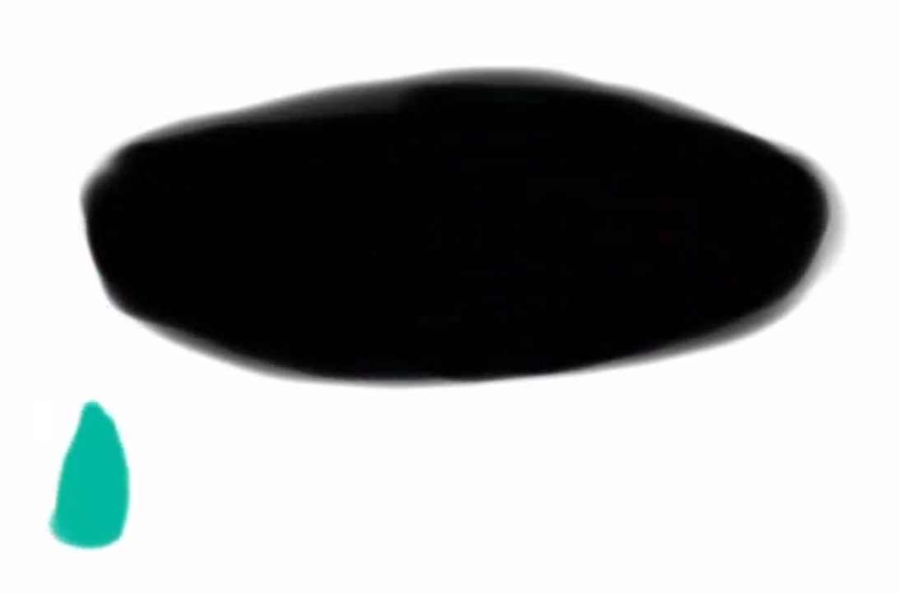
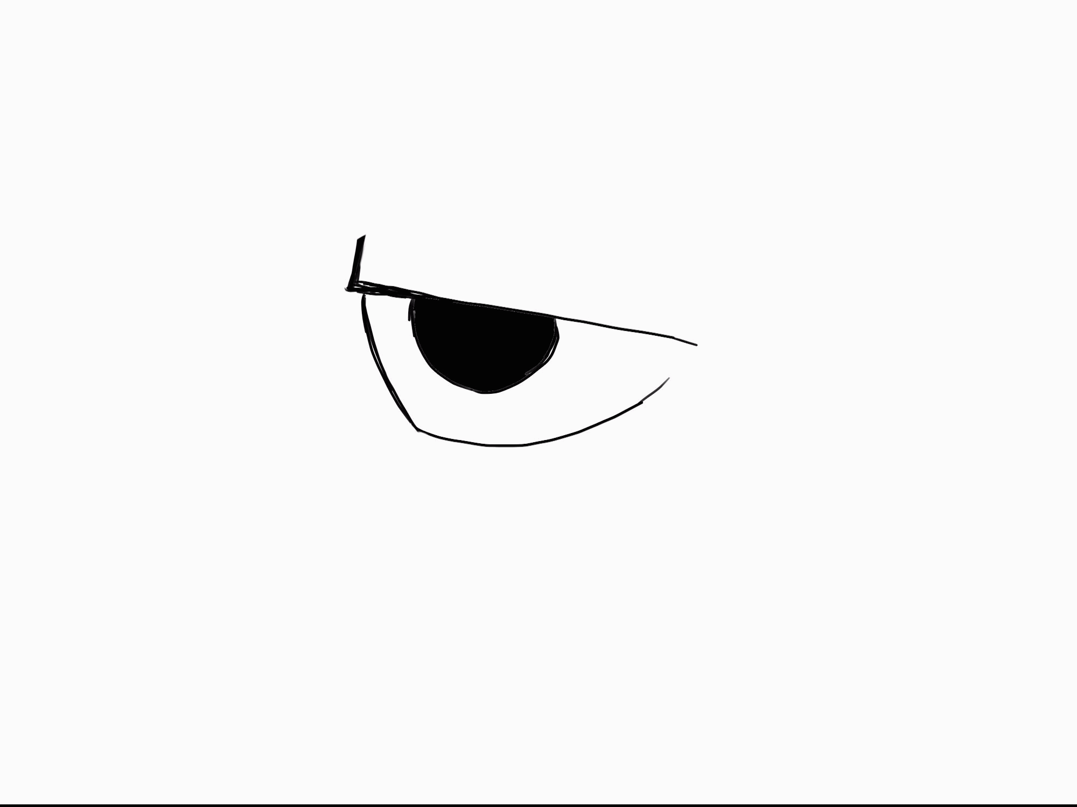
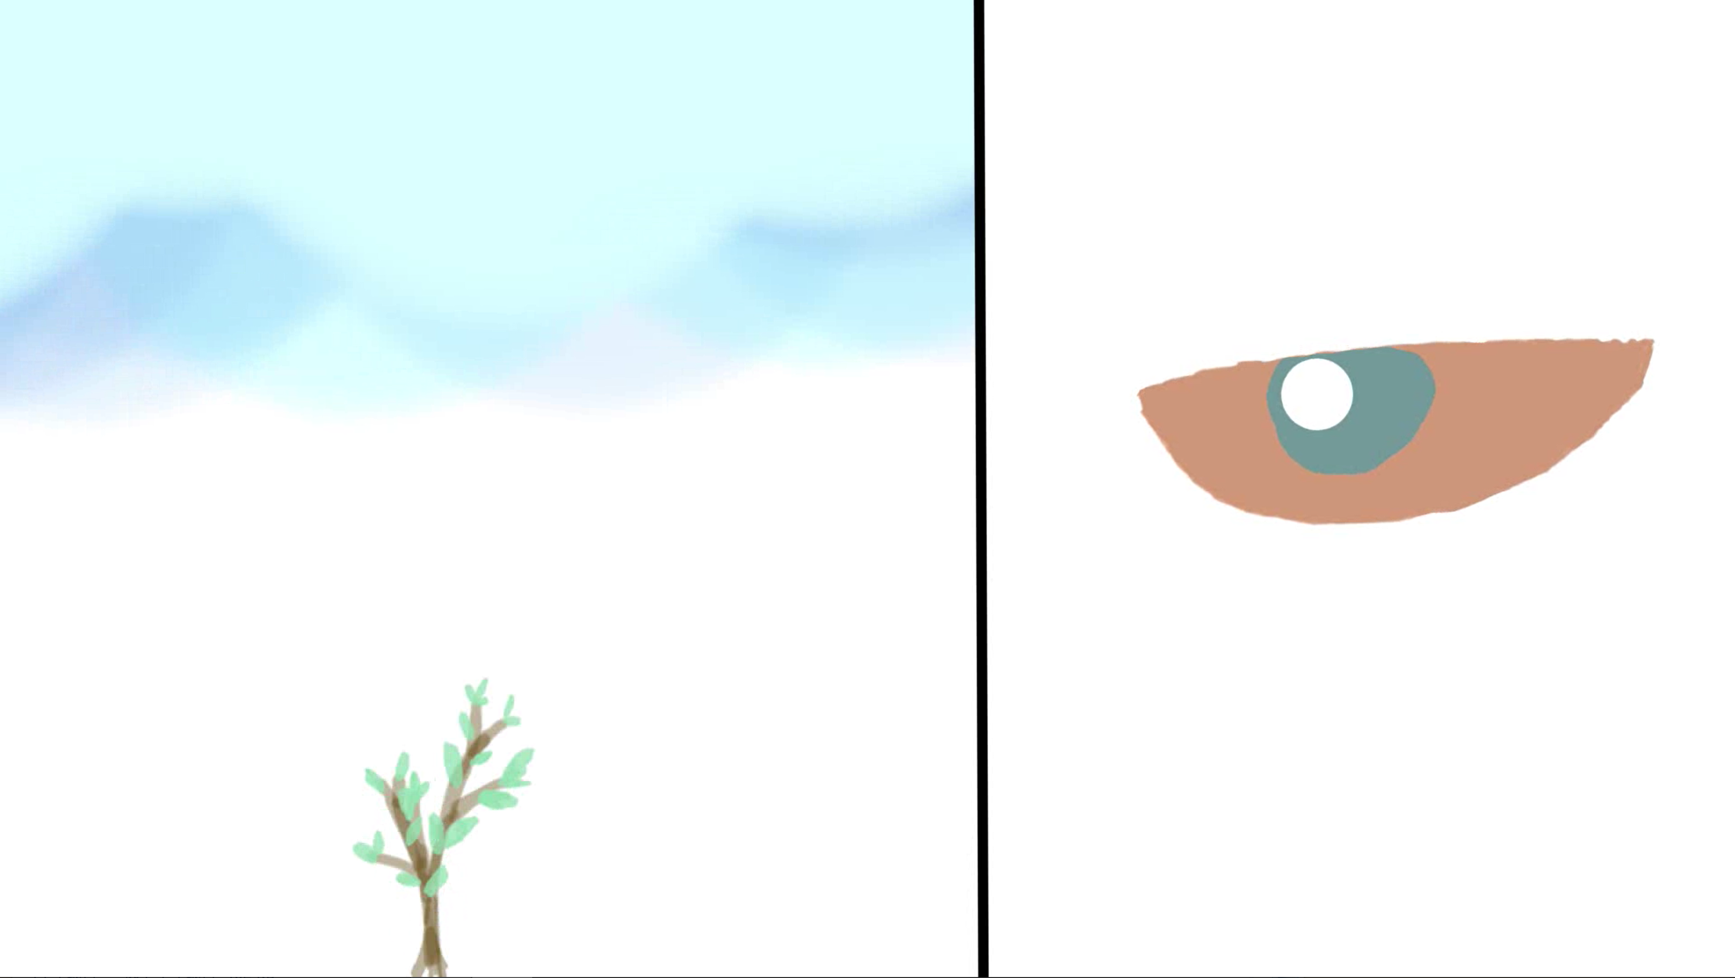
Practices:
Expectation：
I tried to make the first three scenes in the storyboard. I think the eyes do convey some emotional changes. But it does not explain all the emotions or the master's thoughts, maybe the transition time is too long.
It’s just that the expression of one eye is a bit too thin, and it may be better to have a voice or text help，even changing the color of the background
Week 7
More research
Express way
Week 8
Go ahead with the storyboard
Show all emotions, design dolls
Week 9
Complete the next three scenarios
Thinking about the sounds
Week 10、Week 11
Complete the rest of the scenes
https://youtu.be/4jgYlmM-pWY

