Slide 1
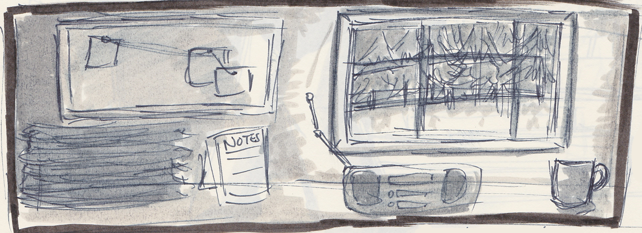
Studio 3 – Folio Plan
Courtenay Price - s3485126

Slide 2
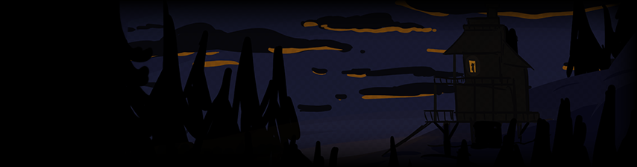
What
This semester, I plan to make a short game where the narrative is entirely dictated by the players.
Each player spends three in-game days in a cabin in the woods, and attempt to complete a small goal. Regardless of whether or not they succeed, the game ends on the third day… and their save file is passed along to the next player, who has no idea what transpired before them and must work it out on their own.
The game then repeats. Each player's actions are recorded, and serve to build the narrative for the next player who picks up the game.

Slide 3
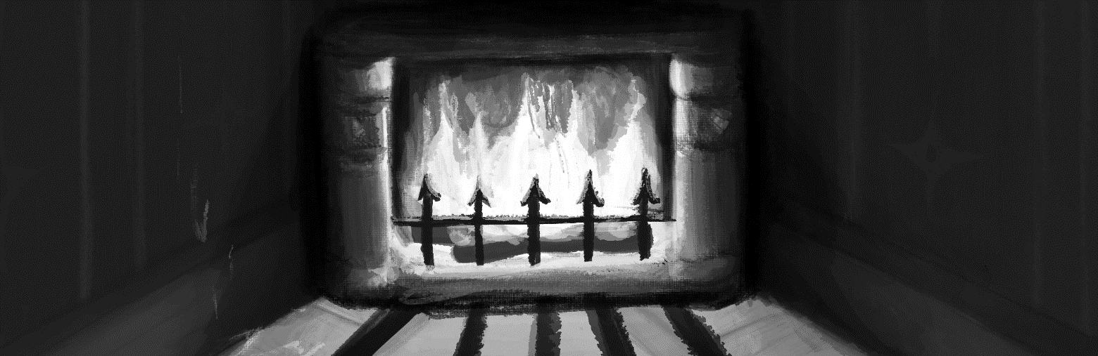
Why this project?
I have a fascination with environmental storytelling – particularly small details, and what they say about the people who live in that space
Environments are often treated as backdrops by game designers – I aim to investigate how even the tiniest interactions with a setting can affect perceptions of that world
Games often have a set story or progression to them. I want to see what’s possible if you give players a bunch of random tools, and let them go nuts.
Exploring environments in this way helps me grow as both an illustrator and game designer.

Slide 4
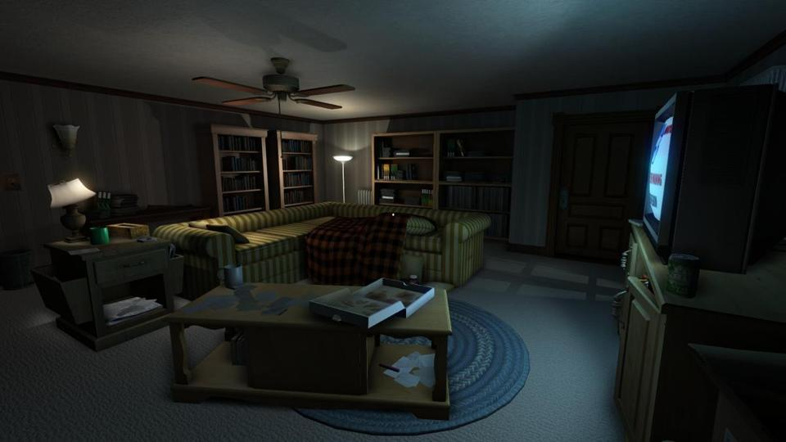
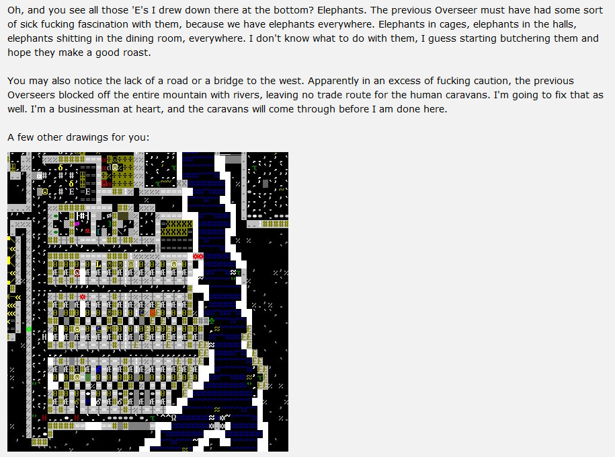
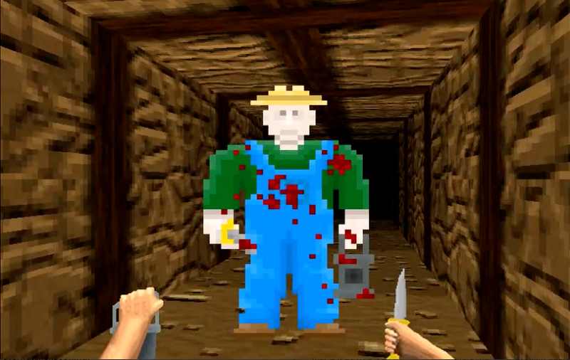
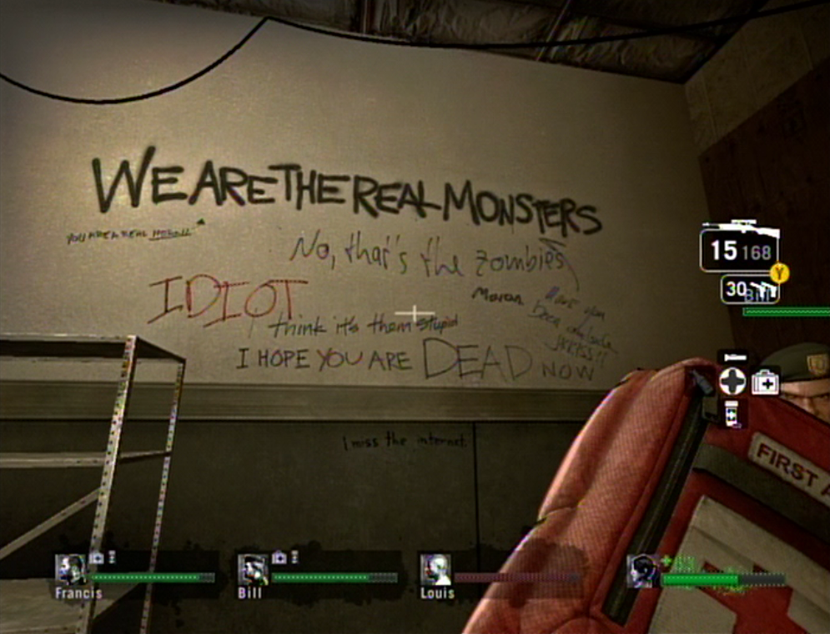
Context
Gone Home (lots of subtle interactivity)
Boatmurdered (A collaborative Dwarf Fortress LP with a round-robin storytelling style)
Moirai (one NPC is secretly the last player’s choices, personified.
Left 4 Dead (linear, but feels “lived in”)

Slide 5
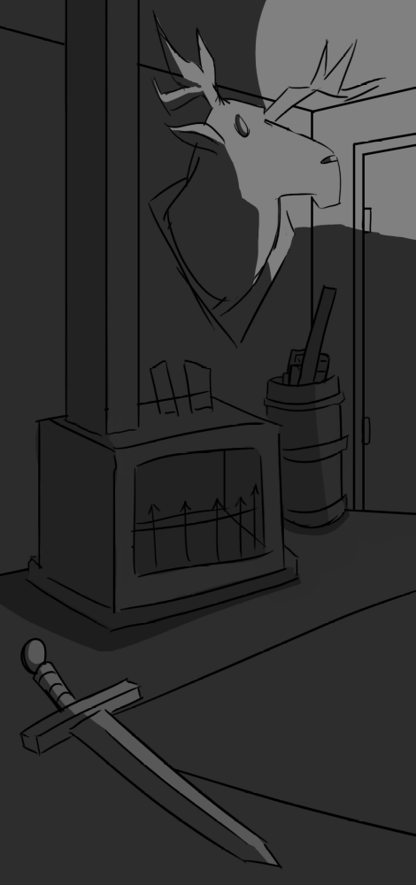
Self-Assessment
Already figured out the basics of the idea (reusing a pitch from APD, and previously explored setting aesthetics in a personal project)
Can already program in the software I plan to use
Already have experience drawing complex backgrounds (thanks, CP&S!)
Tend to struggle writing narratives on a deadline – so ditching them altogether will make this much more manageable
Tend to struggle with large, abstract projects – so a module-based approach to creation should help me keep a consistent momentum
Haven’t had much experience with rapid prototyping, but am familiar with the how and why

Slide 6
Production Plan (…a very rough one)
A module-based approach to making;
Step 1: research – try and find an interesting environment bit that could be interactive
Step 2: whole lotta concept art scribbles – how does it look? How can people interact with it?
Step 3: Prototype it; give it to others to play/give feedback on
Step 4: Add that feedback in
Do this cycle once/twice a week until week 6, then start compiling the experiments that “worked” into a single game.
Week 7, 8: Compile minigames into a single executable
Week 9: Playtest – get feedback, see how things can better fit together, tweak/add/subtract as appropriate
Week 10, 11: Add in the save system/multiplayer (time permitting), playtest it, etc…
Week 12: Polishing, working on presentations, etc

