Slide 1
VR RPG Game, Fate
Yin Li
Masters of Animation, Games and Interactivity (MAGI),
School of Design,
RMIT University,
Melbourne, Australia
s3634535@stuent.rmit.edu.au

Slide 2


Slide 3
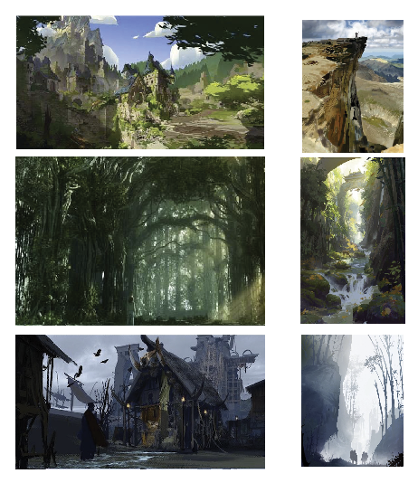
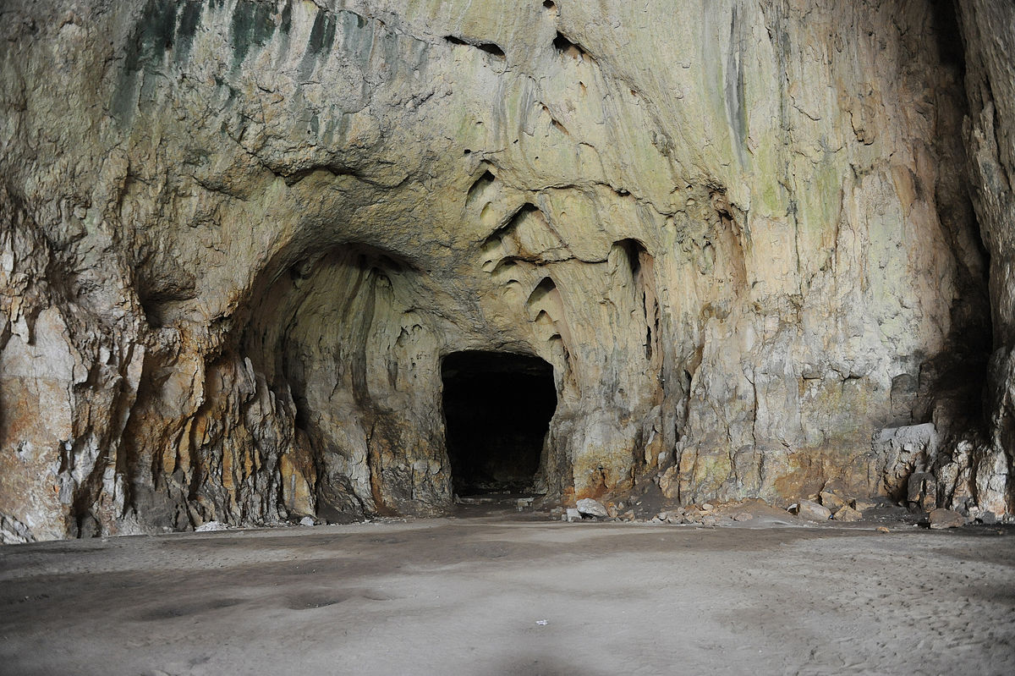

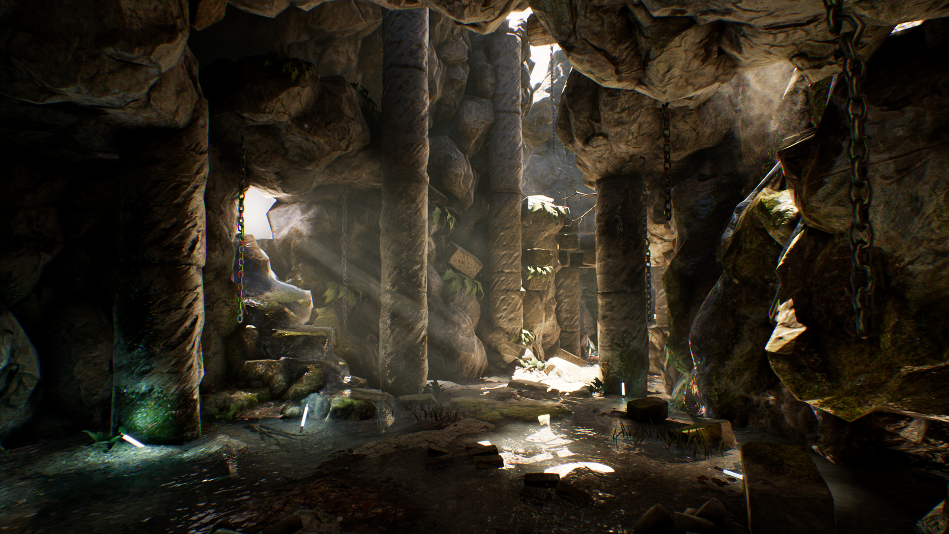

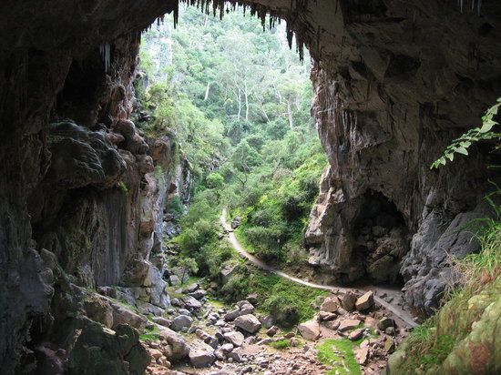


Slide 4
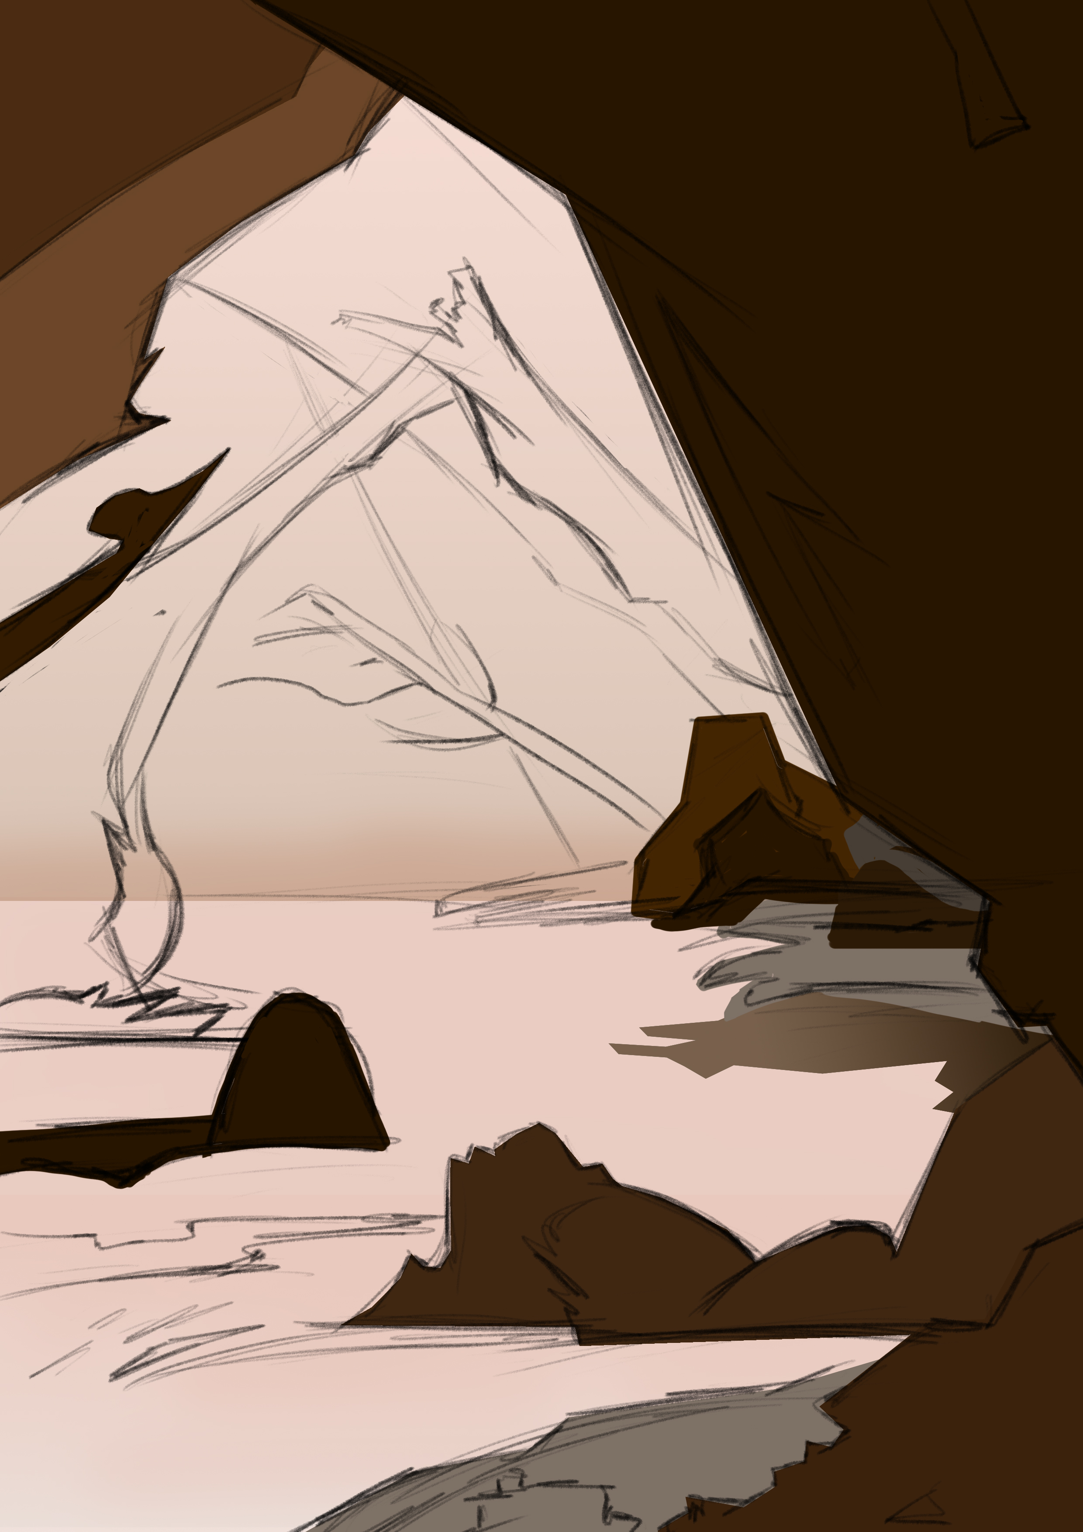
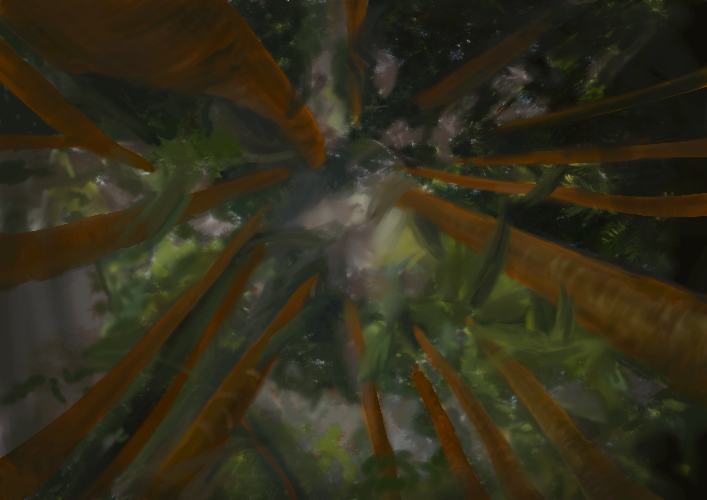

Slide 5
