Slide 1
Comedic character design in animation
jEssiE

Slide 2
Outline
Anthropomorphism & Zoomorphism
MyPractice
Further more

Slide 3
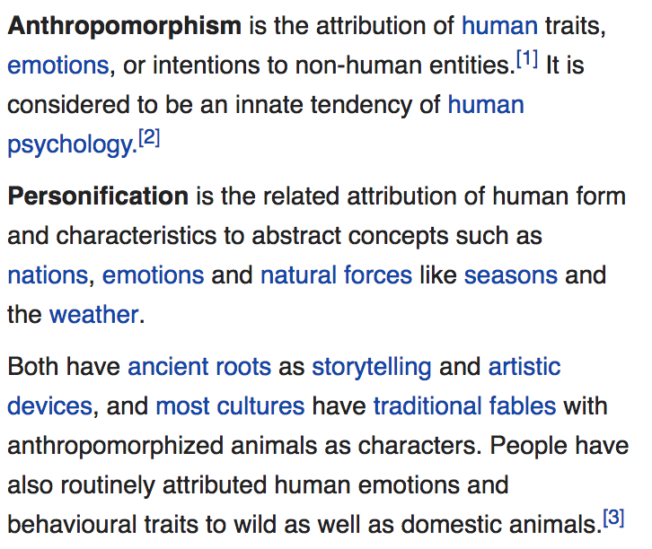
Anthropomorphism
Definition
Notes:
ignore

Slide 4
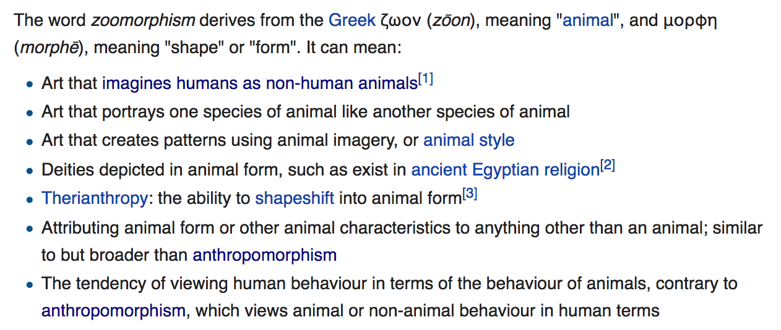
Zoomorphism
Notes:
ignore

Slide 5
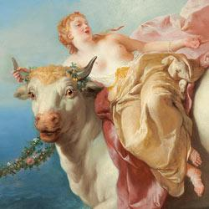
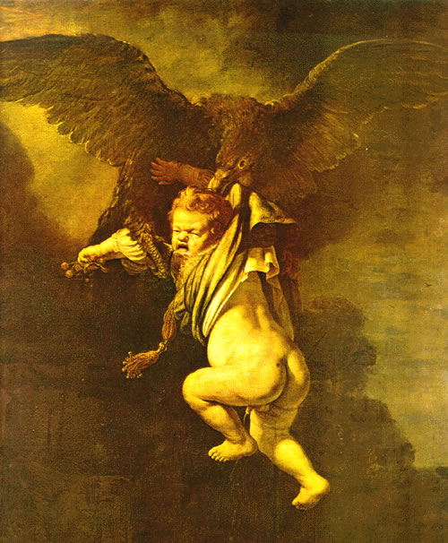
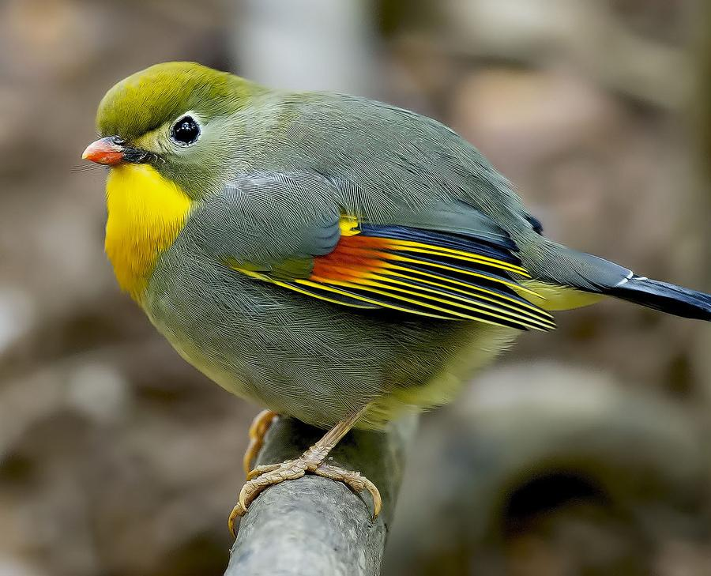
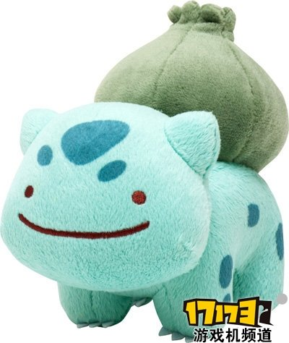
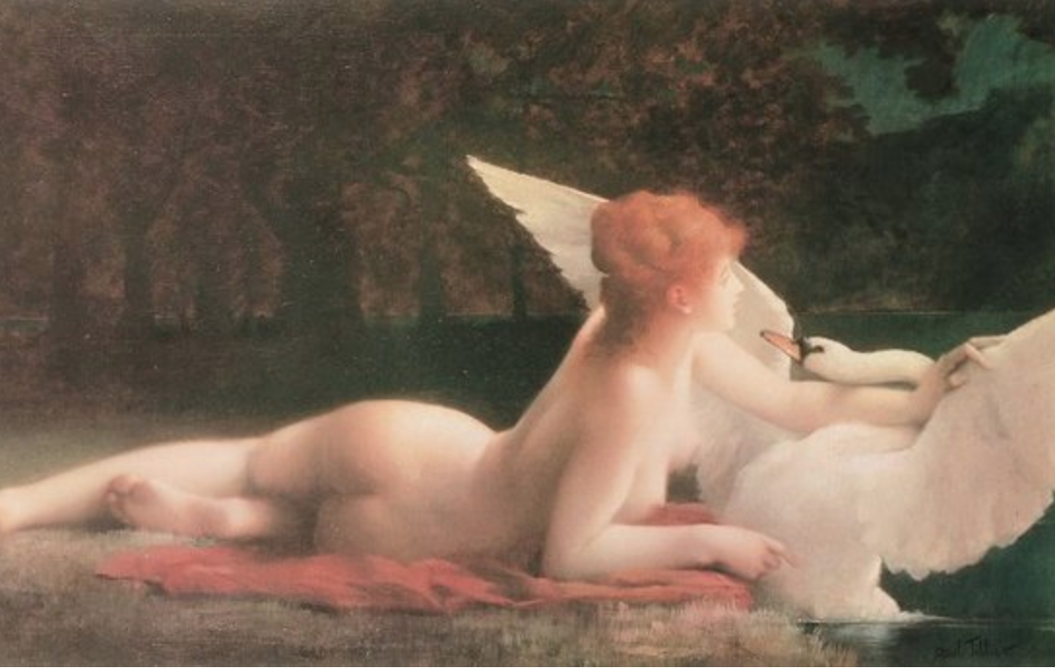
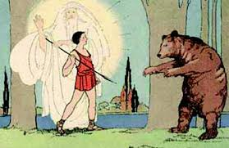
Greek Mythology
Zeus
Kallisto
Io

Slide 6
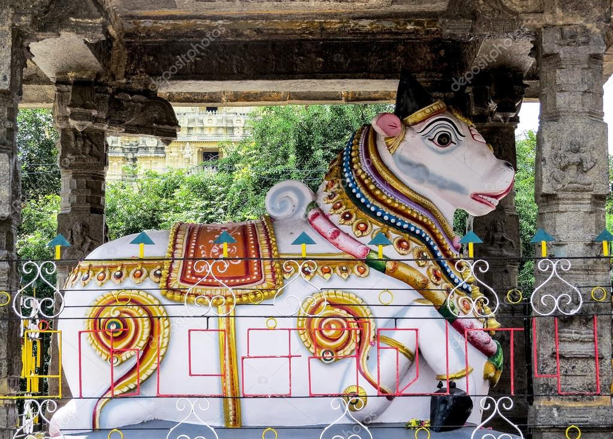
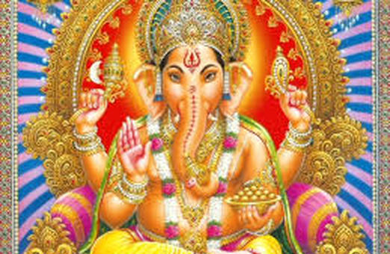
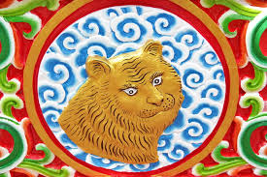
India Animal God

Slide 7
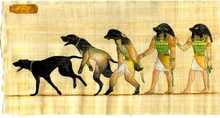
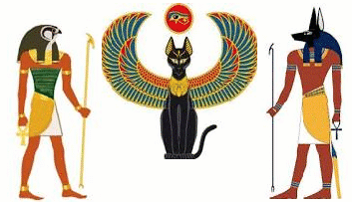
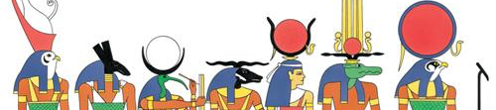
Egypt Animal Gods

Slide 8
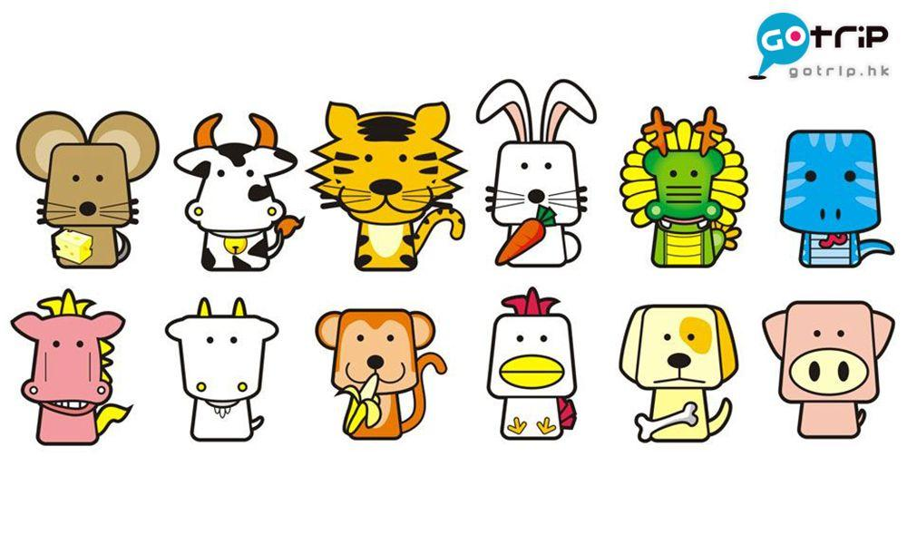
Chinese 12 zodac

Slide 9
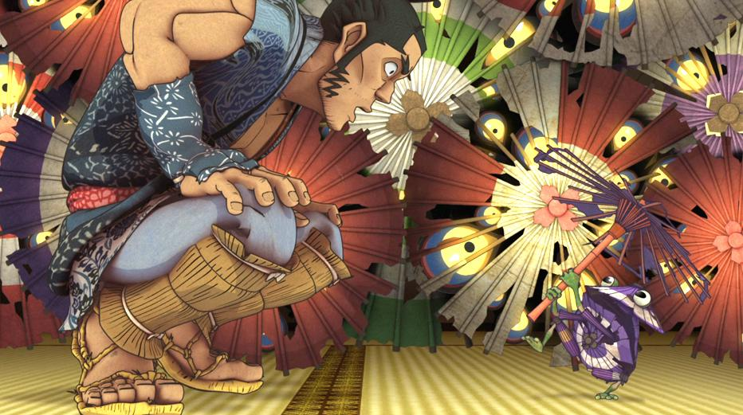
Japanese Yokai
Possessions, by Shuhei Morita (2013 Oscar nominated Animation Short)

Slide 10
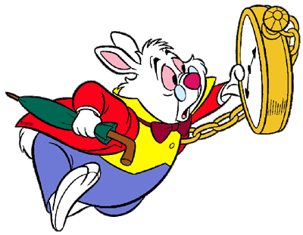
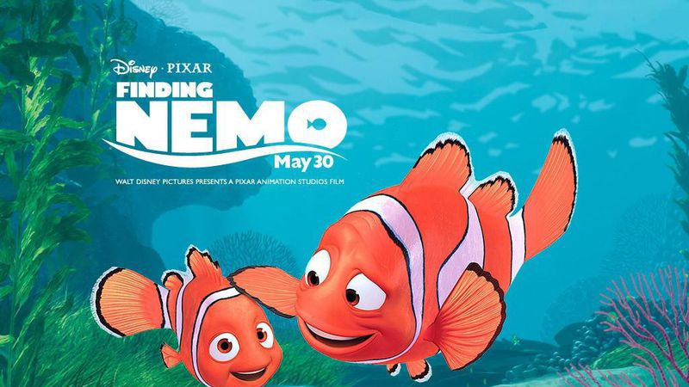
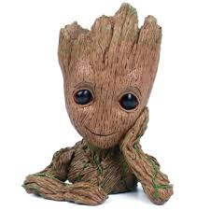
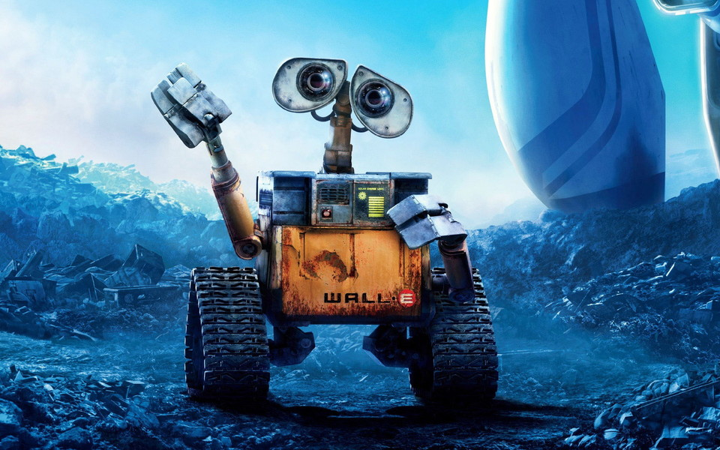
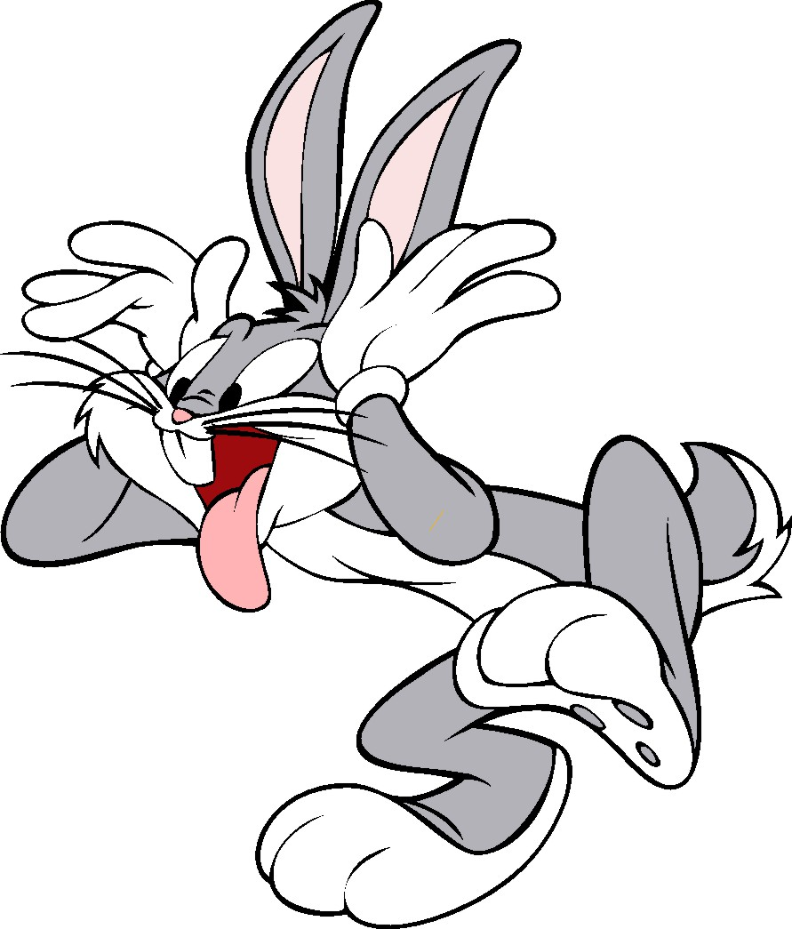
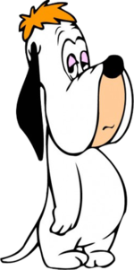
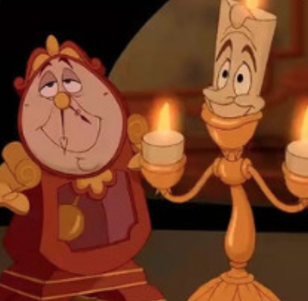
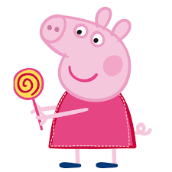
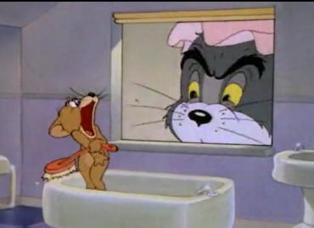
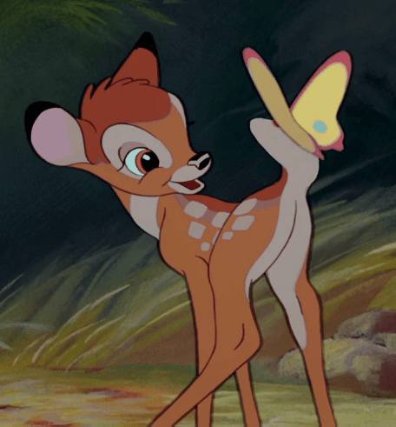
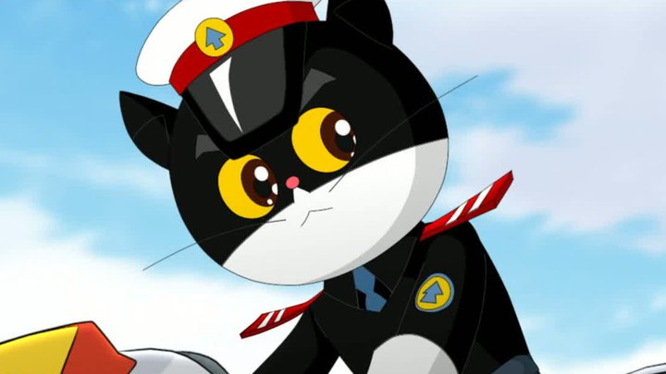
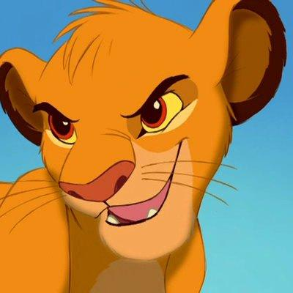
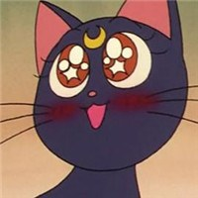
Modern culture

Slide 11
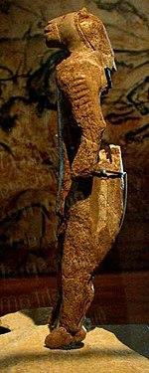
Conclusion
Anthropomorphism and Zoomorphism(animal-shaped) is popular in animation and has a historical foundation in many areas with local cultures.
Lion-man, Germany, made by ivory 32,000 years old

Slide 12
MyPractice

Slide 13
Comedic Character Design
MyPractice

Slide 14
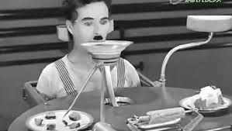
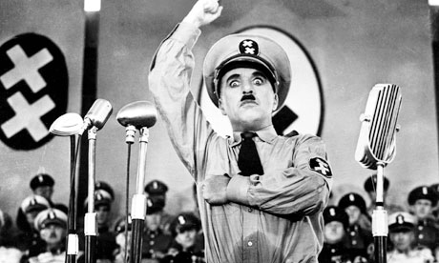
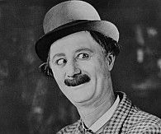
Back to Silent Film Era
Silent-film actors emphasized body language and facial expression so that the audience could better understand what an actor was feeling and portraying on screen.
I prefer non-human character design because that make me concentrate on actions which provides richer content than dialog.

Slide 15
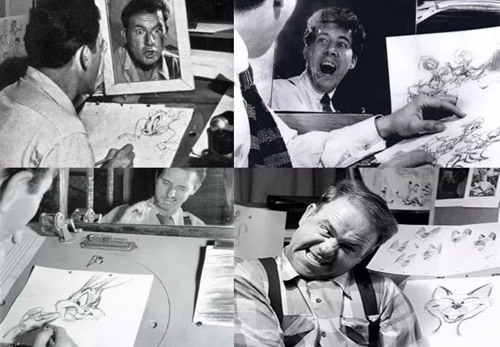
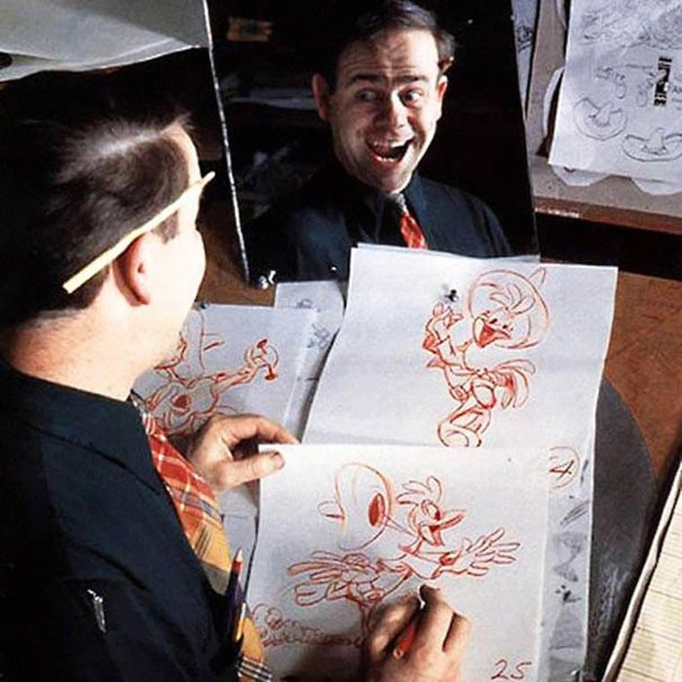
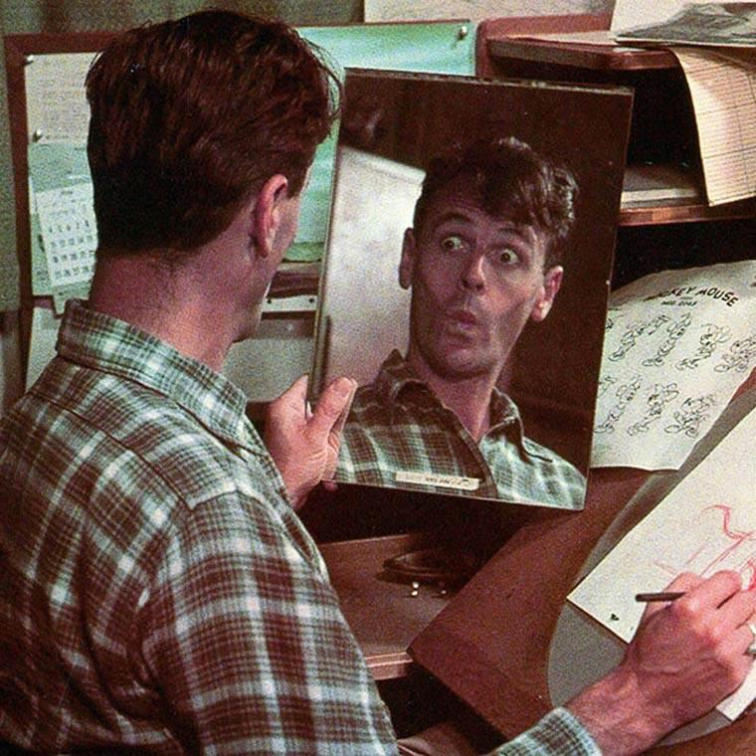
Back to The Golden Age of American Animation
In terms of body language and facial expression, comedians and animators have similarities.
We are actors. We perform while we design.

Slide 16
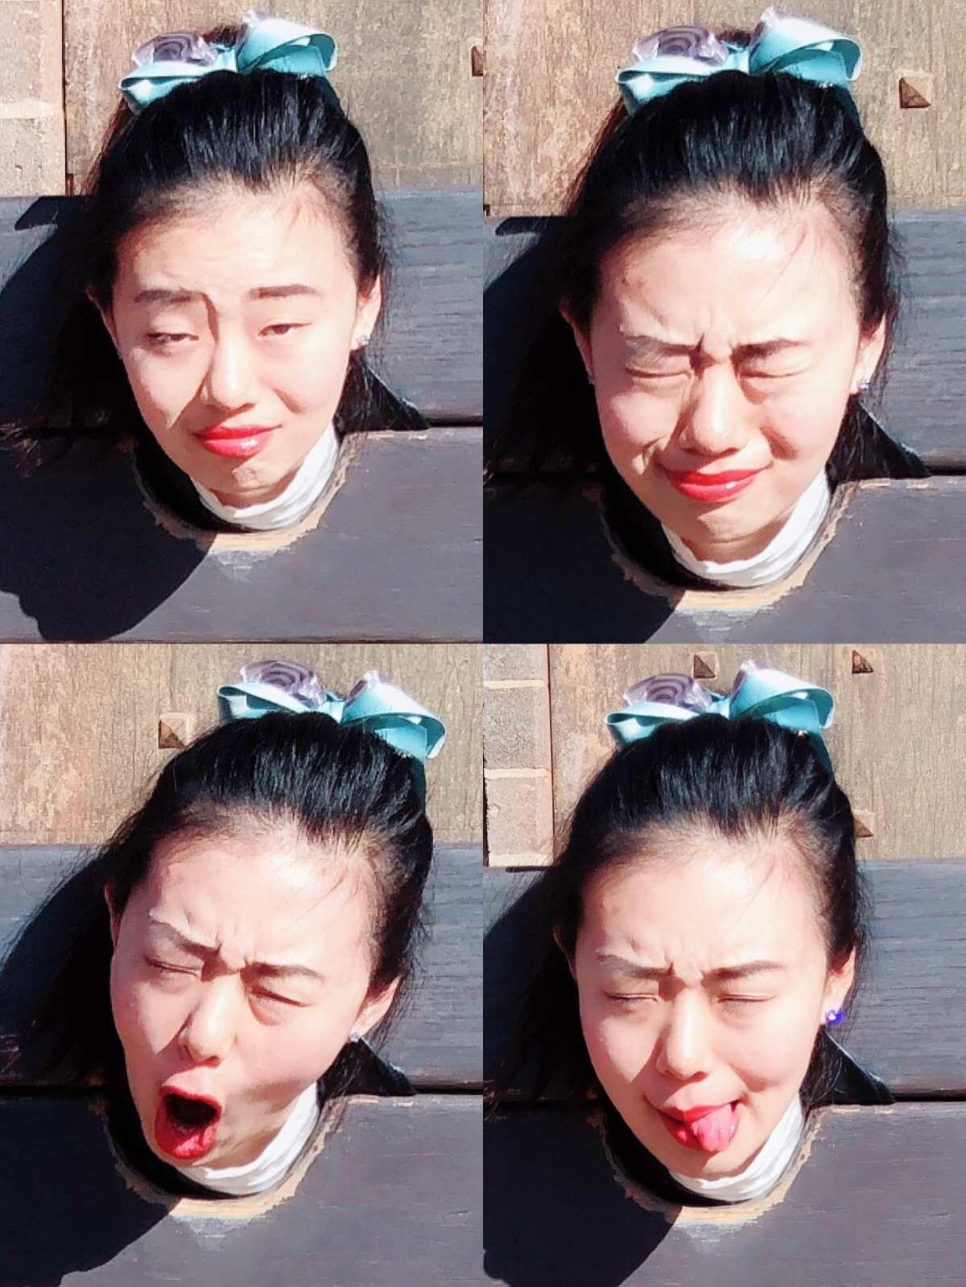
We animators...
… are characers.

Slide 17
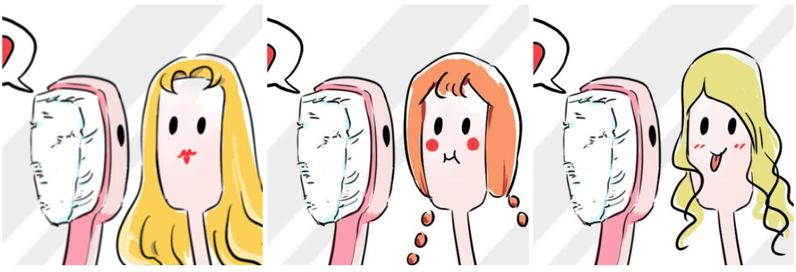
Design_Facial expression

Slide 18
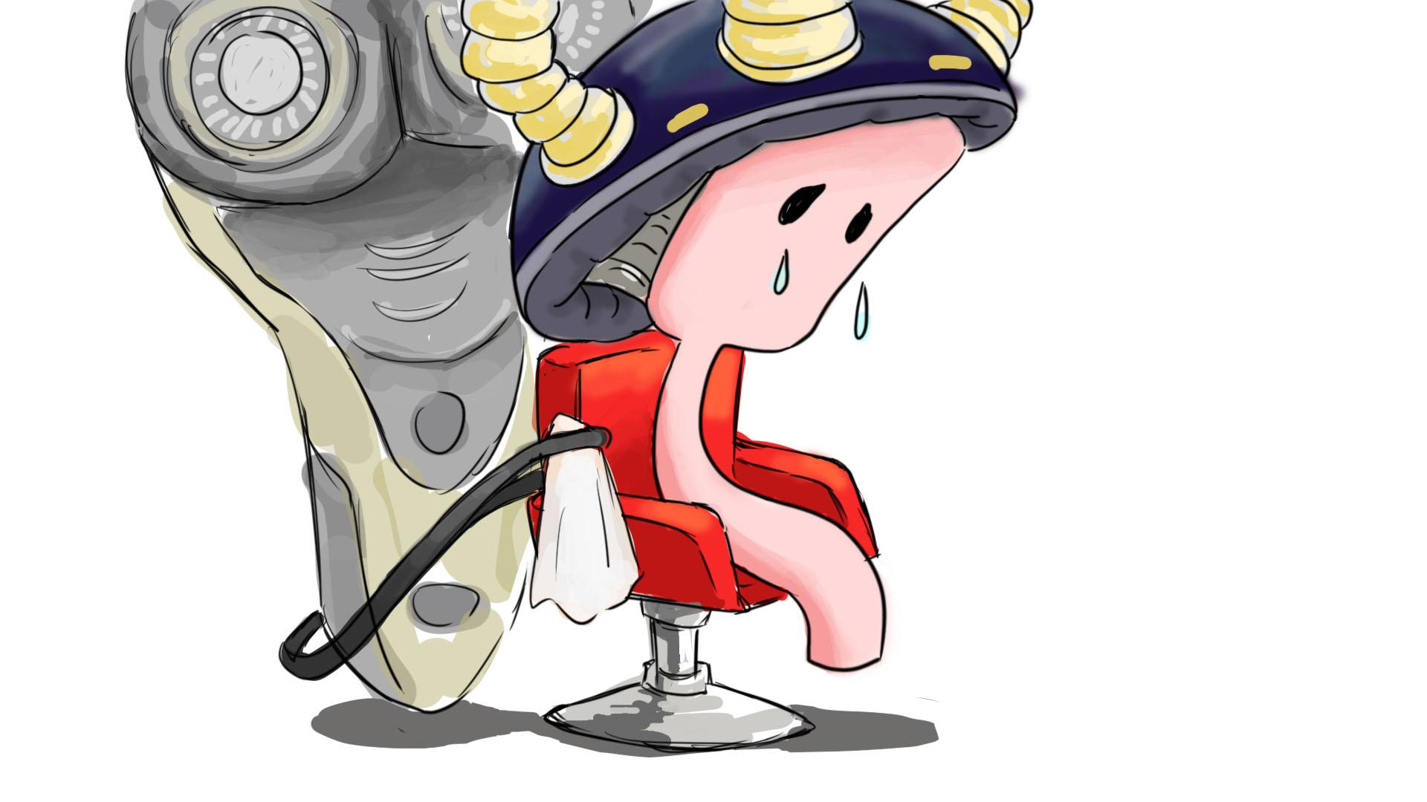

Slide 19
Design_Gestures
When he i self-love.
How he smile/angry/jealous/shy/embarrass/sad/heart-broken/date girls?
When he is full of power/low battery…
His accessaries...friends!
He is a … (cleanliness/conceited/lazy/irritable/lustfulness etc.) male toothbrush.
What is his hair keep falling/his mater is a beauty/he dislikes the cup beside him...

Slide 20
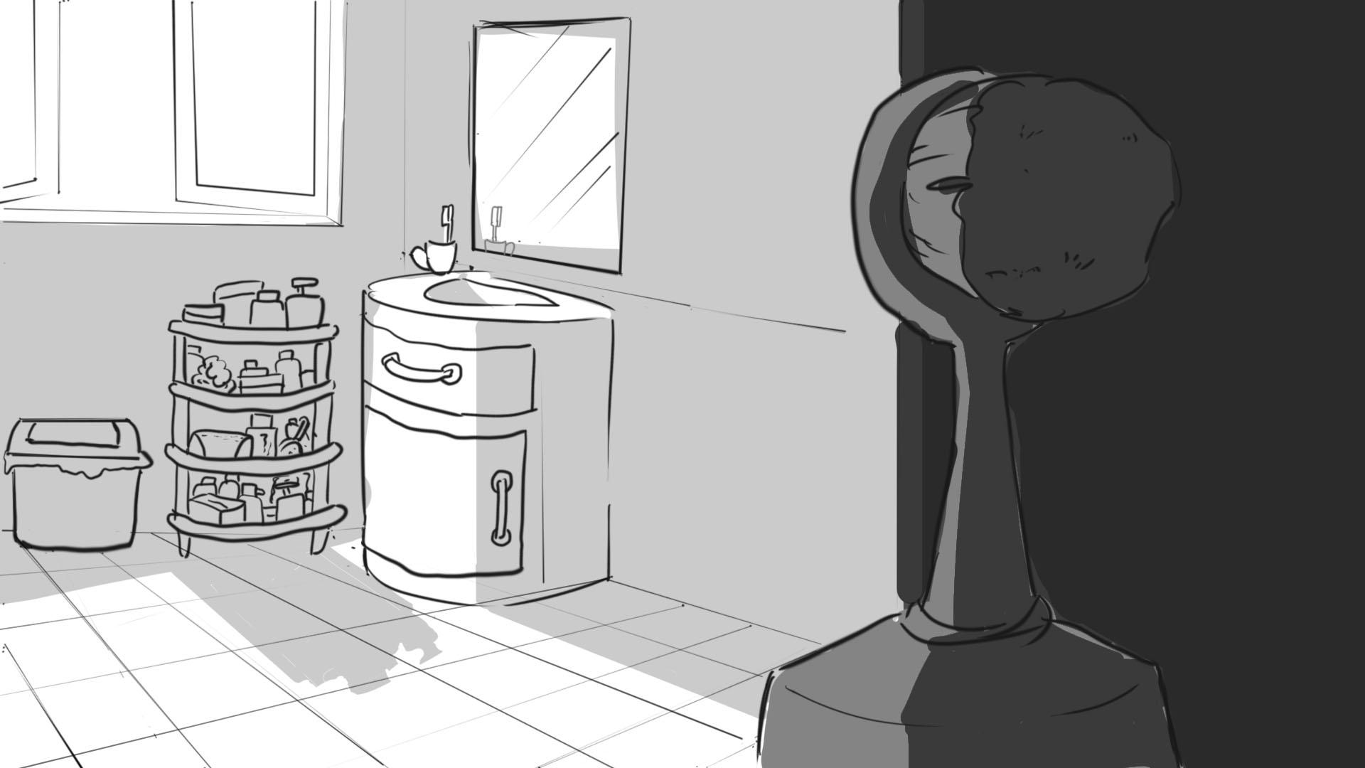
I love u, but u love yourself.

Slide 21
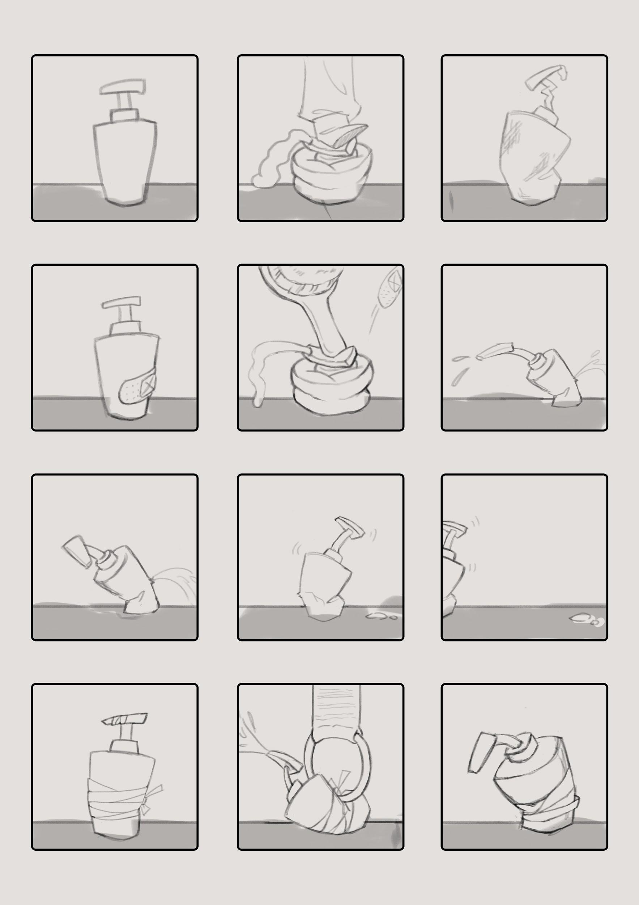
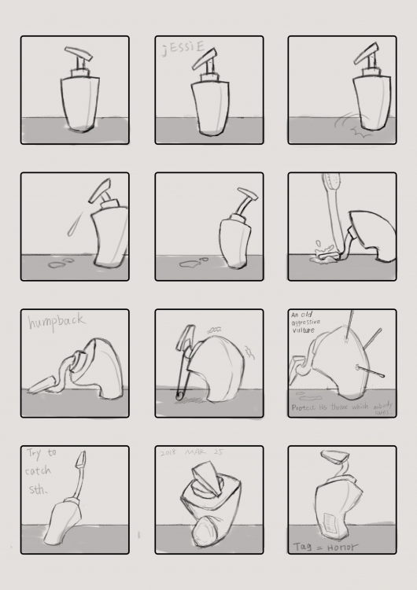

Slide 22
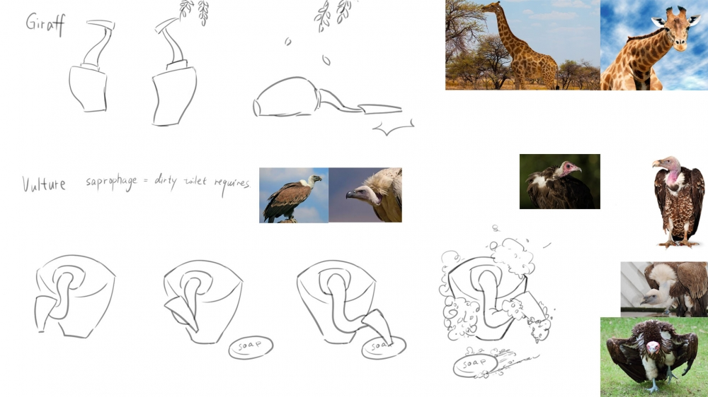

Slide 23
Further More
Exjesus
Reschedule structure
Comedic character design
Anthropomorphism case study
Colour harmony study
Practice
Storyboard
Illustrated book: online version & printed version (ref. Shaun Tan)
… Thank You All

